Slide 1

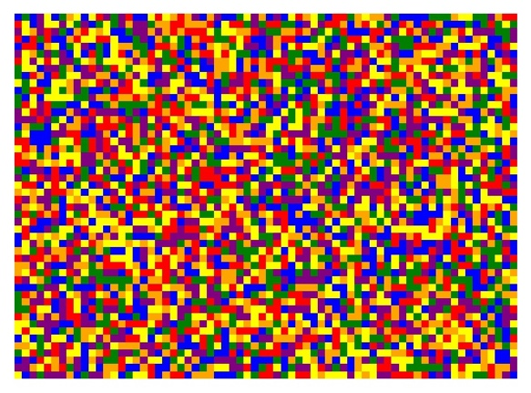

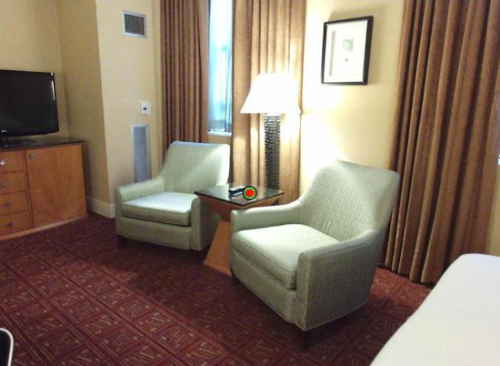
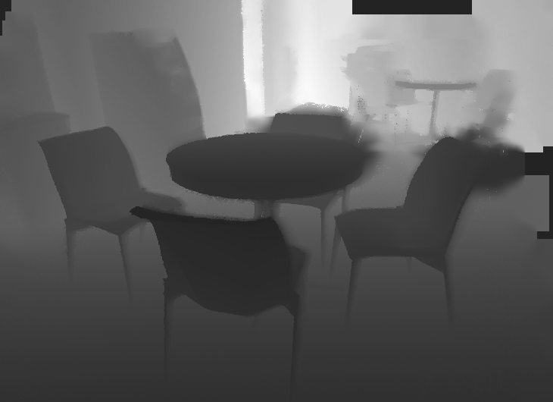
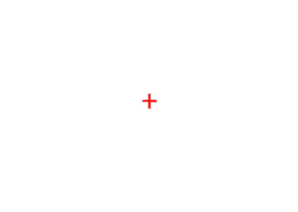
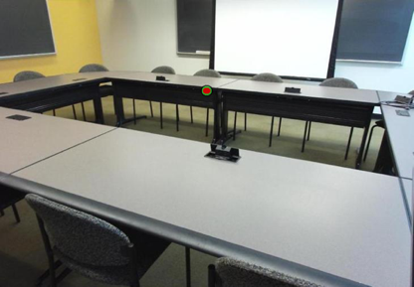

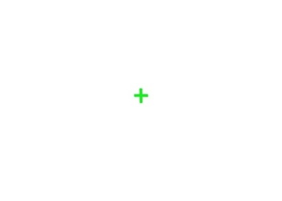
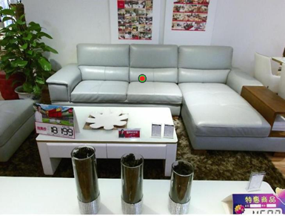

A.
B.
How far away was the target, in meters?
Target Image
125, 250, or 1000 ms
500 ms
time
- 0.25 m
500 ms
Depth Image
- 2.6 m
- 5 m
C.
Respond which target was closer
125, 250, or 1000 ms
500 ms
time
500 ms
500 ms
500 ms
125, 250, or 1000 ms
500 ms
Notes:
DONE

Slide 2
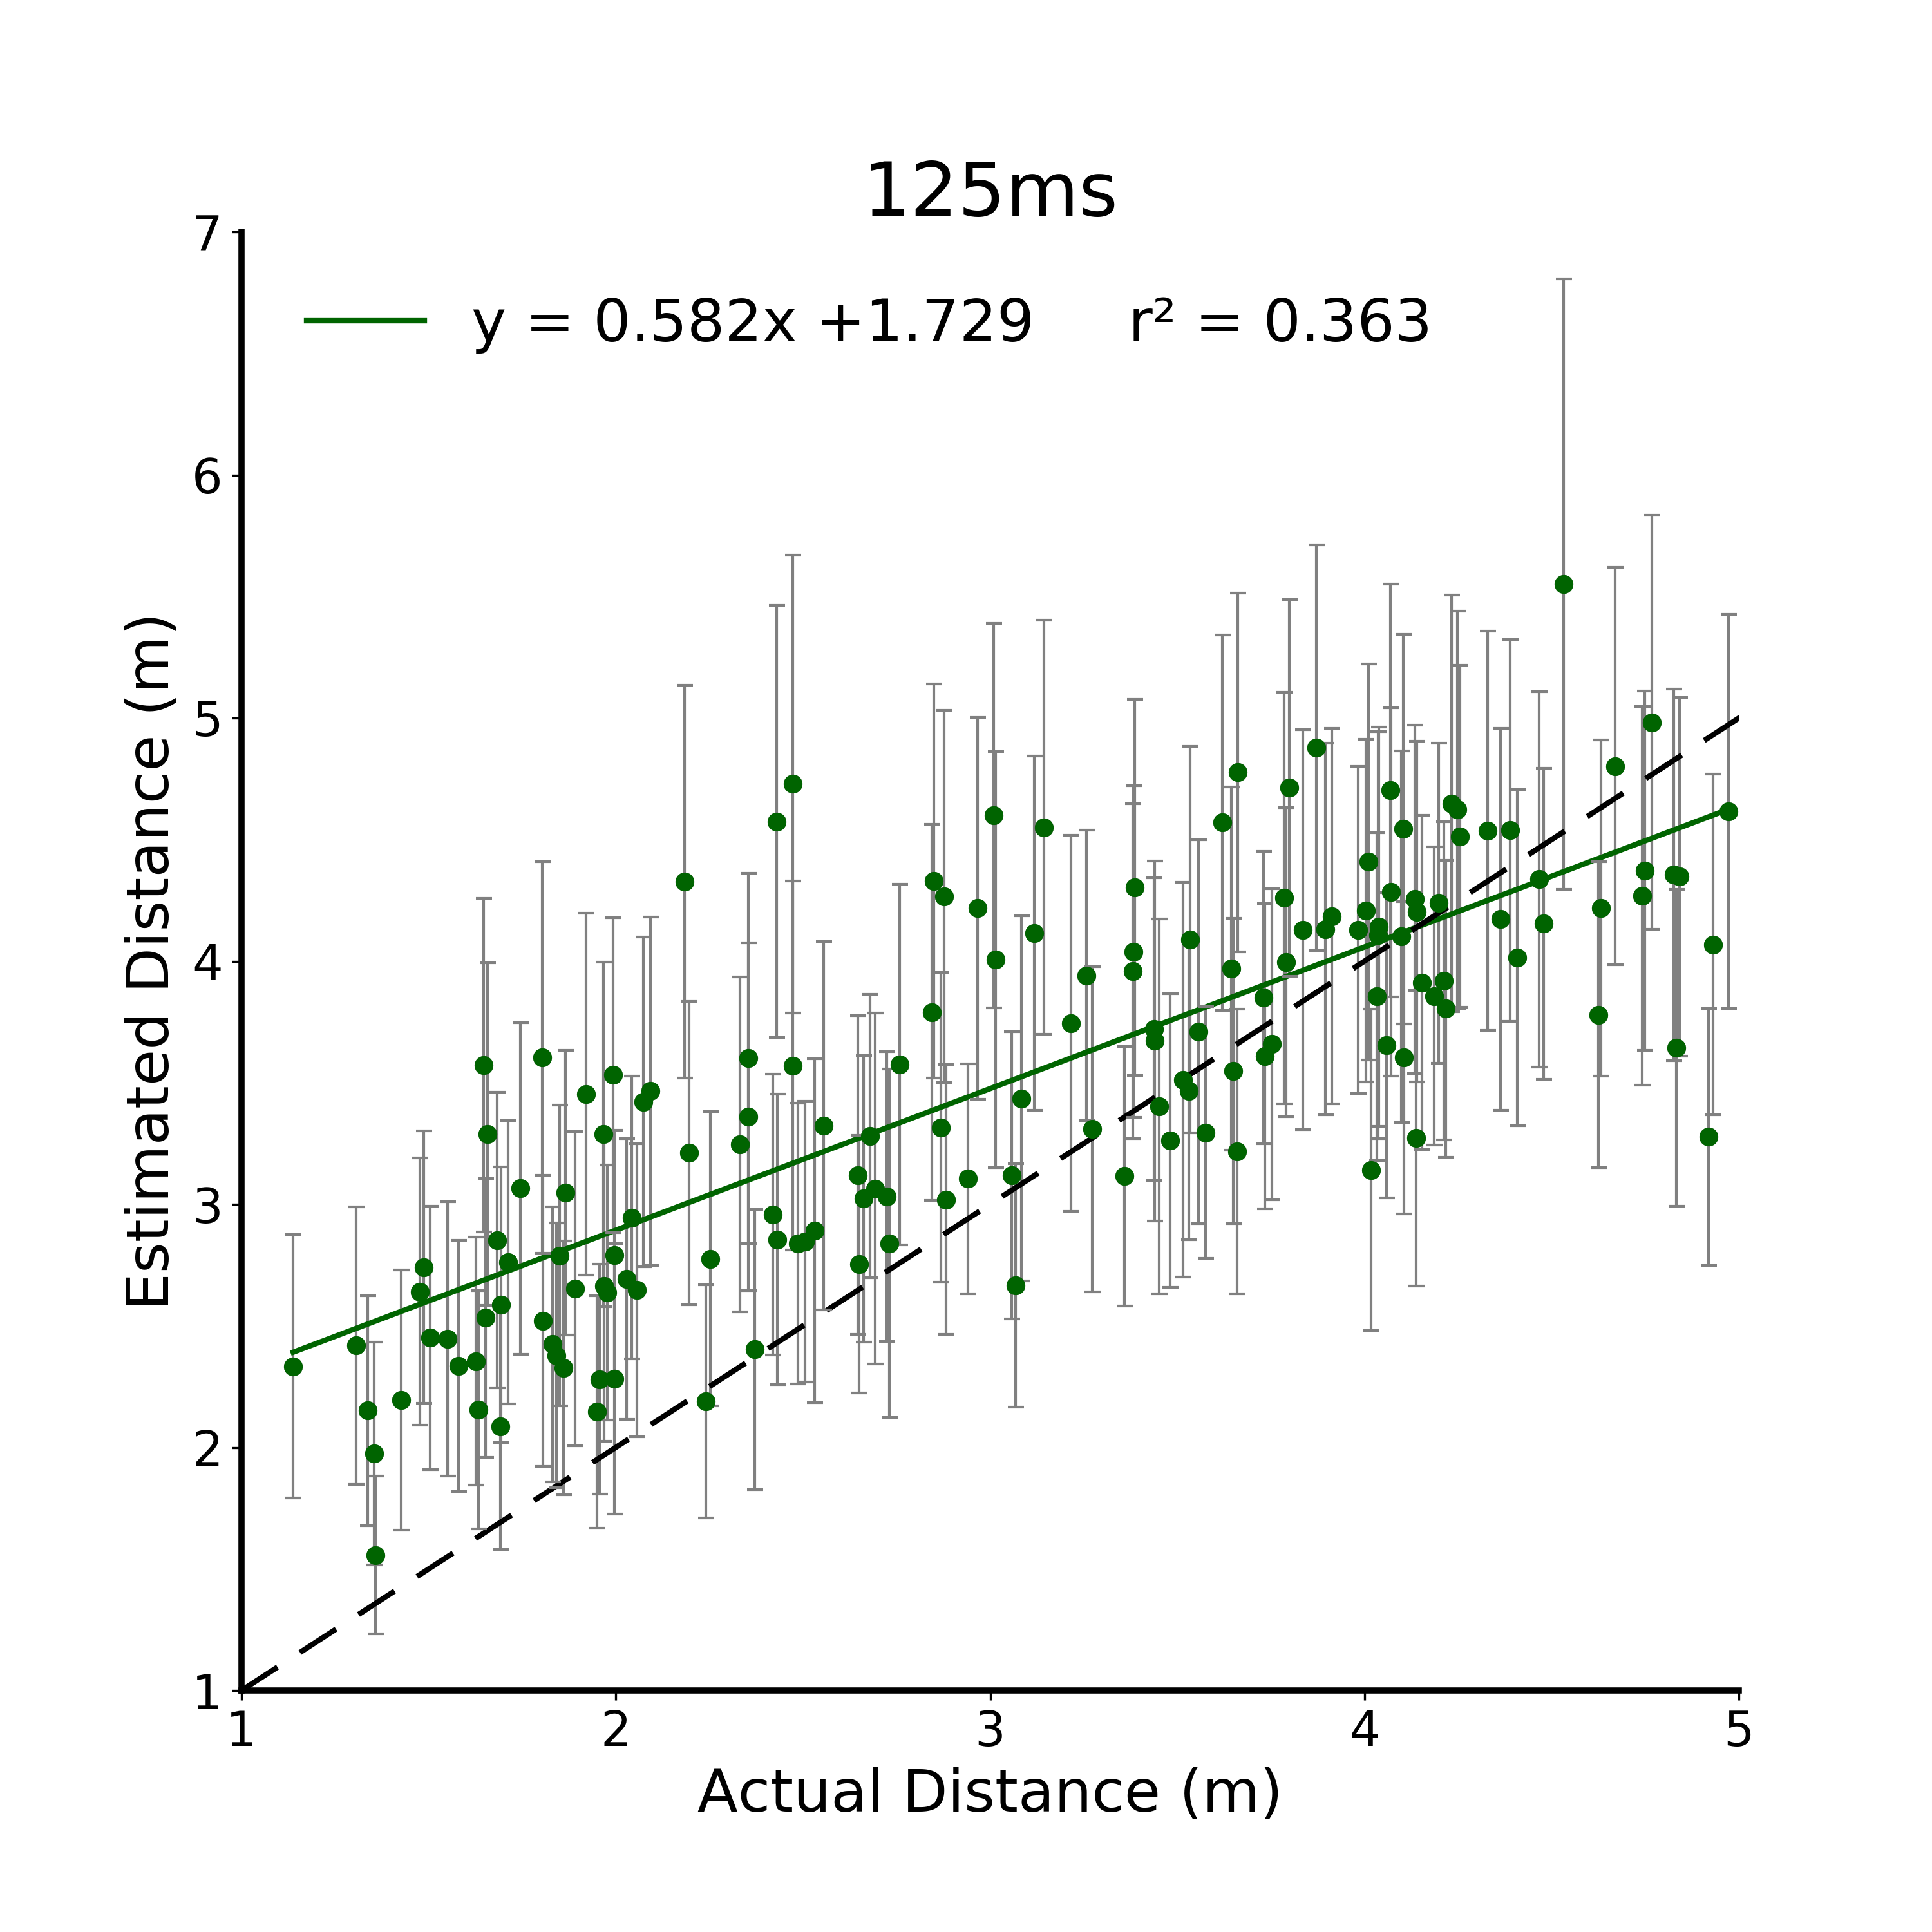
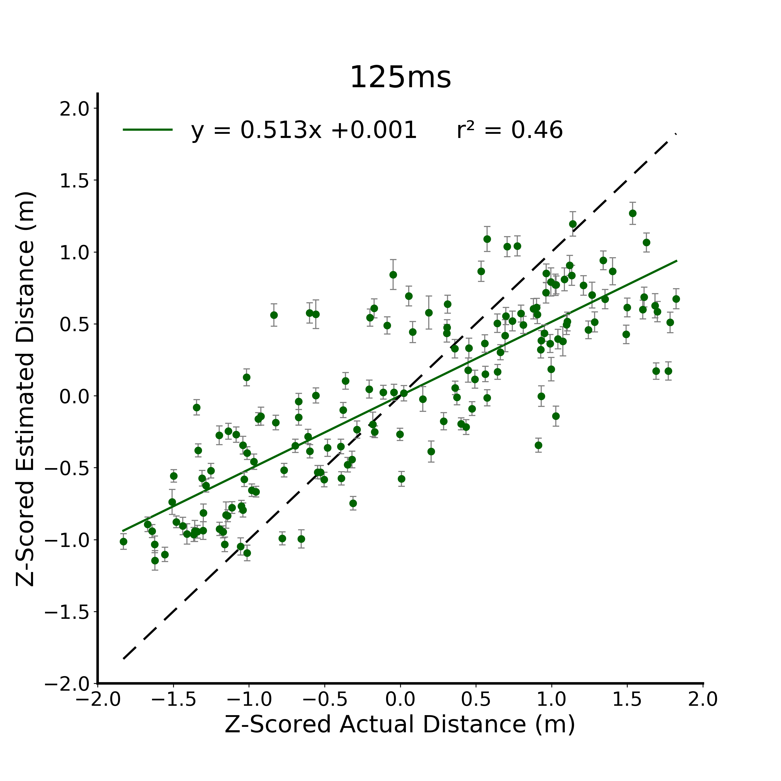
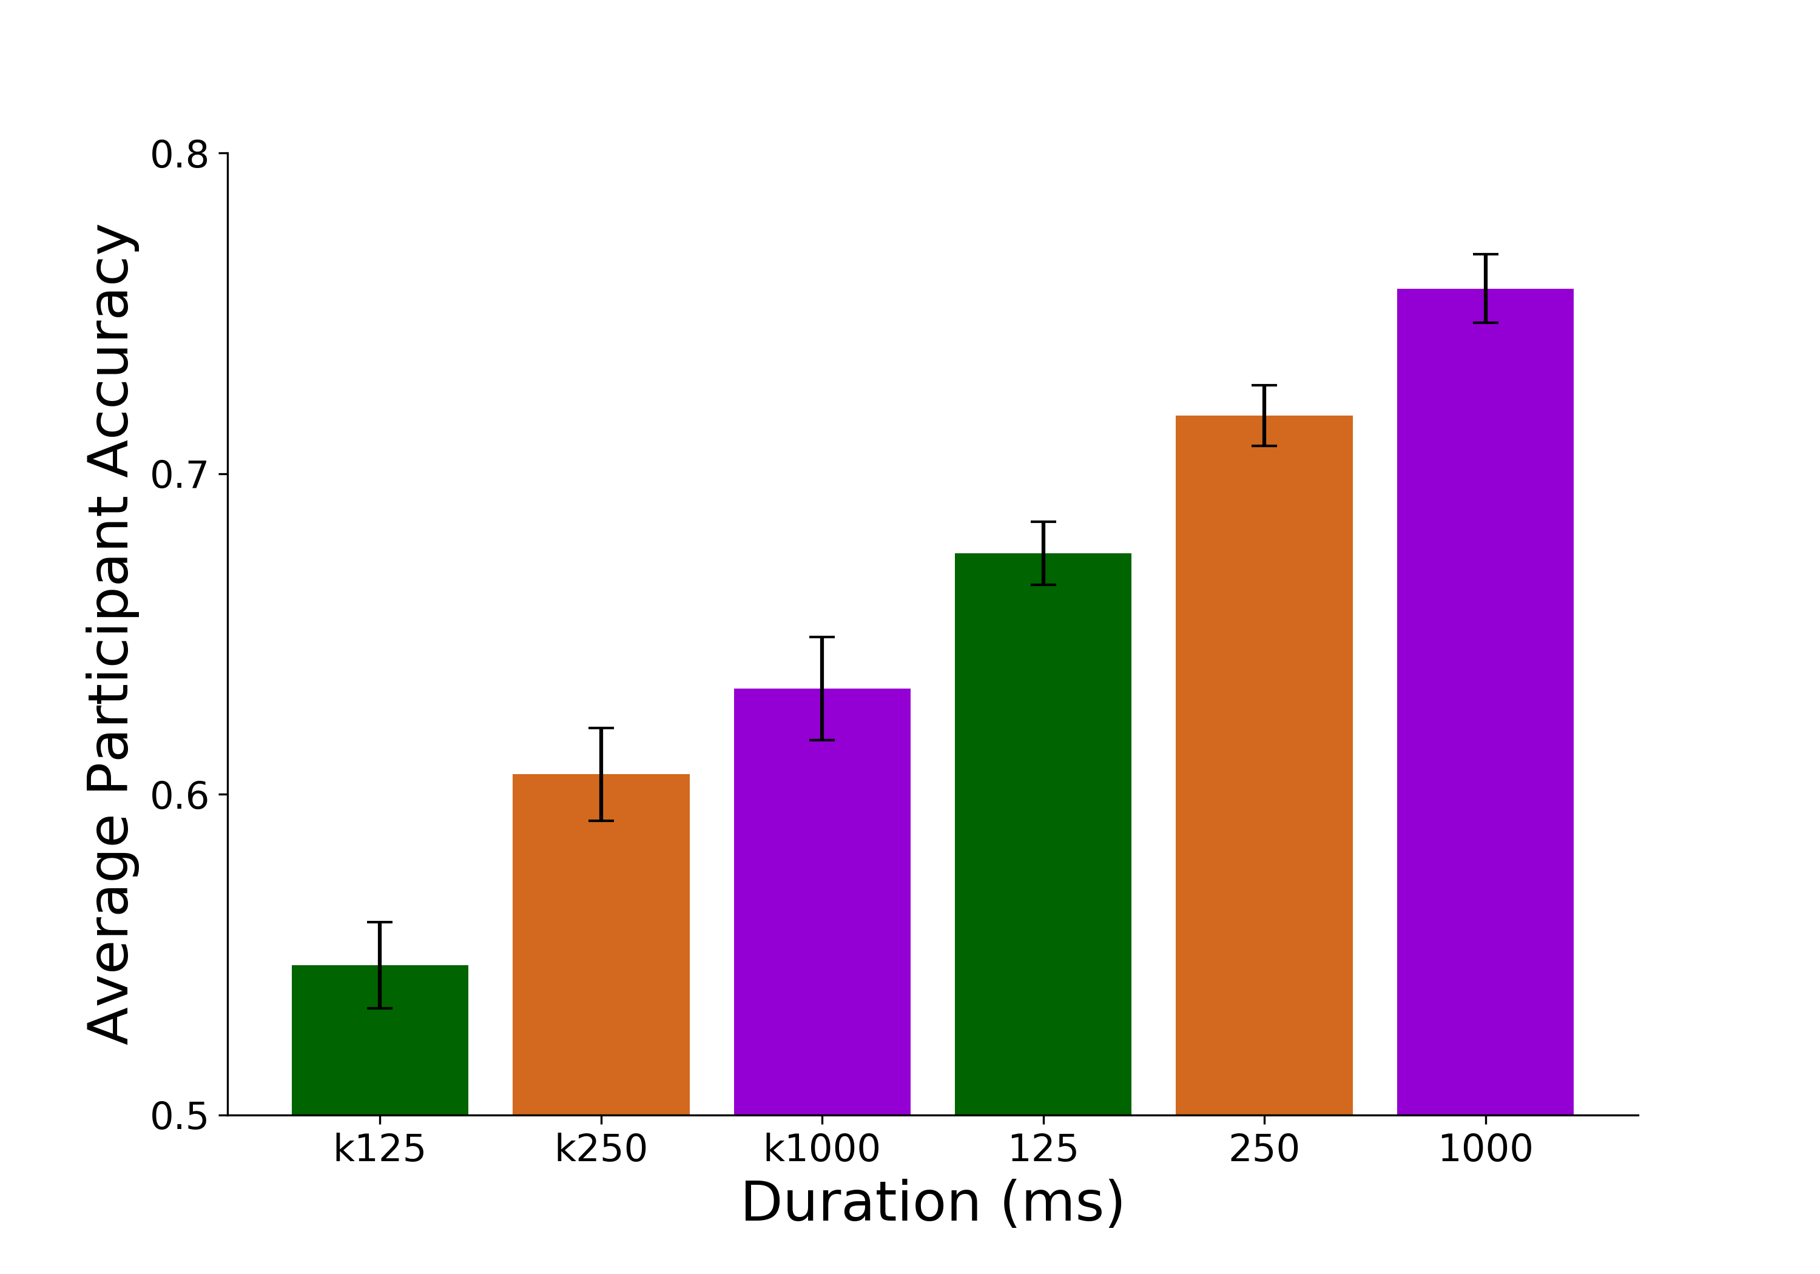
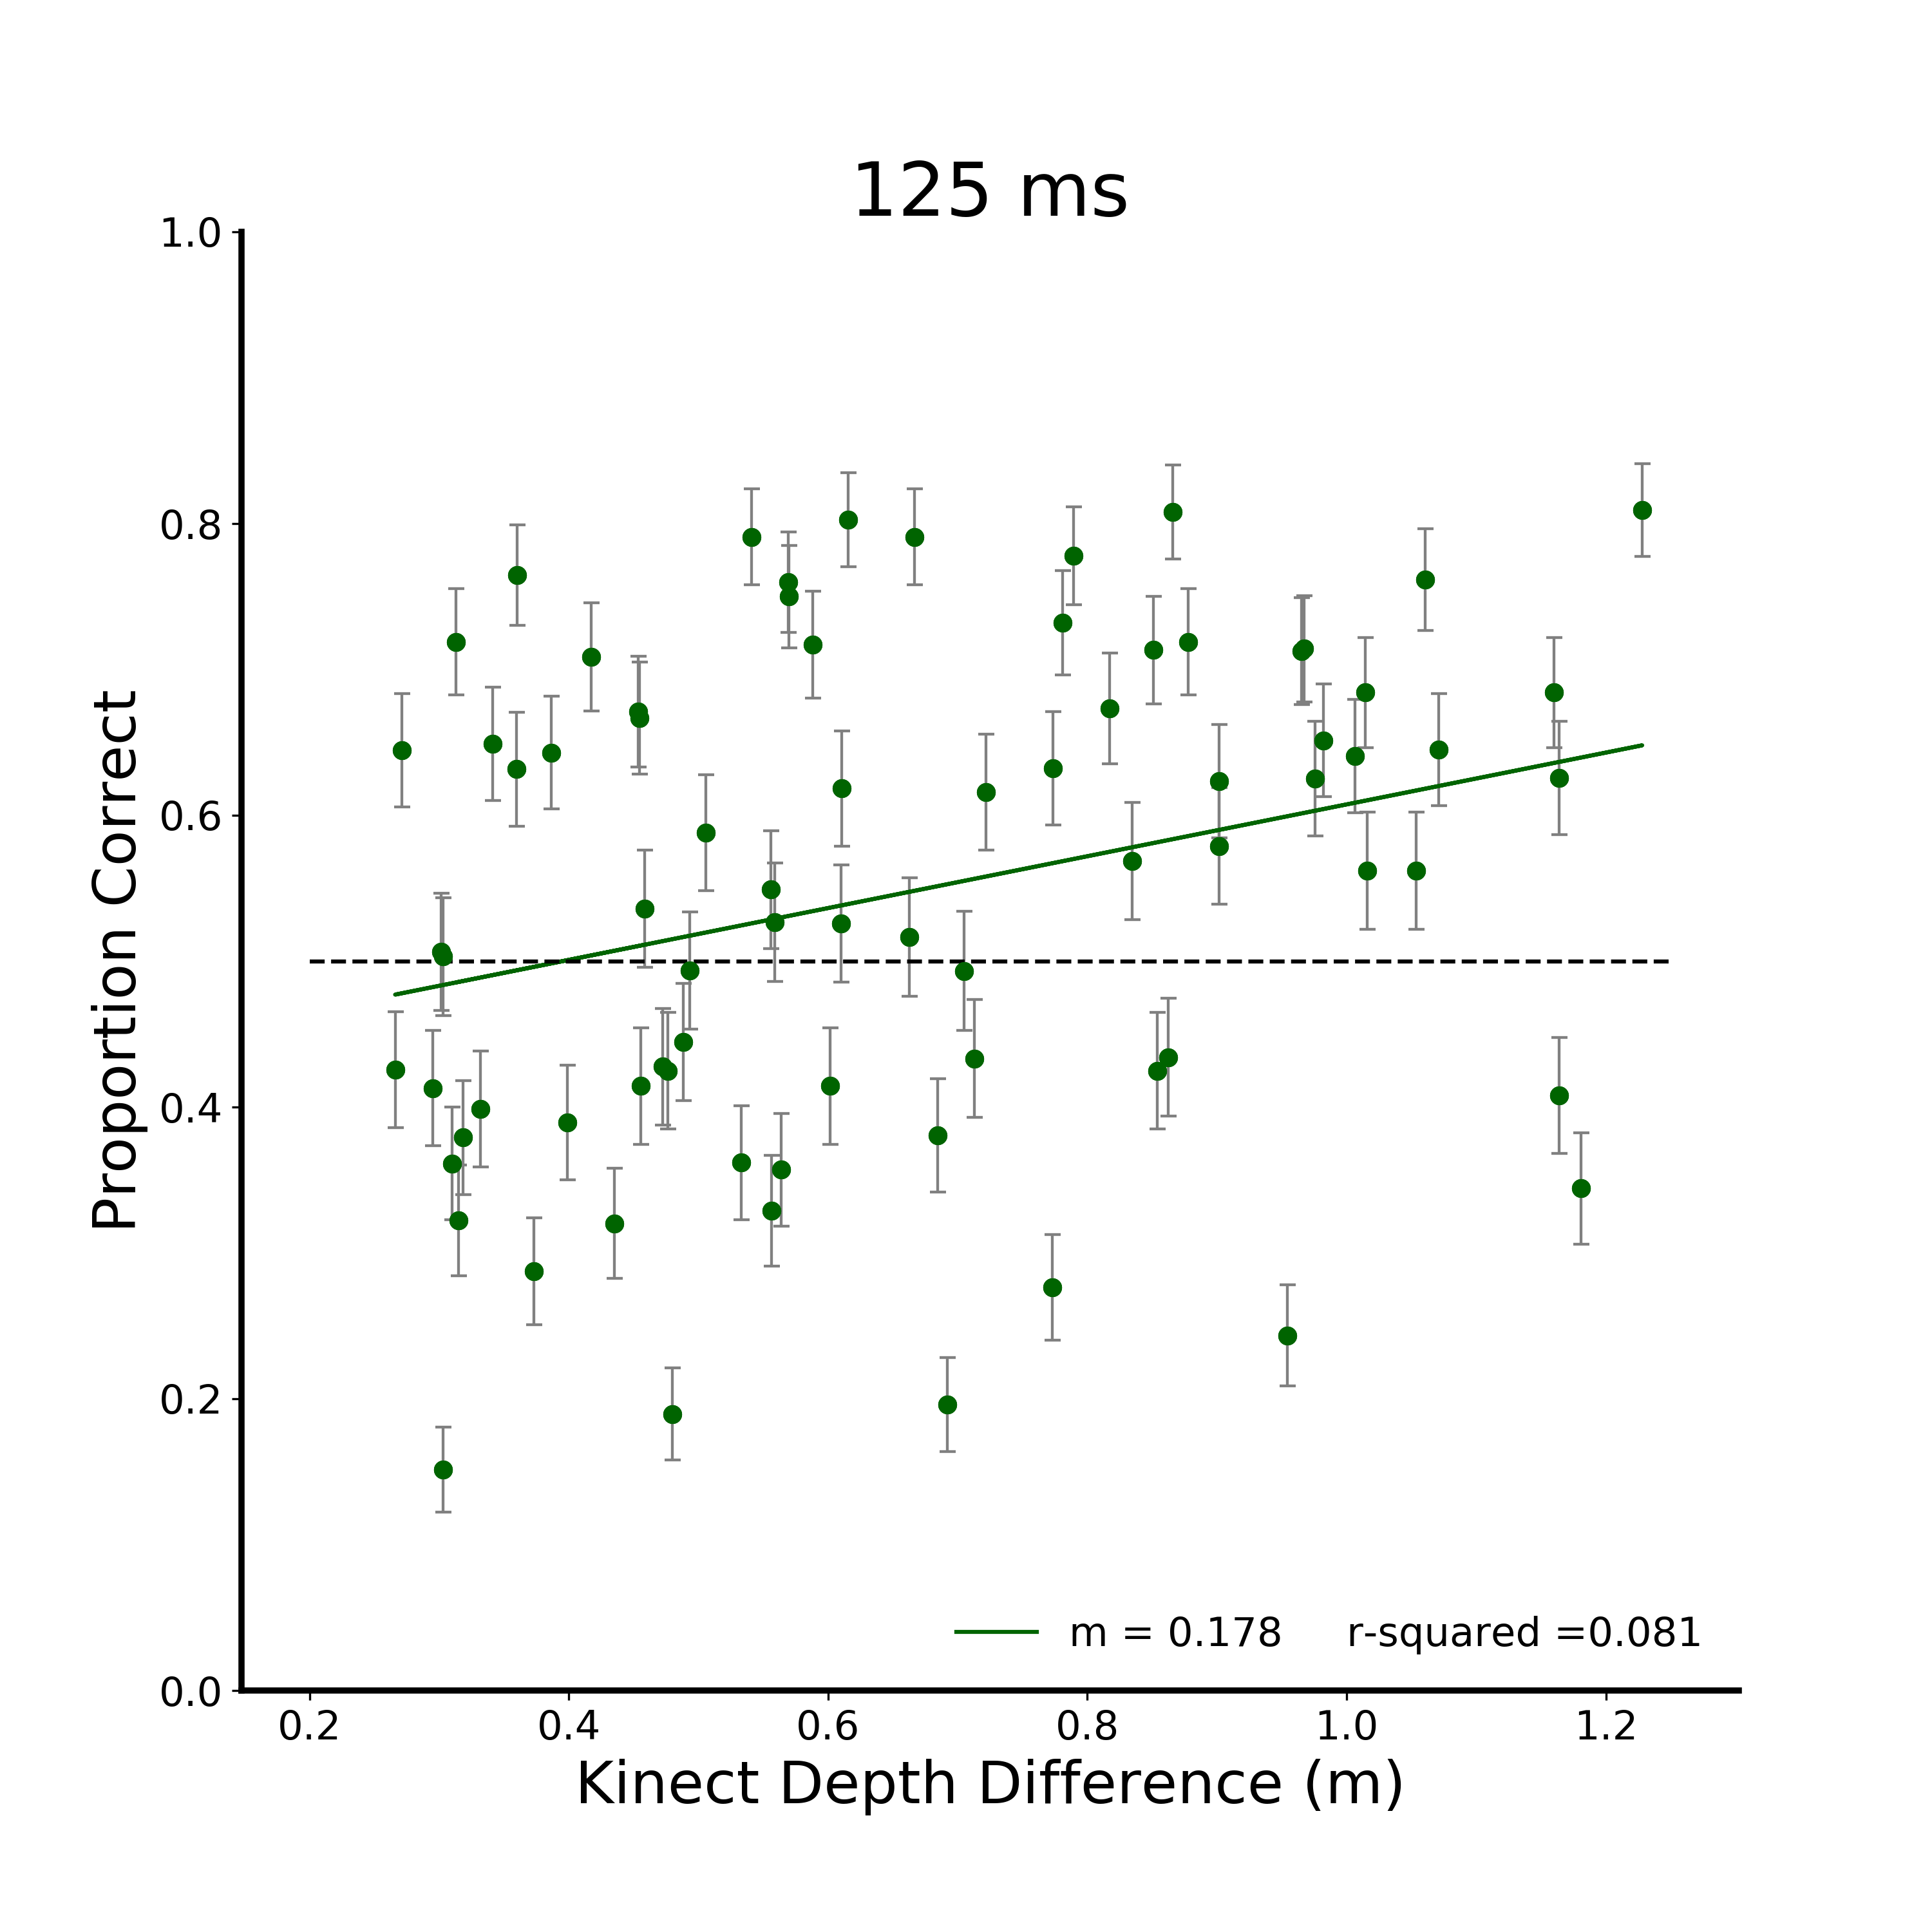
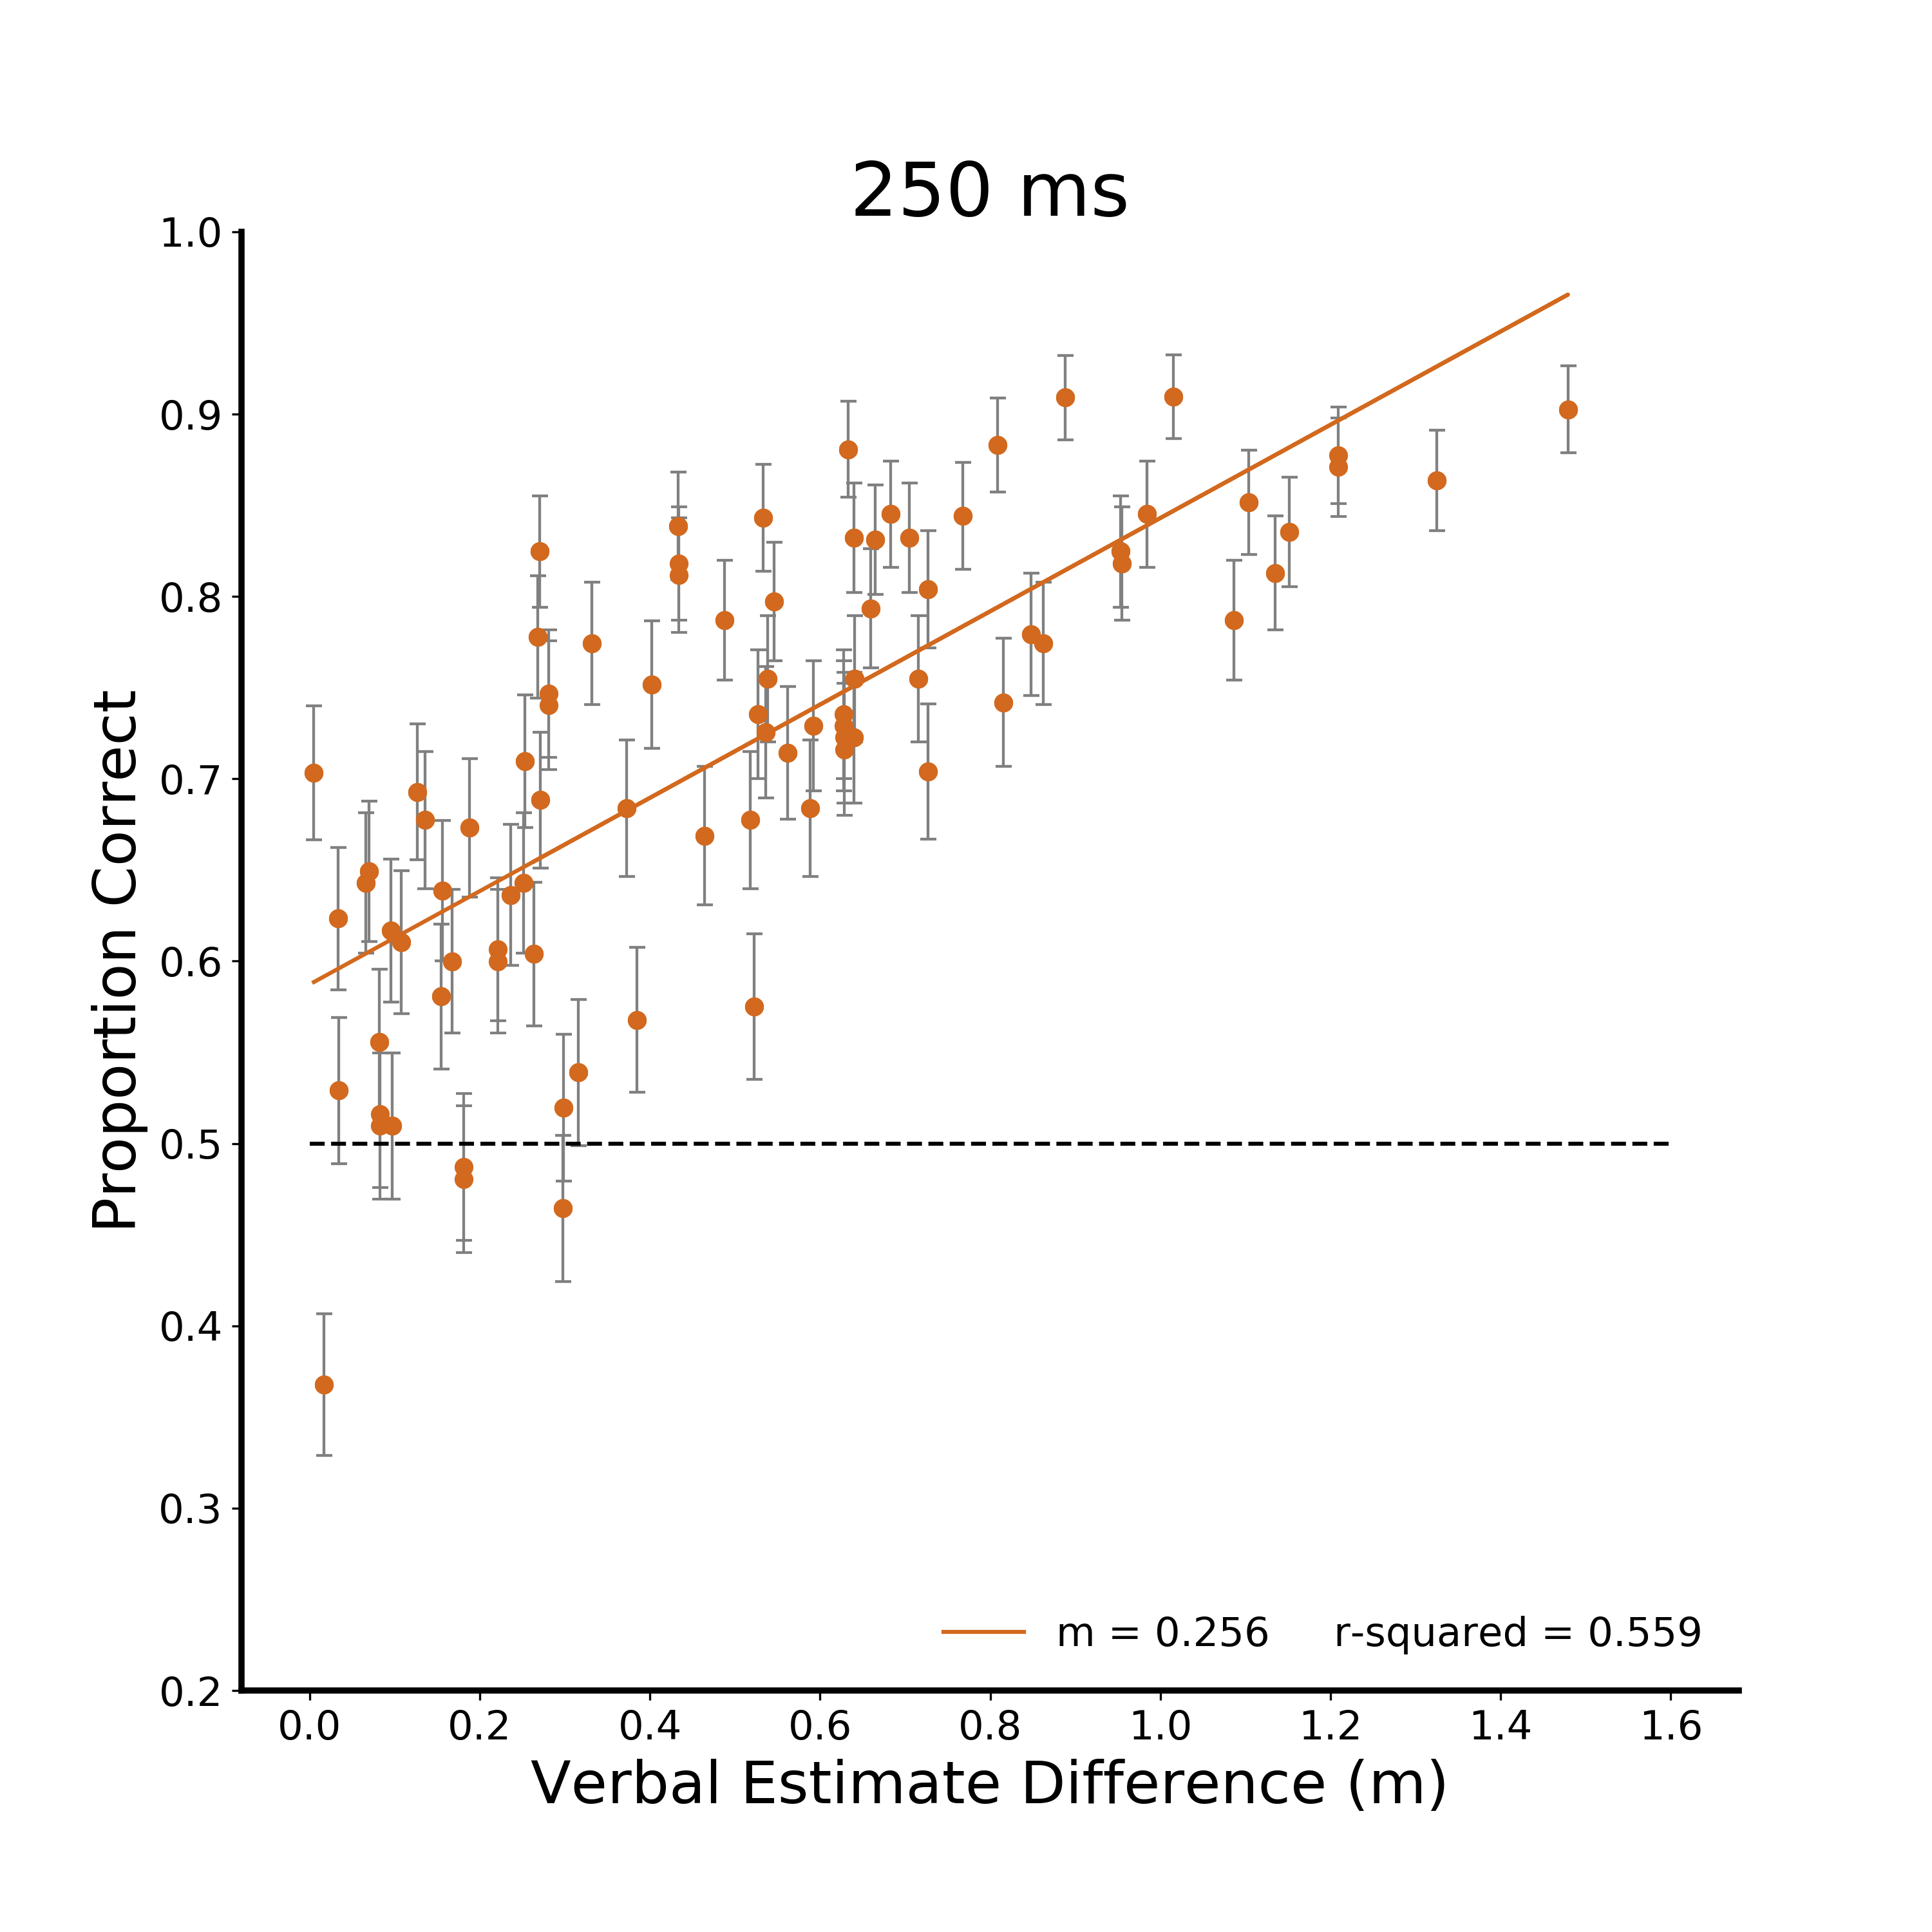
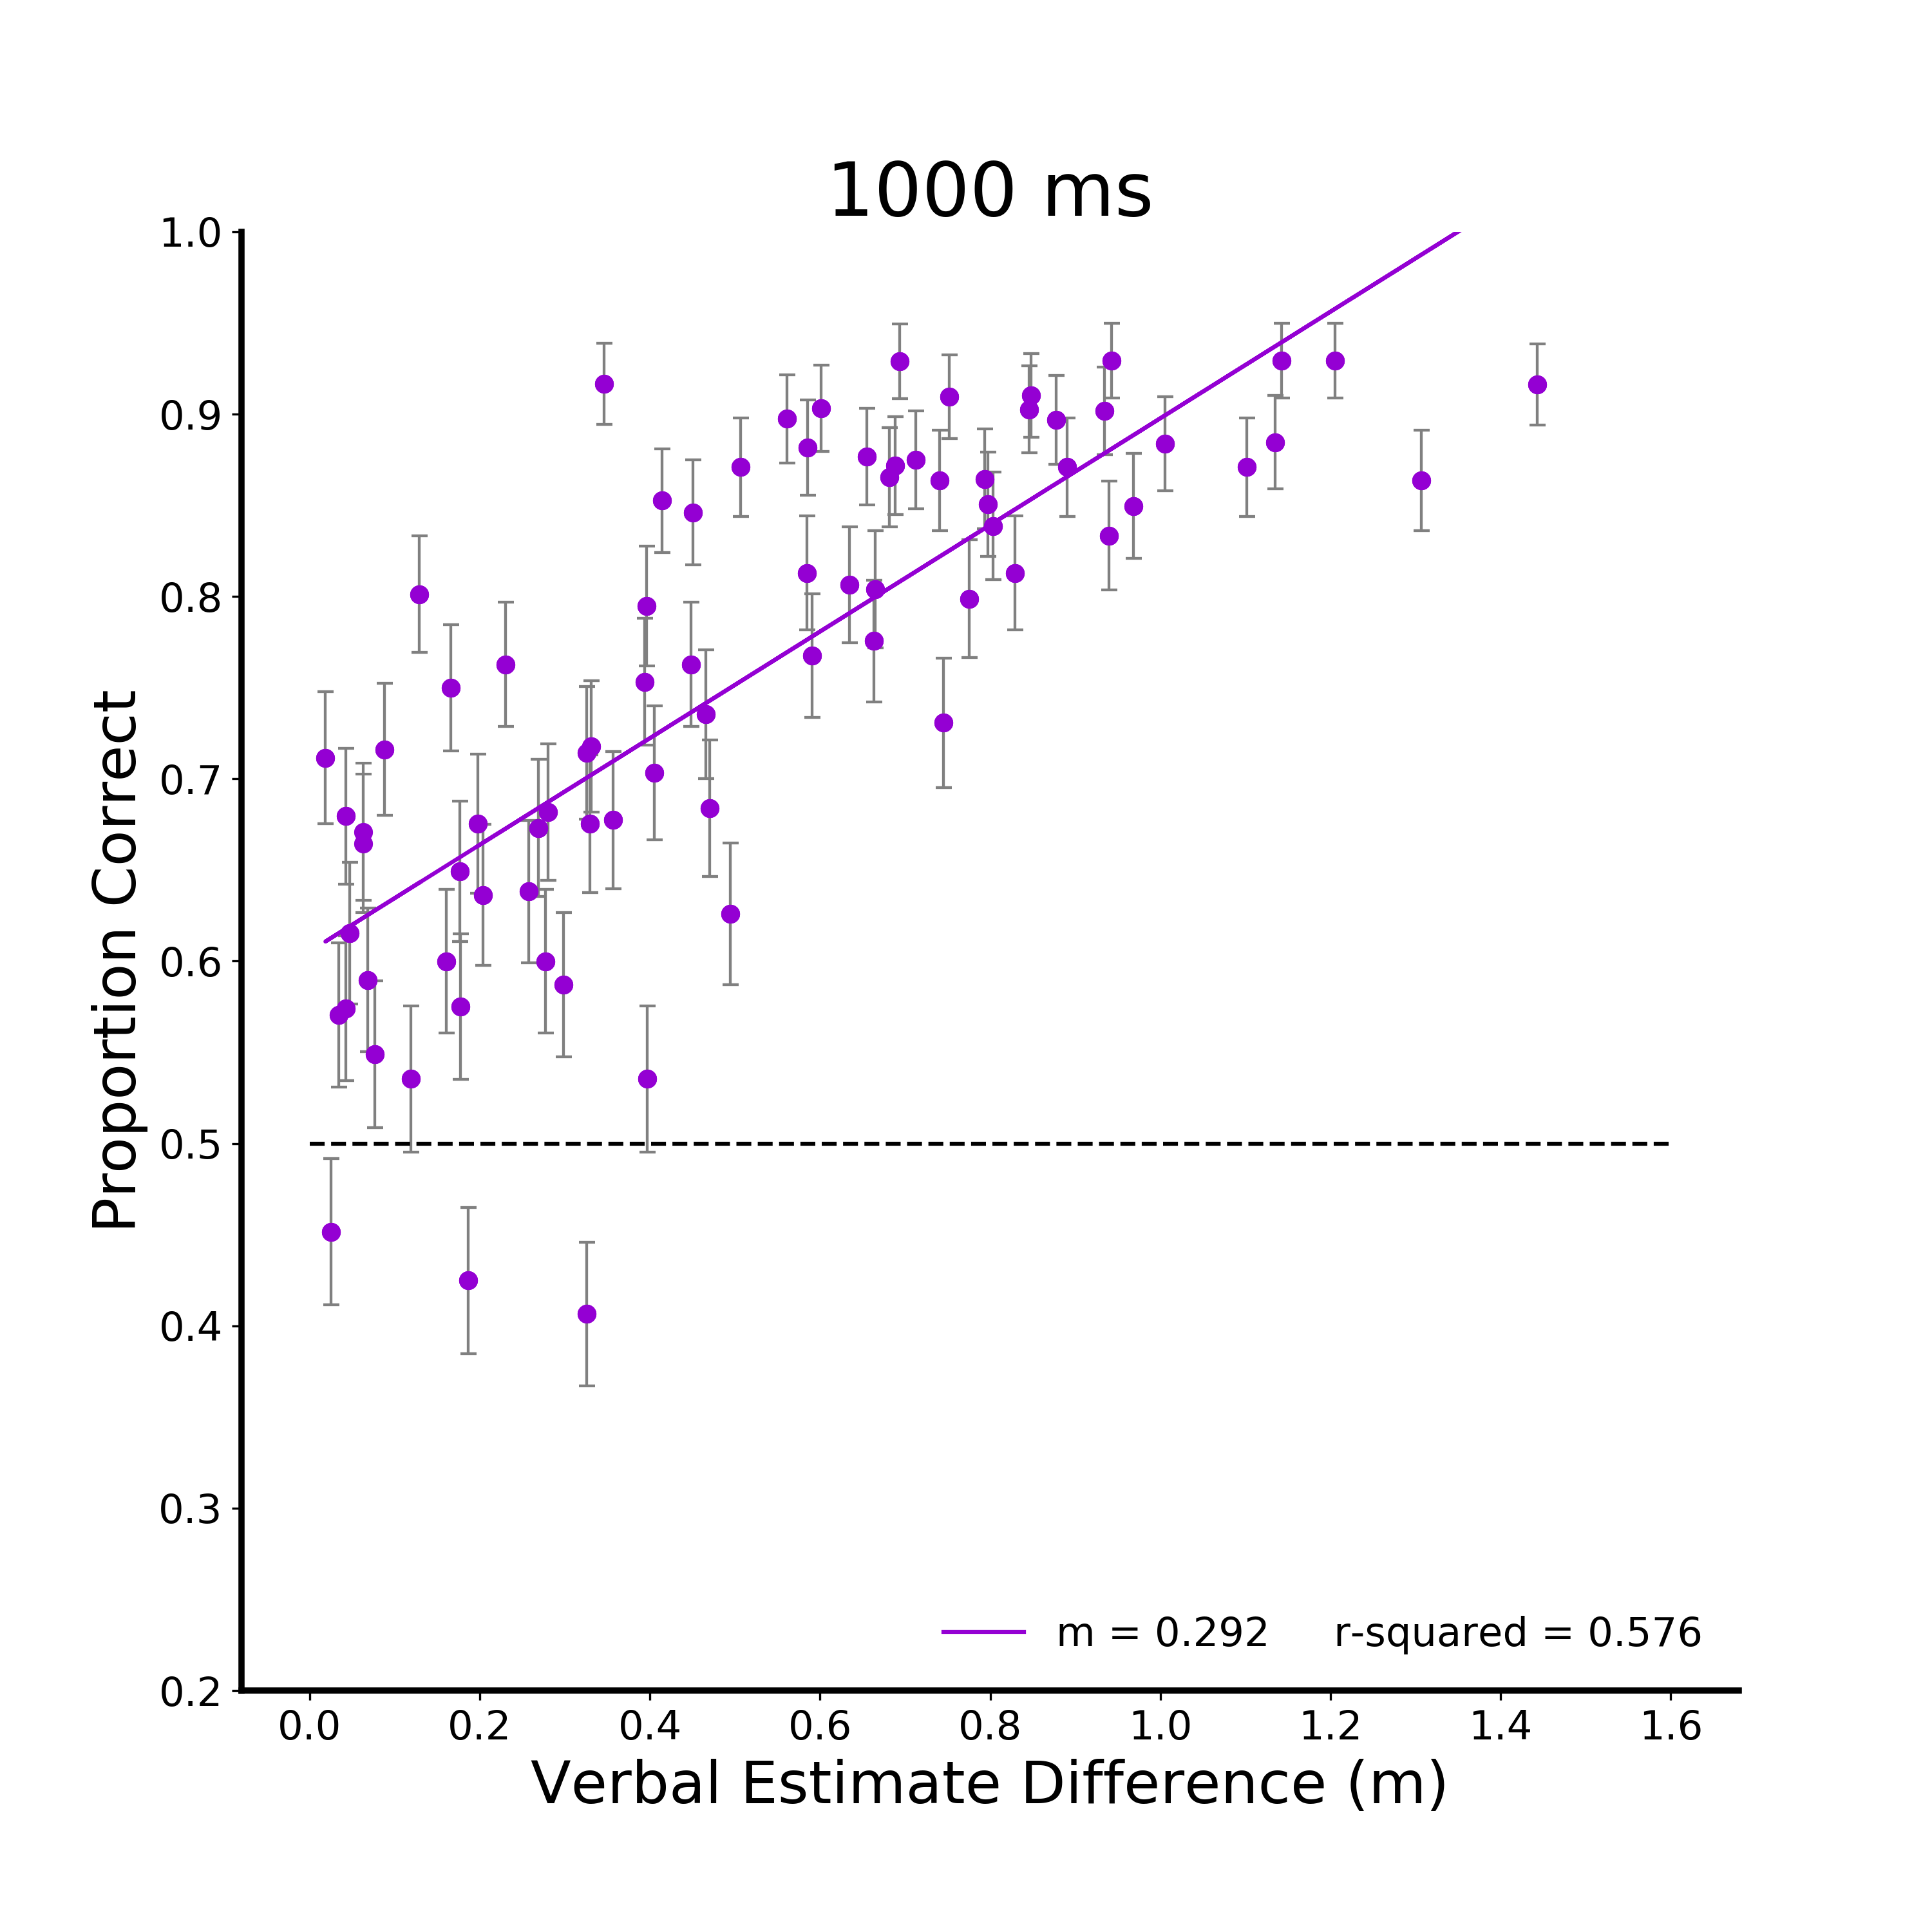
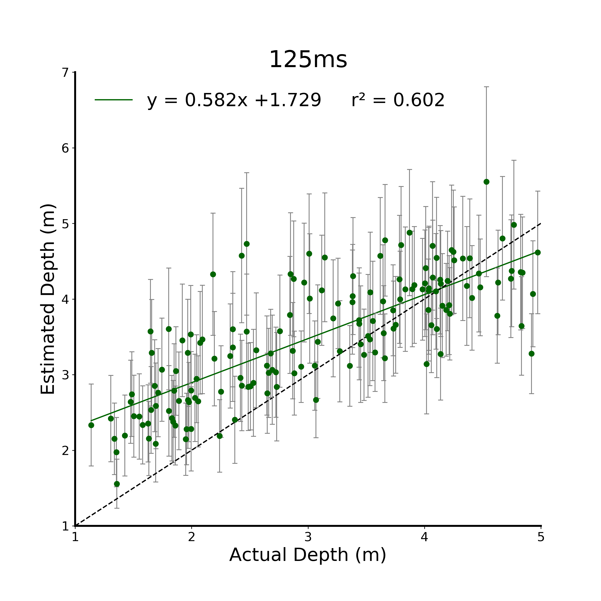
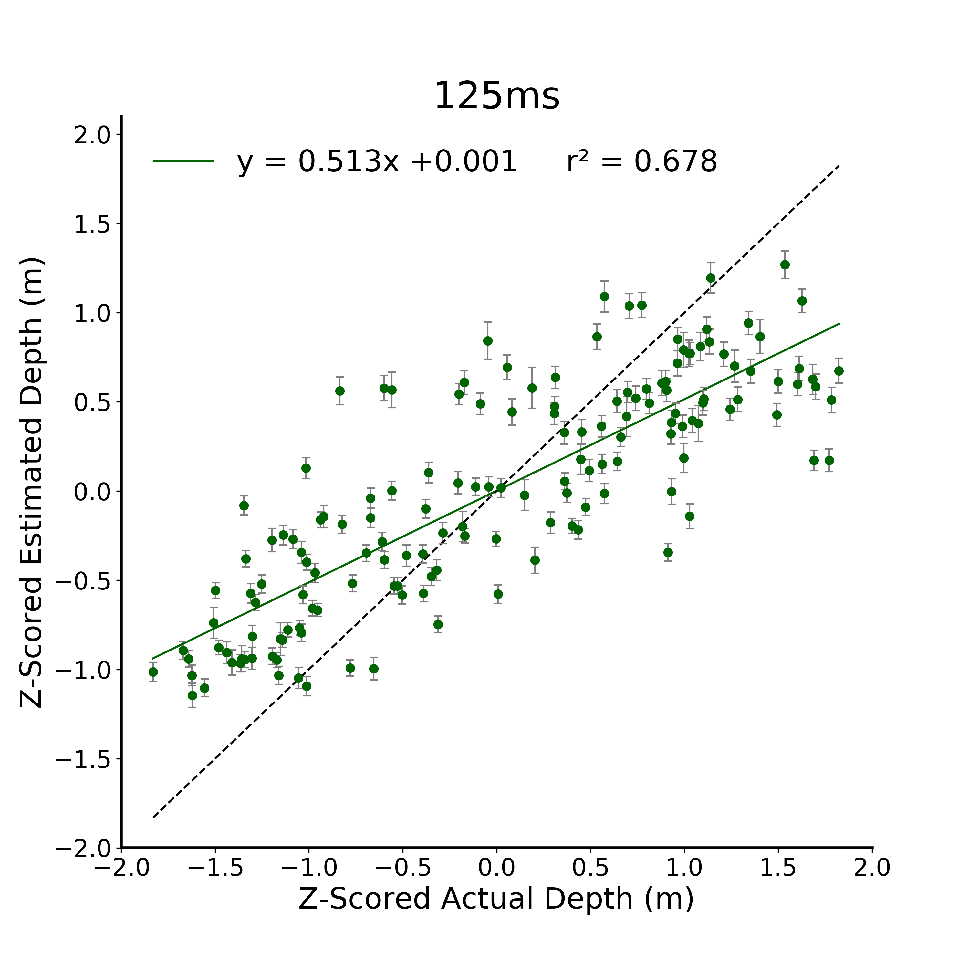

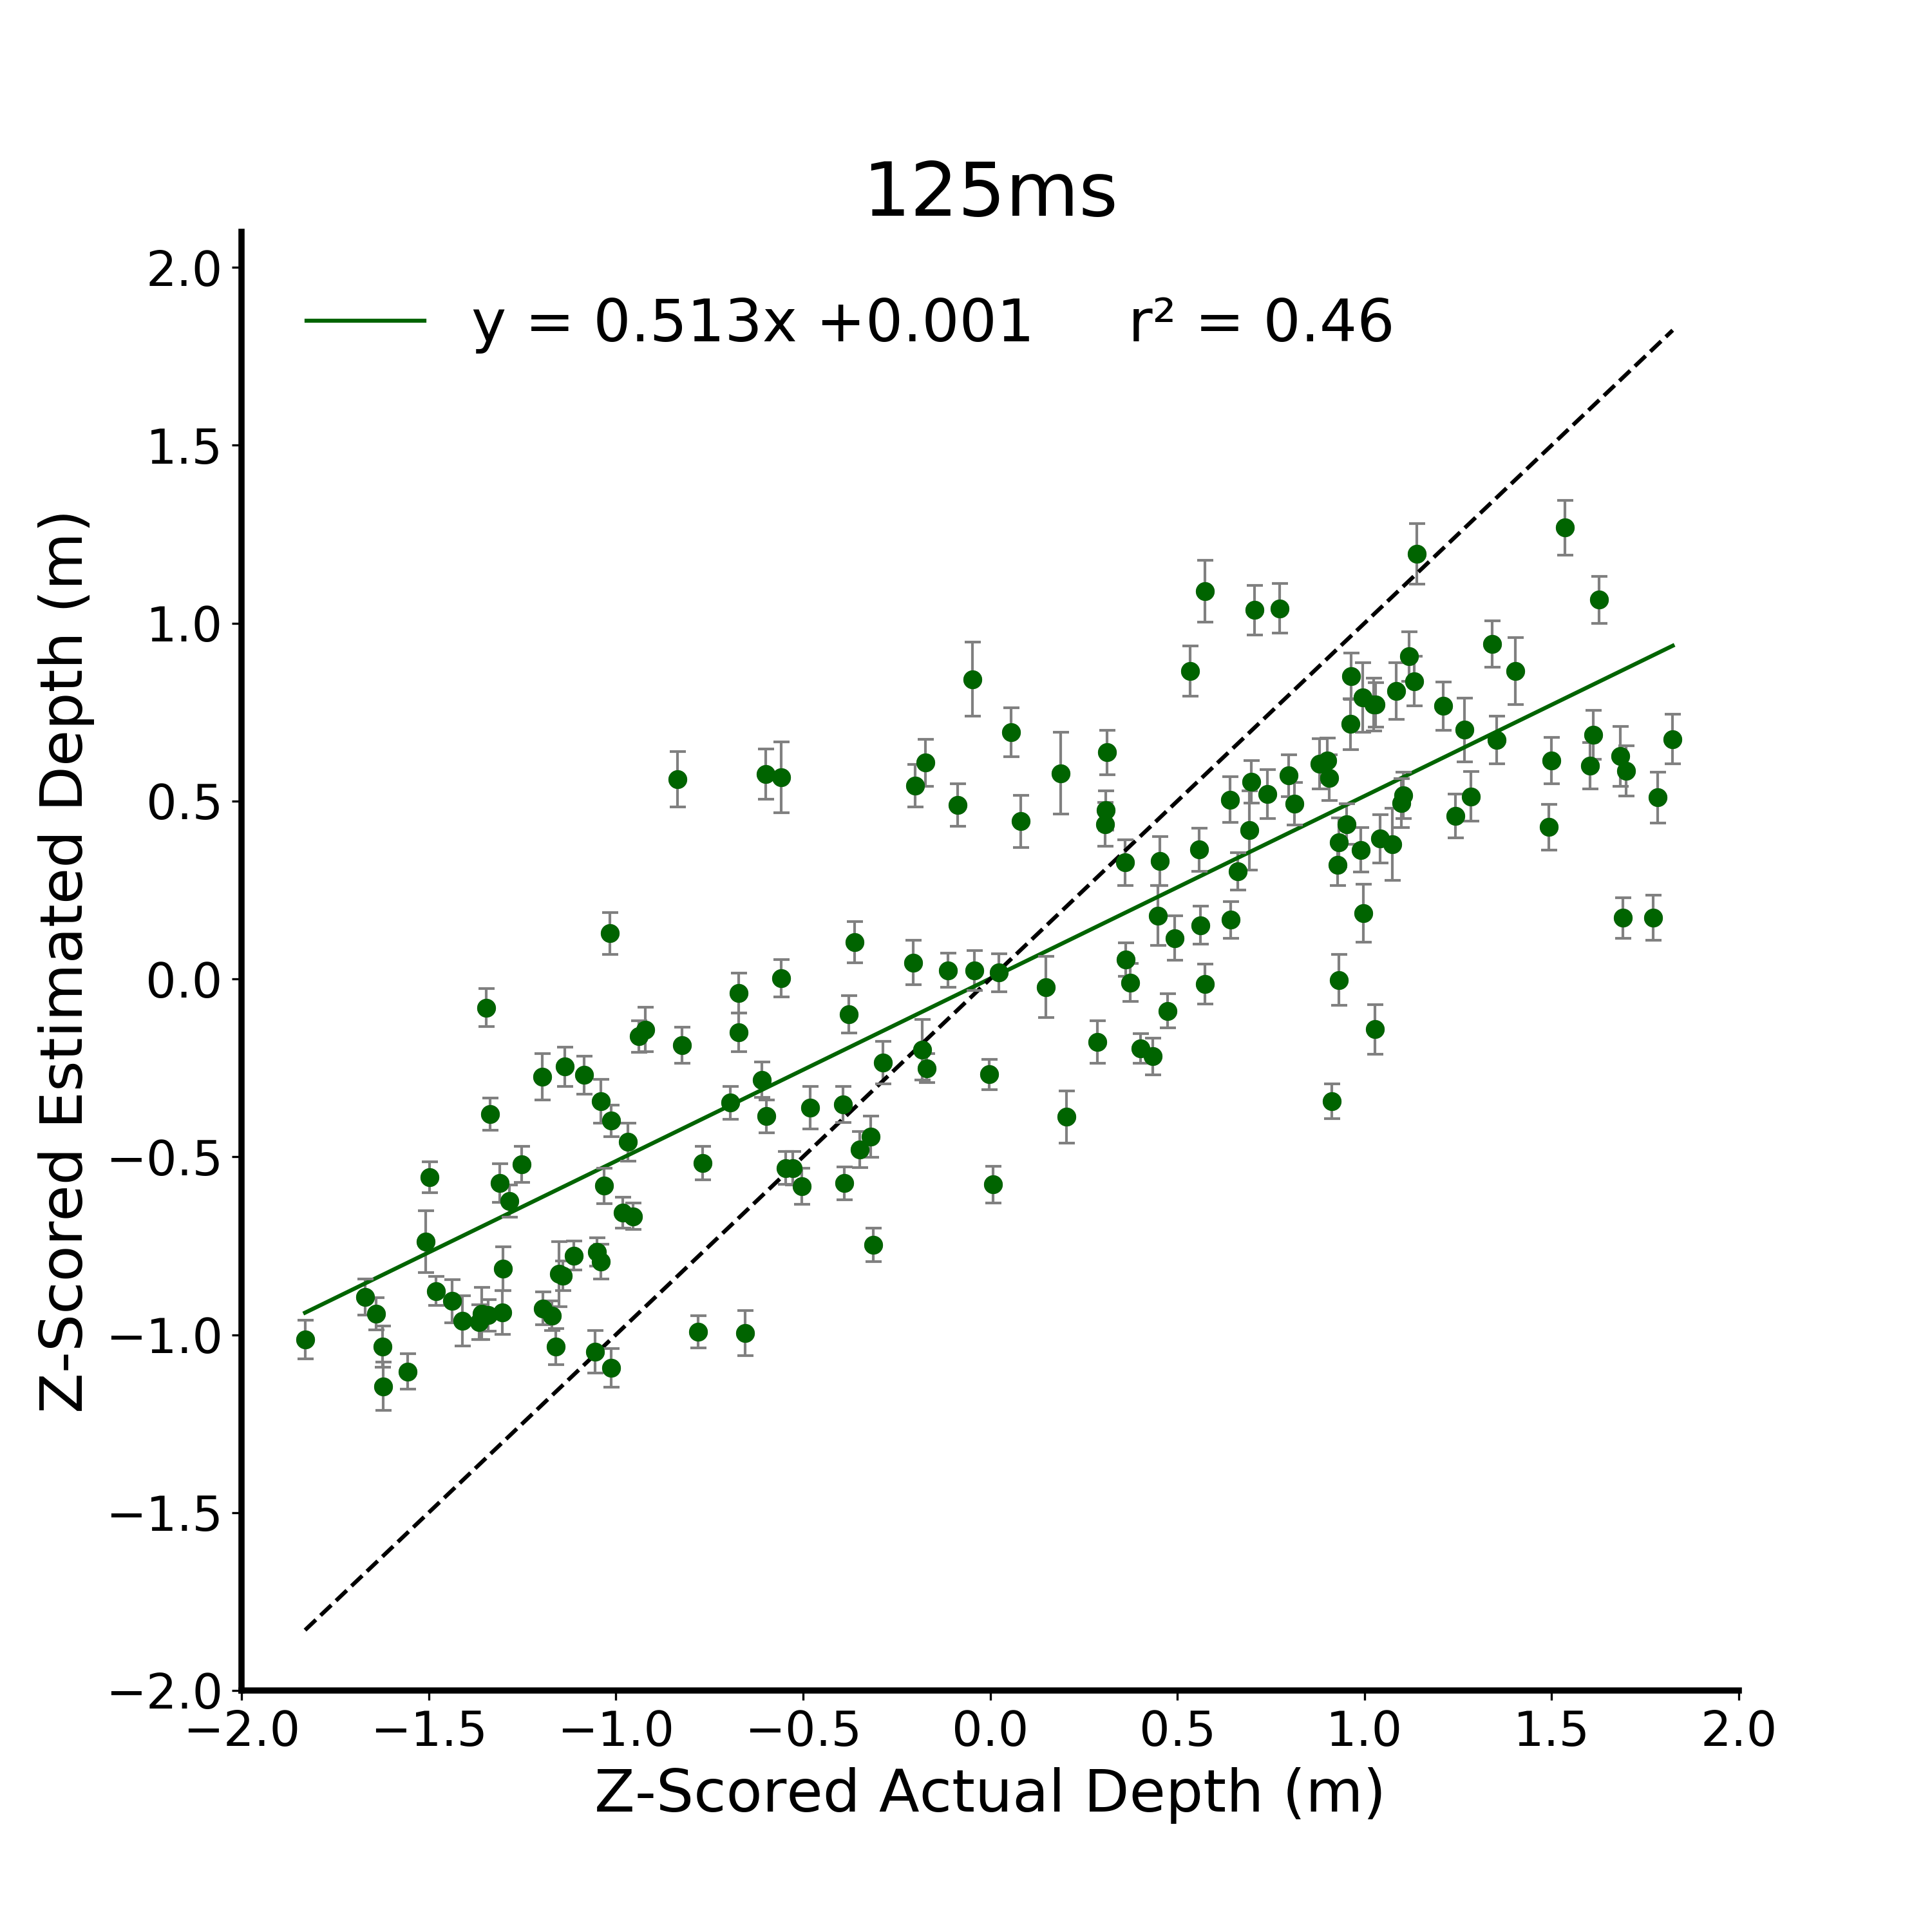
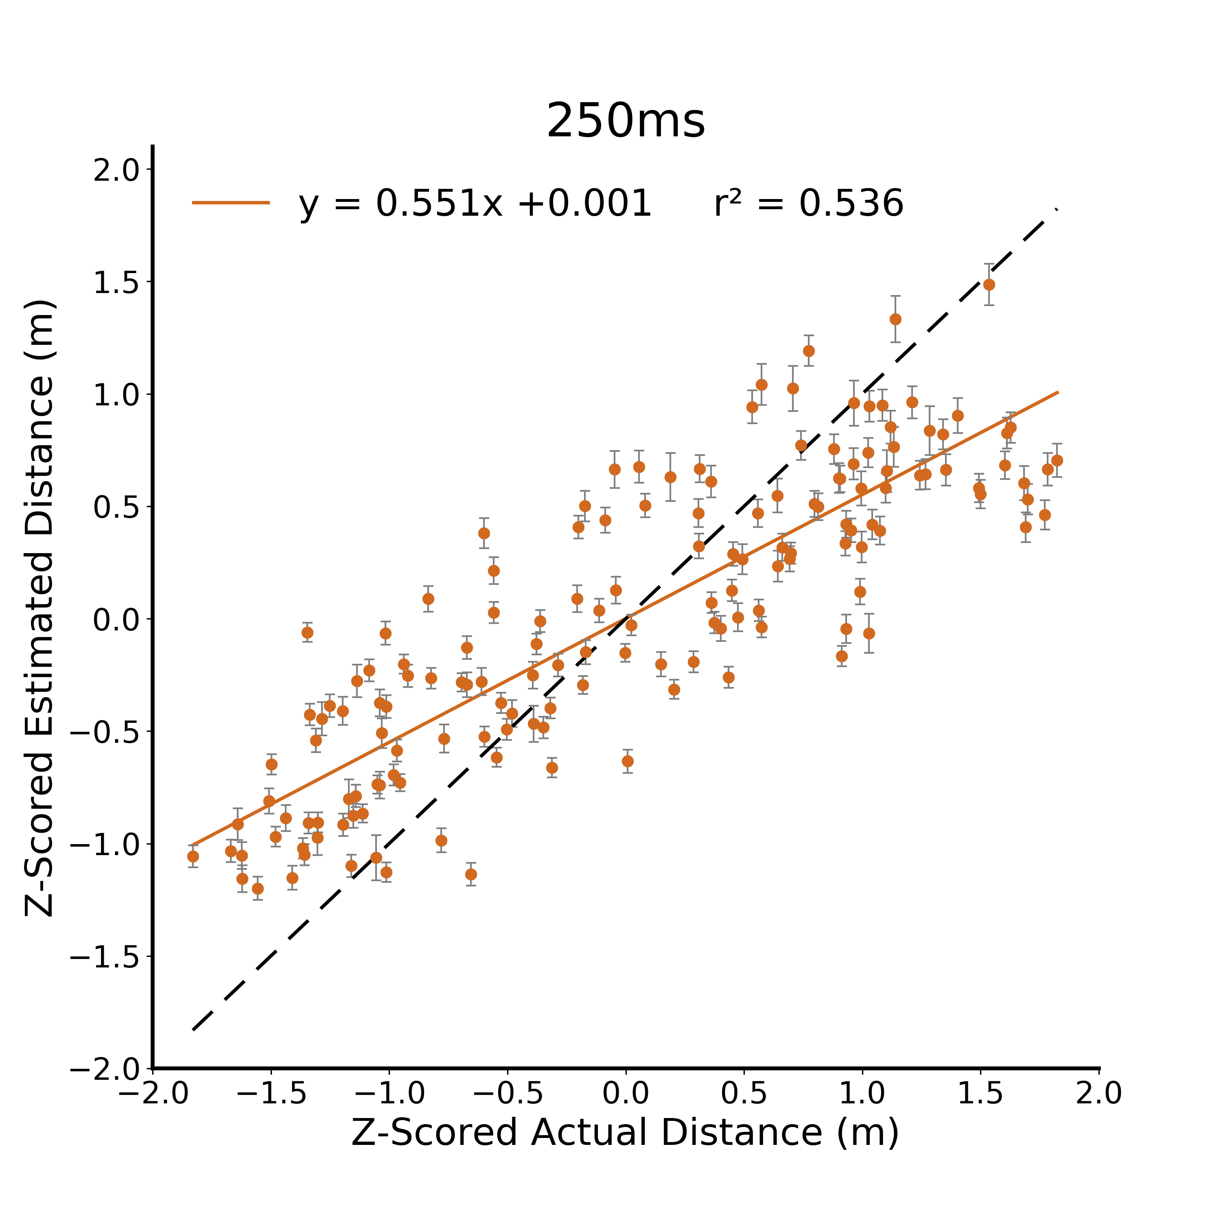
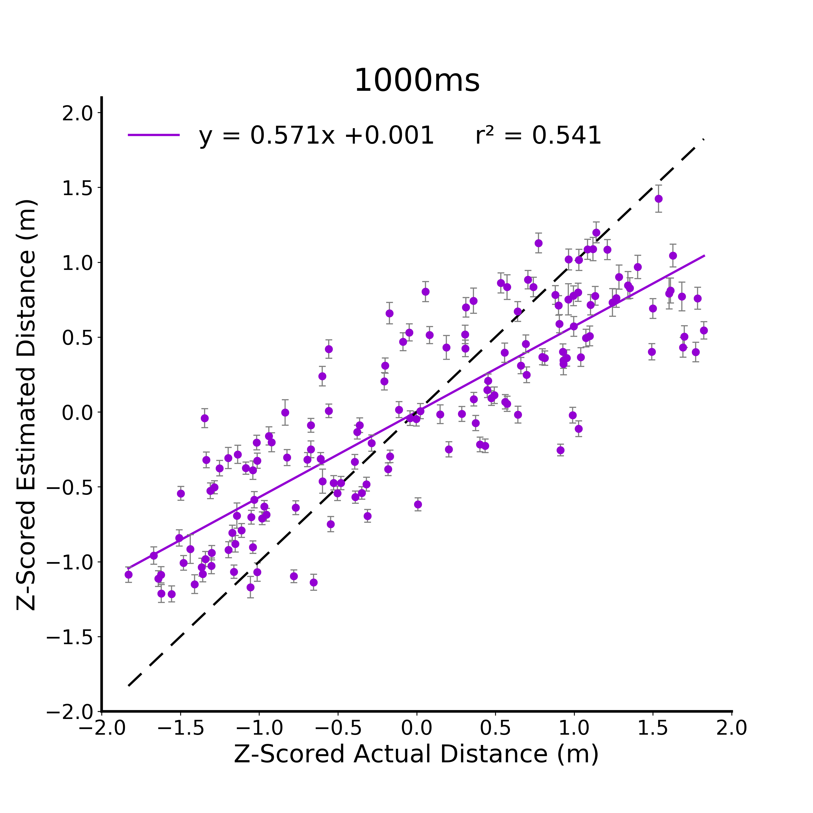

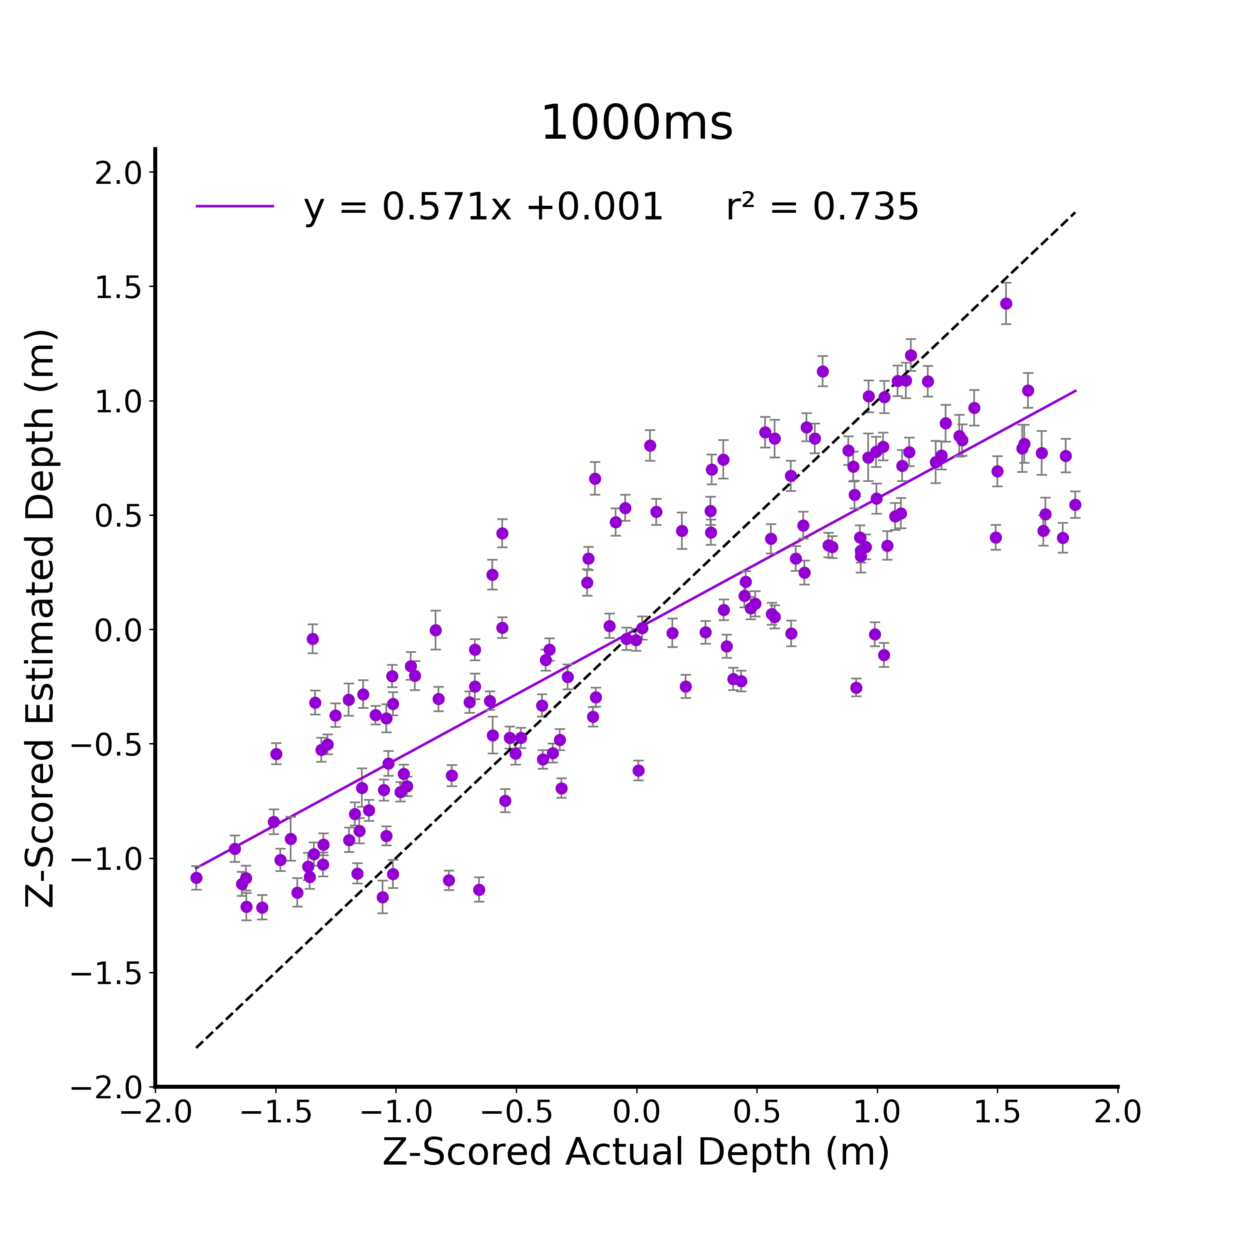


A.
B.
C.
D.
Notes:
DONE

Slide 3
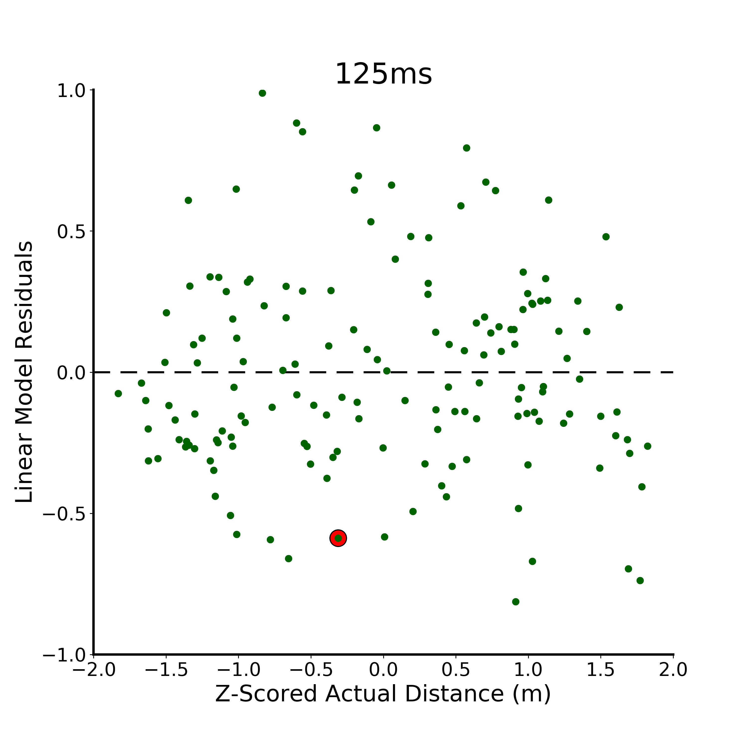
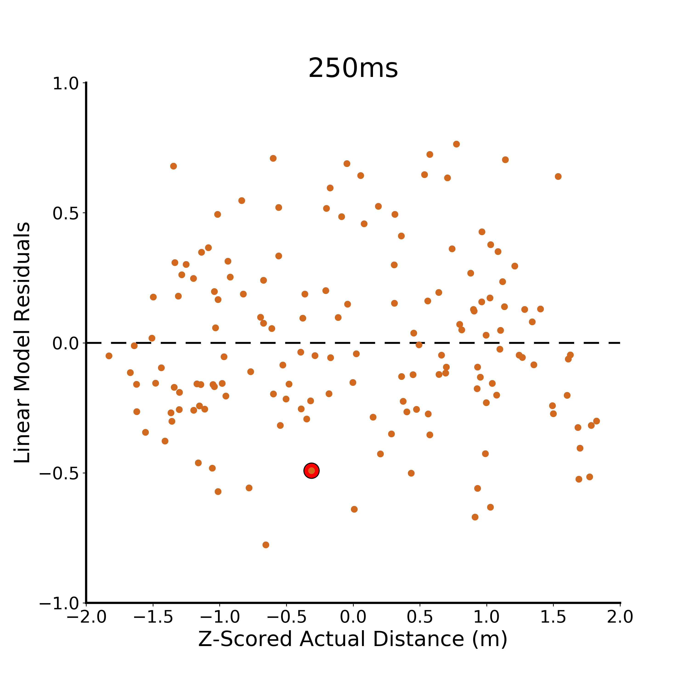
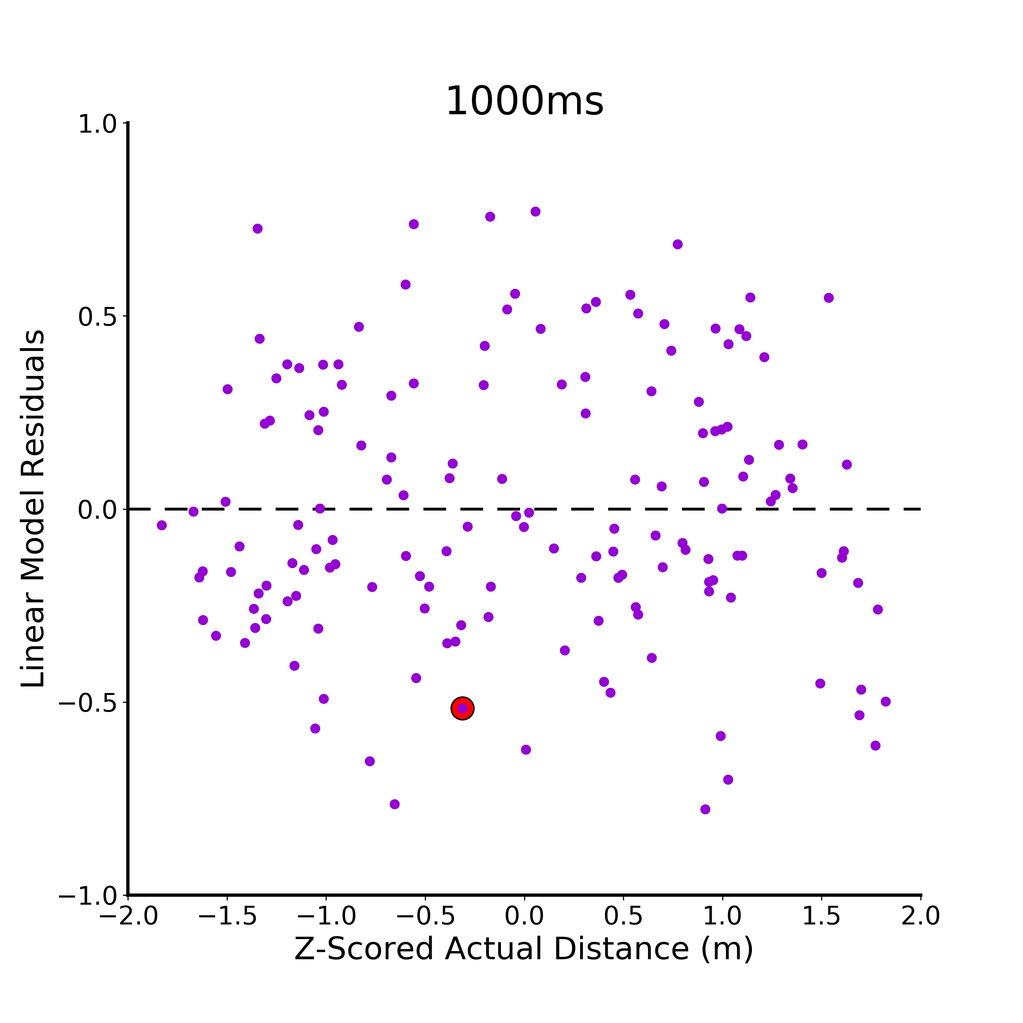
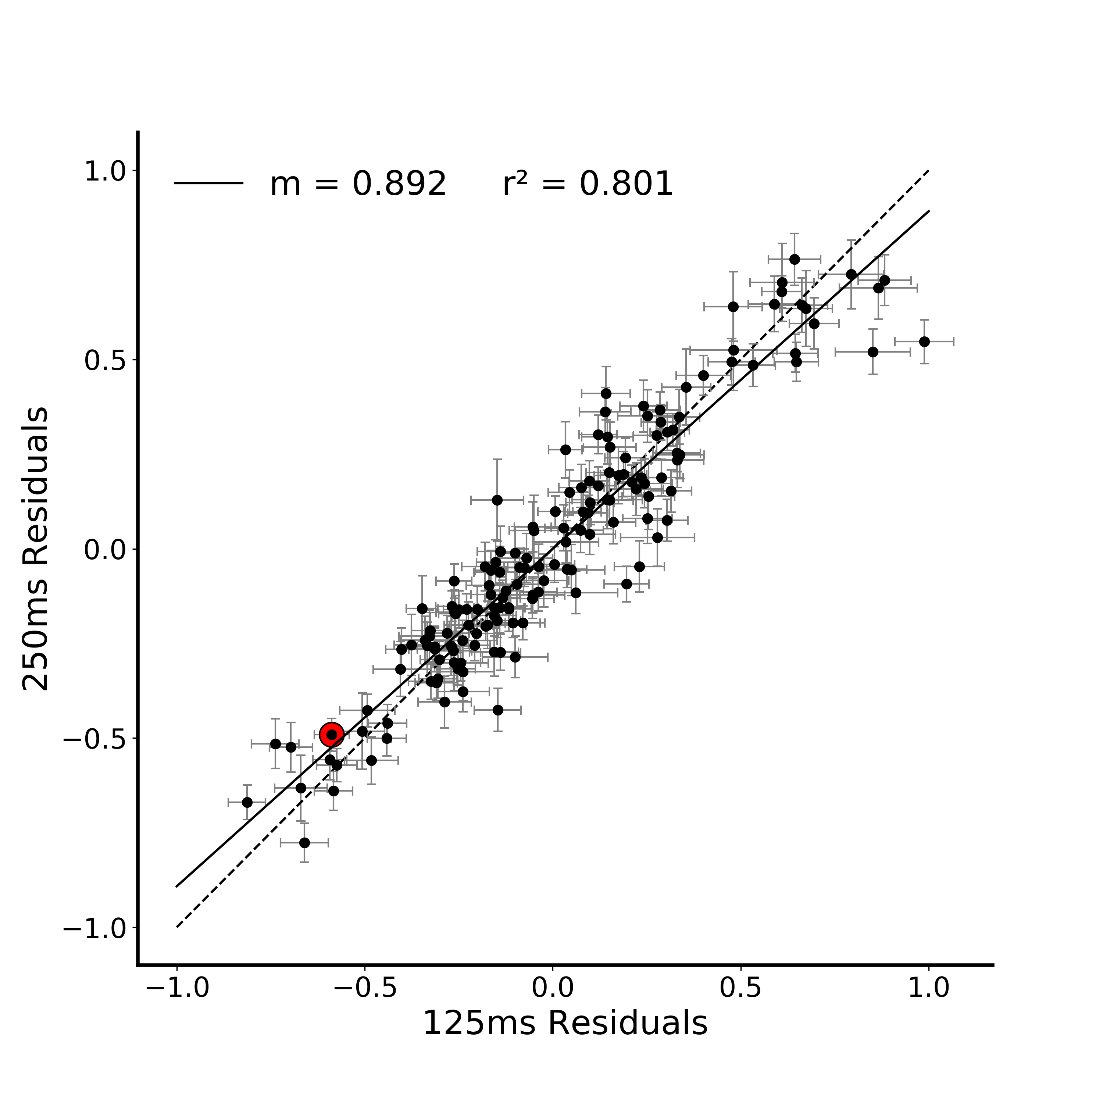
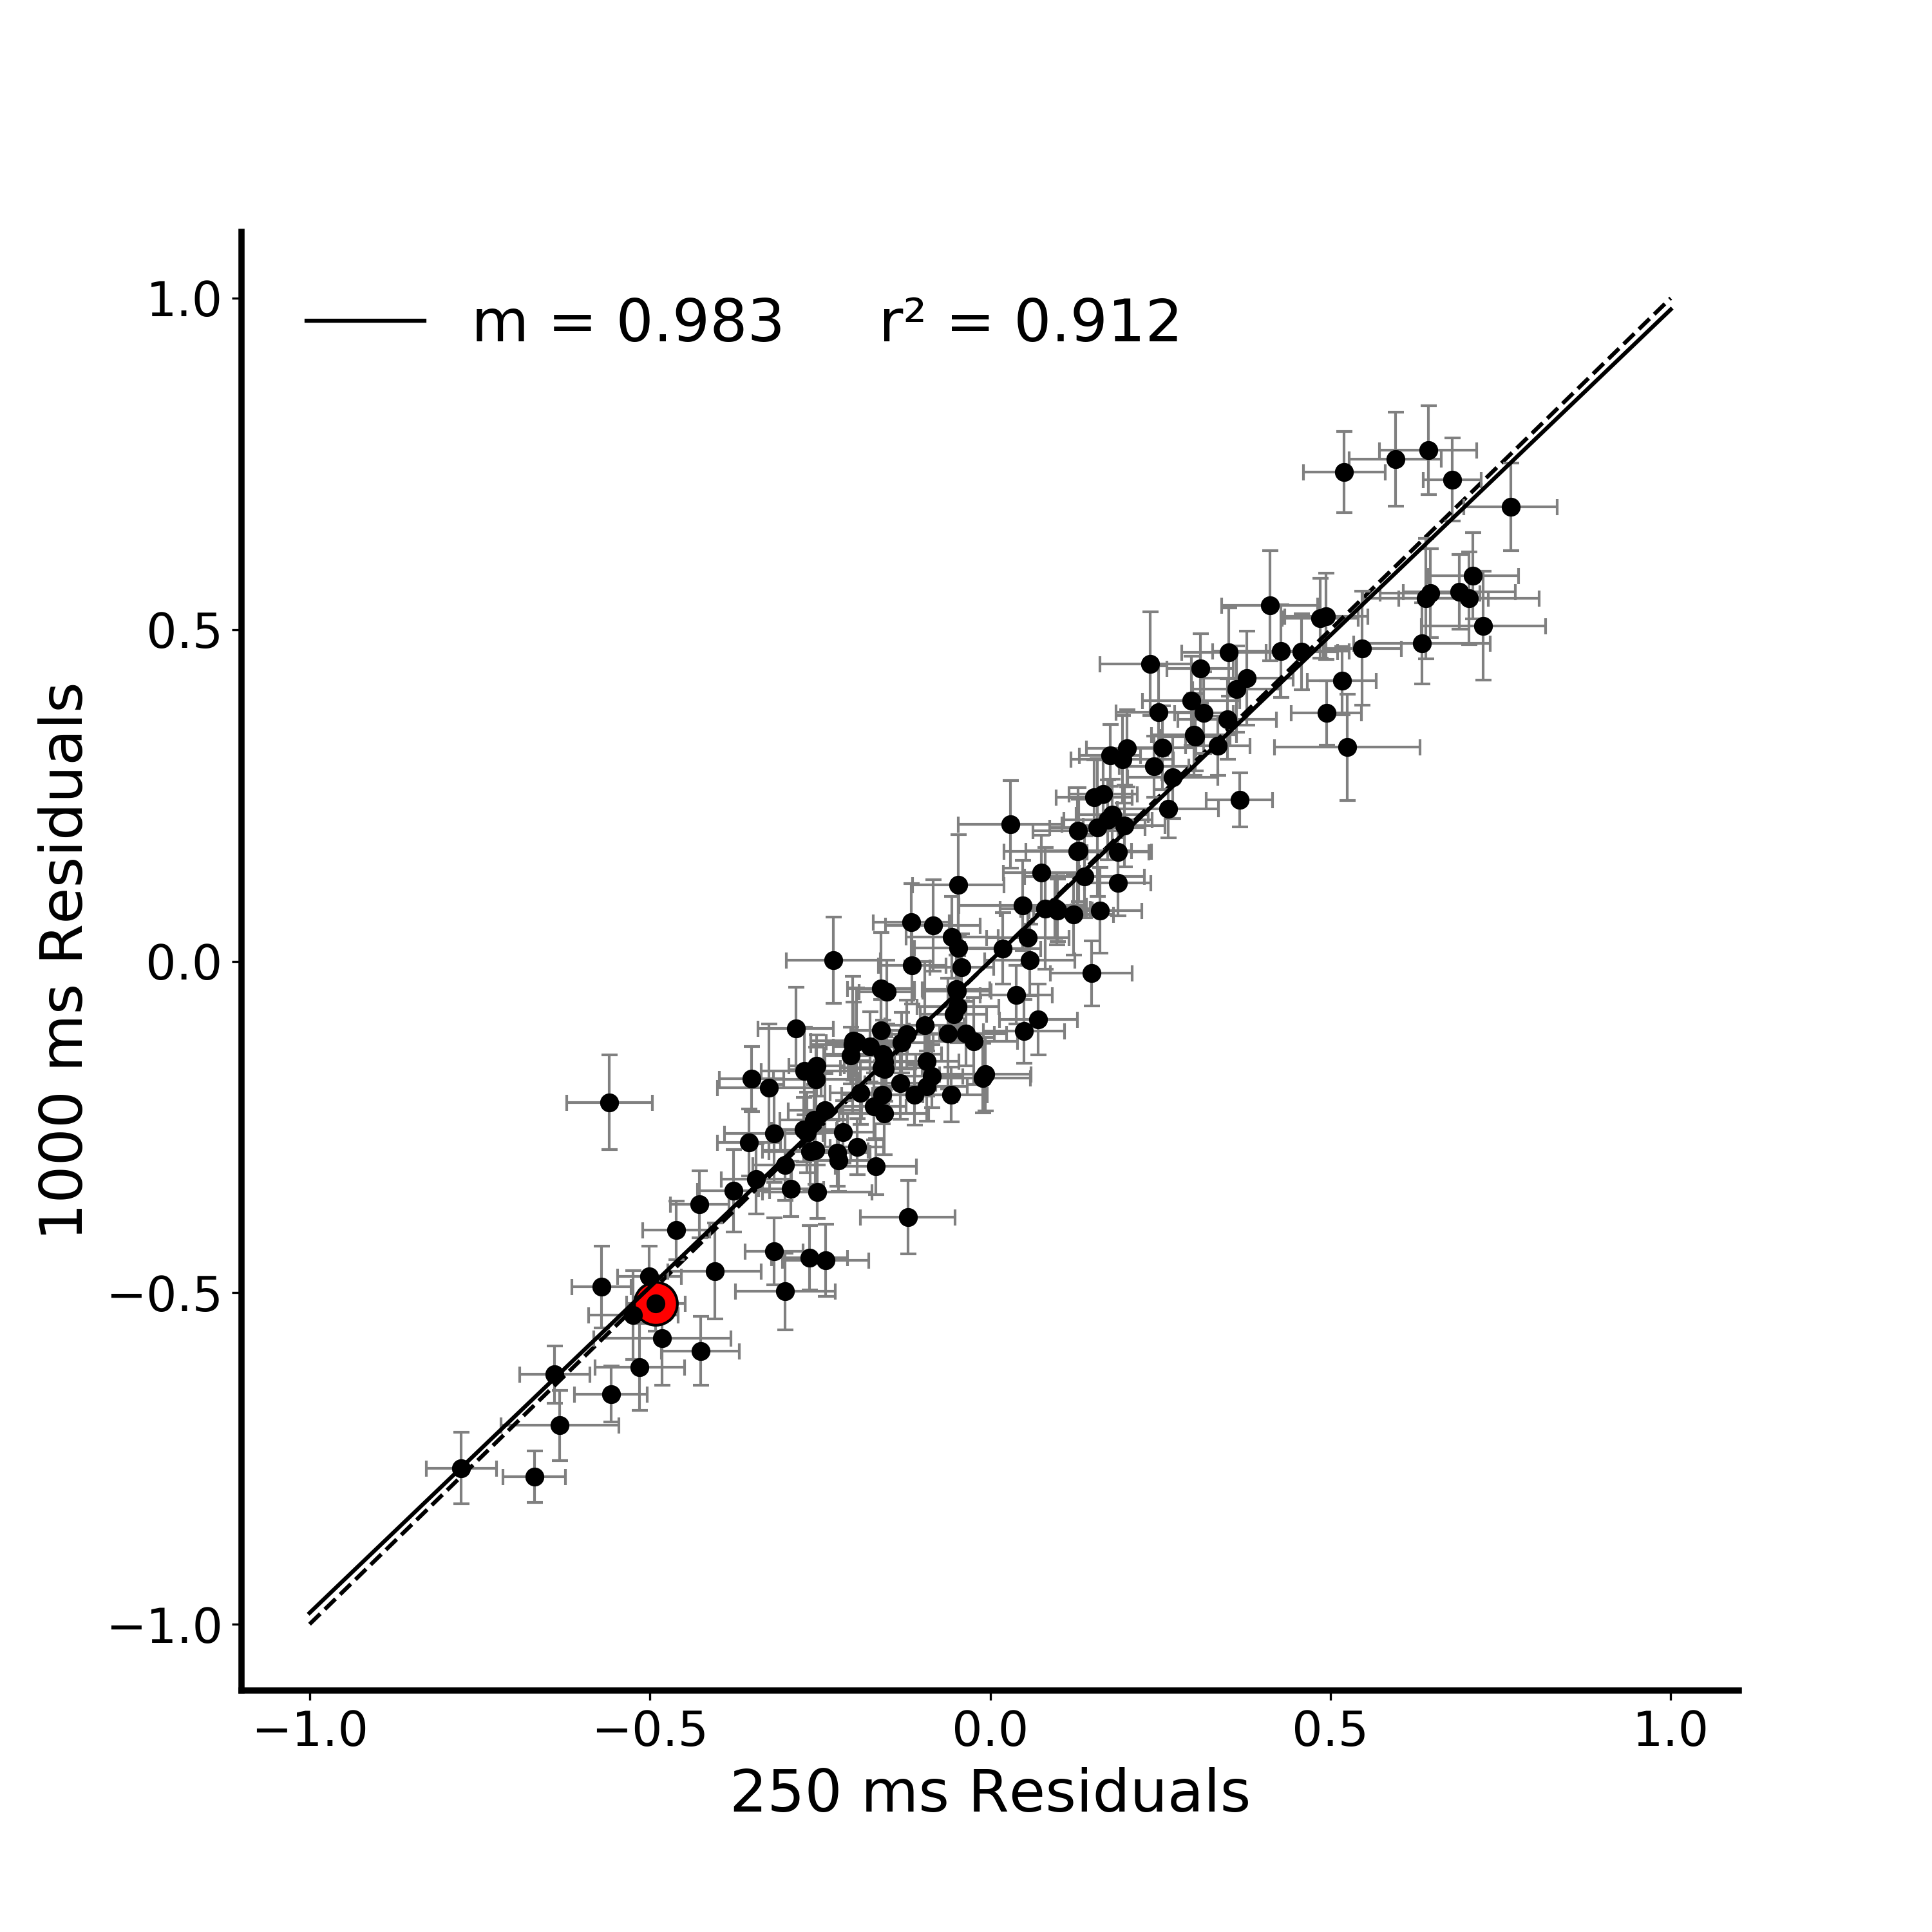
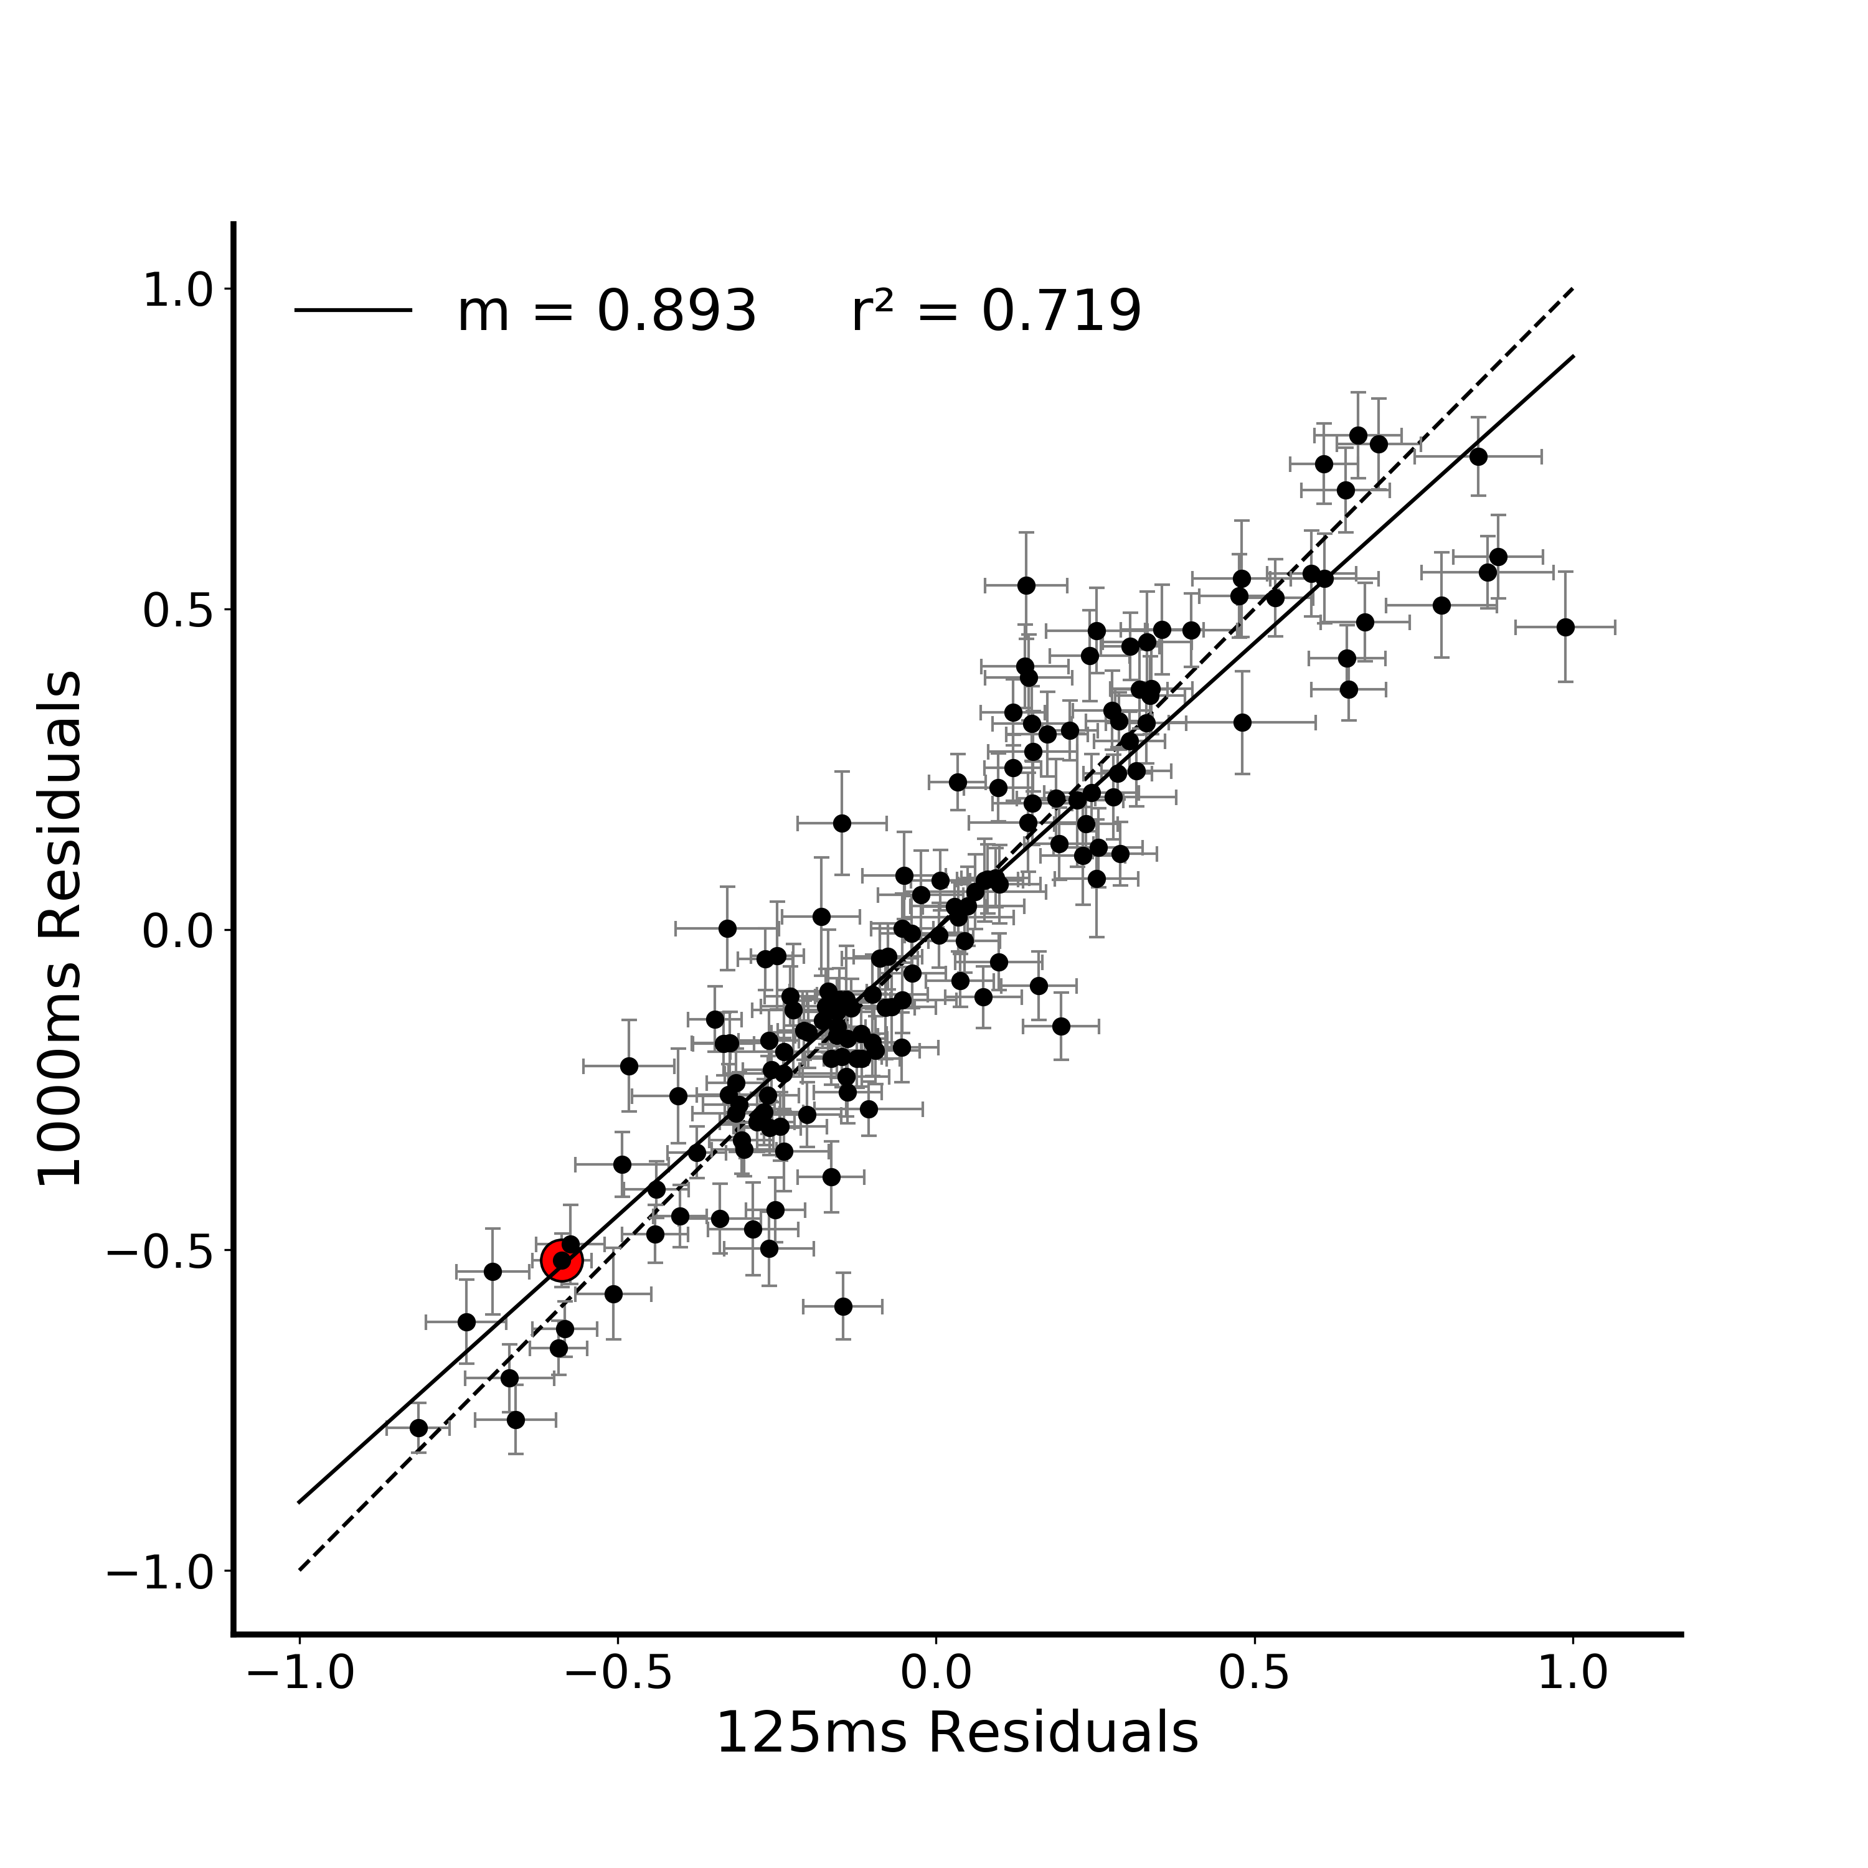
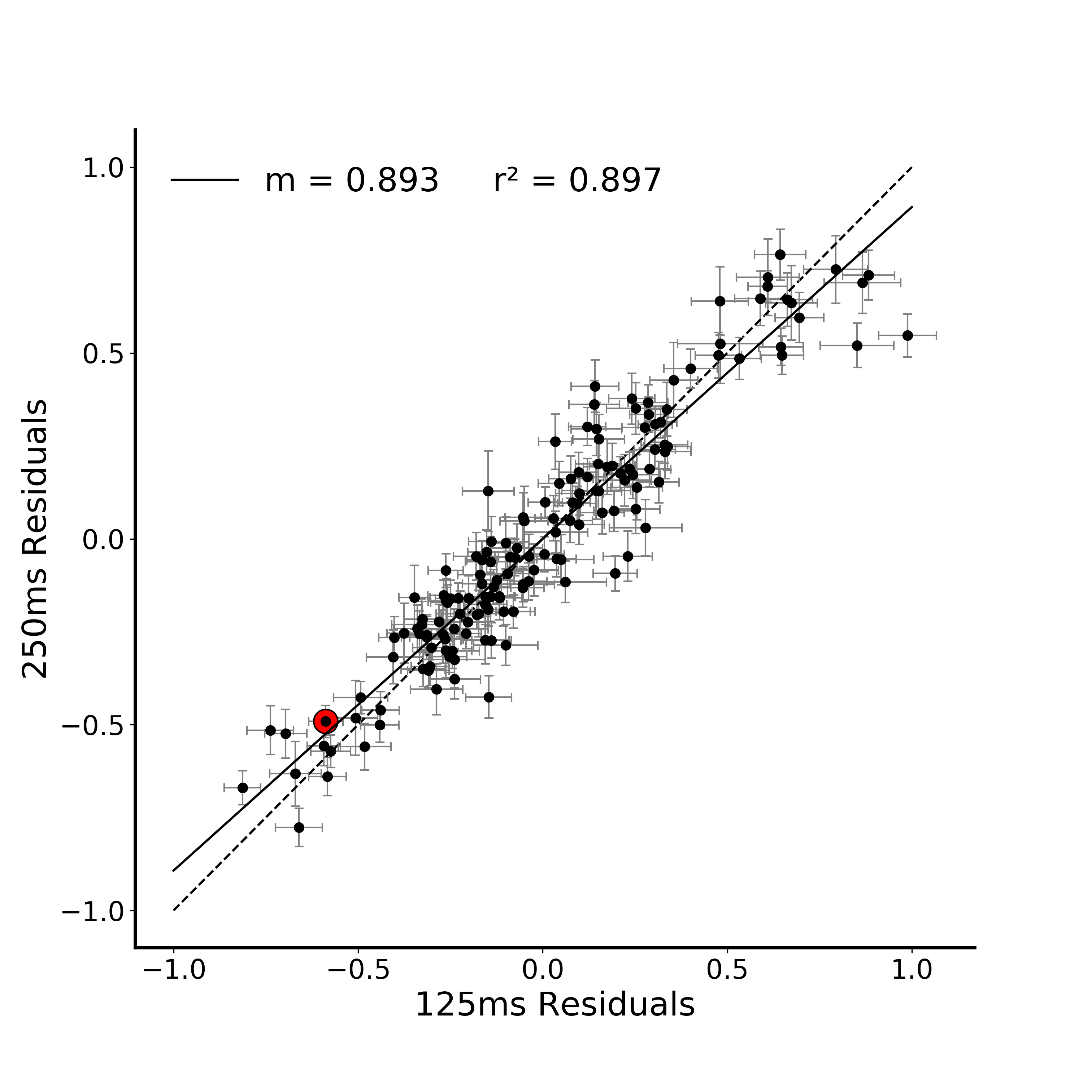


A.
*
**
B.
Notes:
DONE
Note temporal evolution here (250 and 1000 are basically identical)
Pairwise compareisons between the plots – Fischers r to z transform (linearlizes the r values)
http://vassarstats.net/rdiff.html

Slide 4
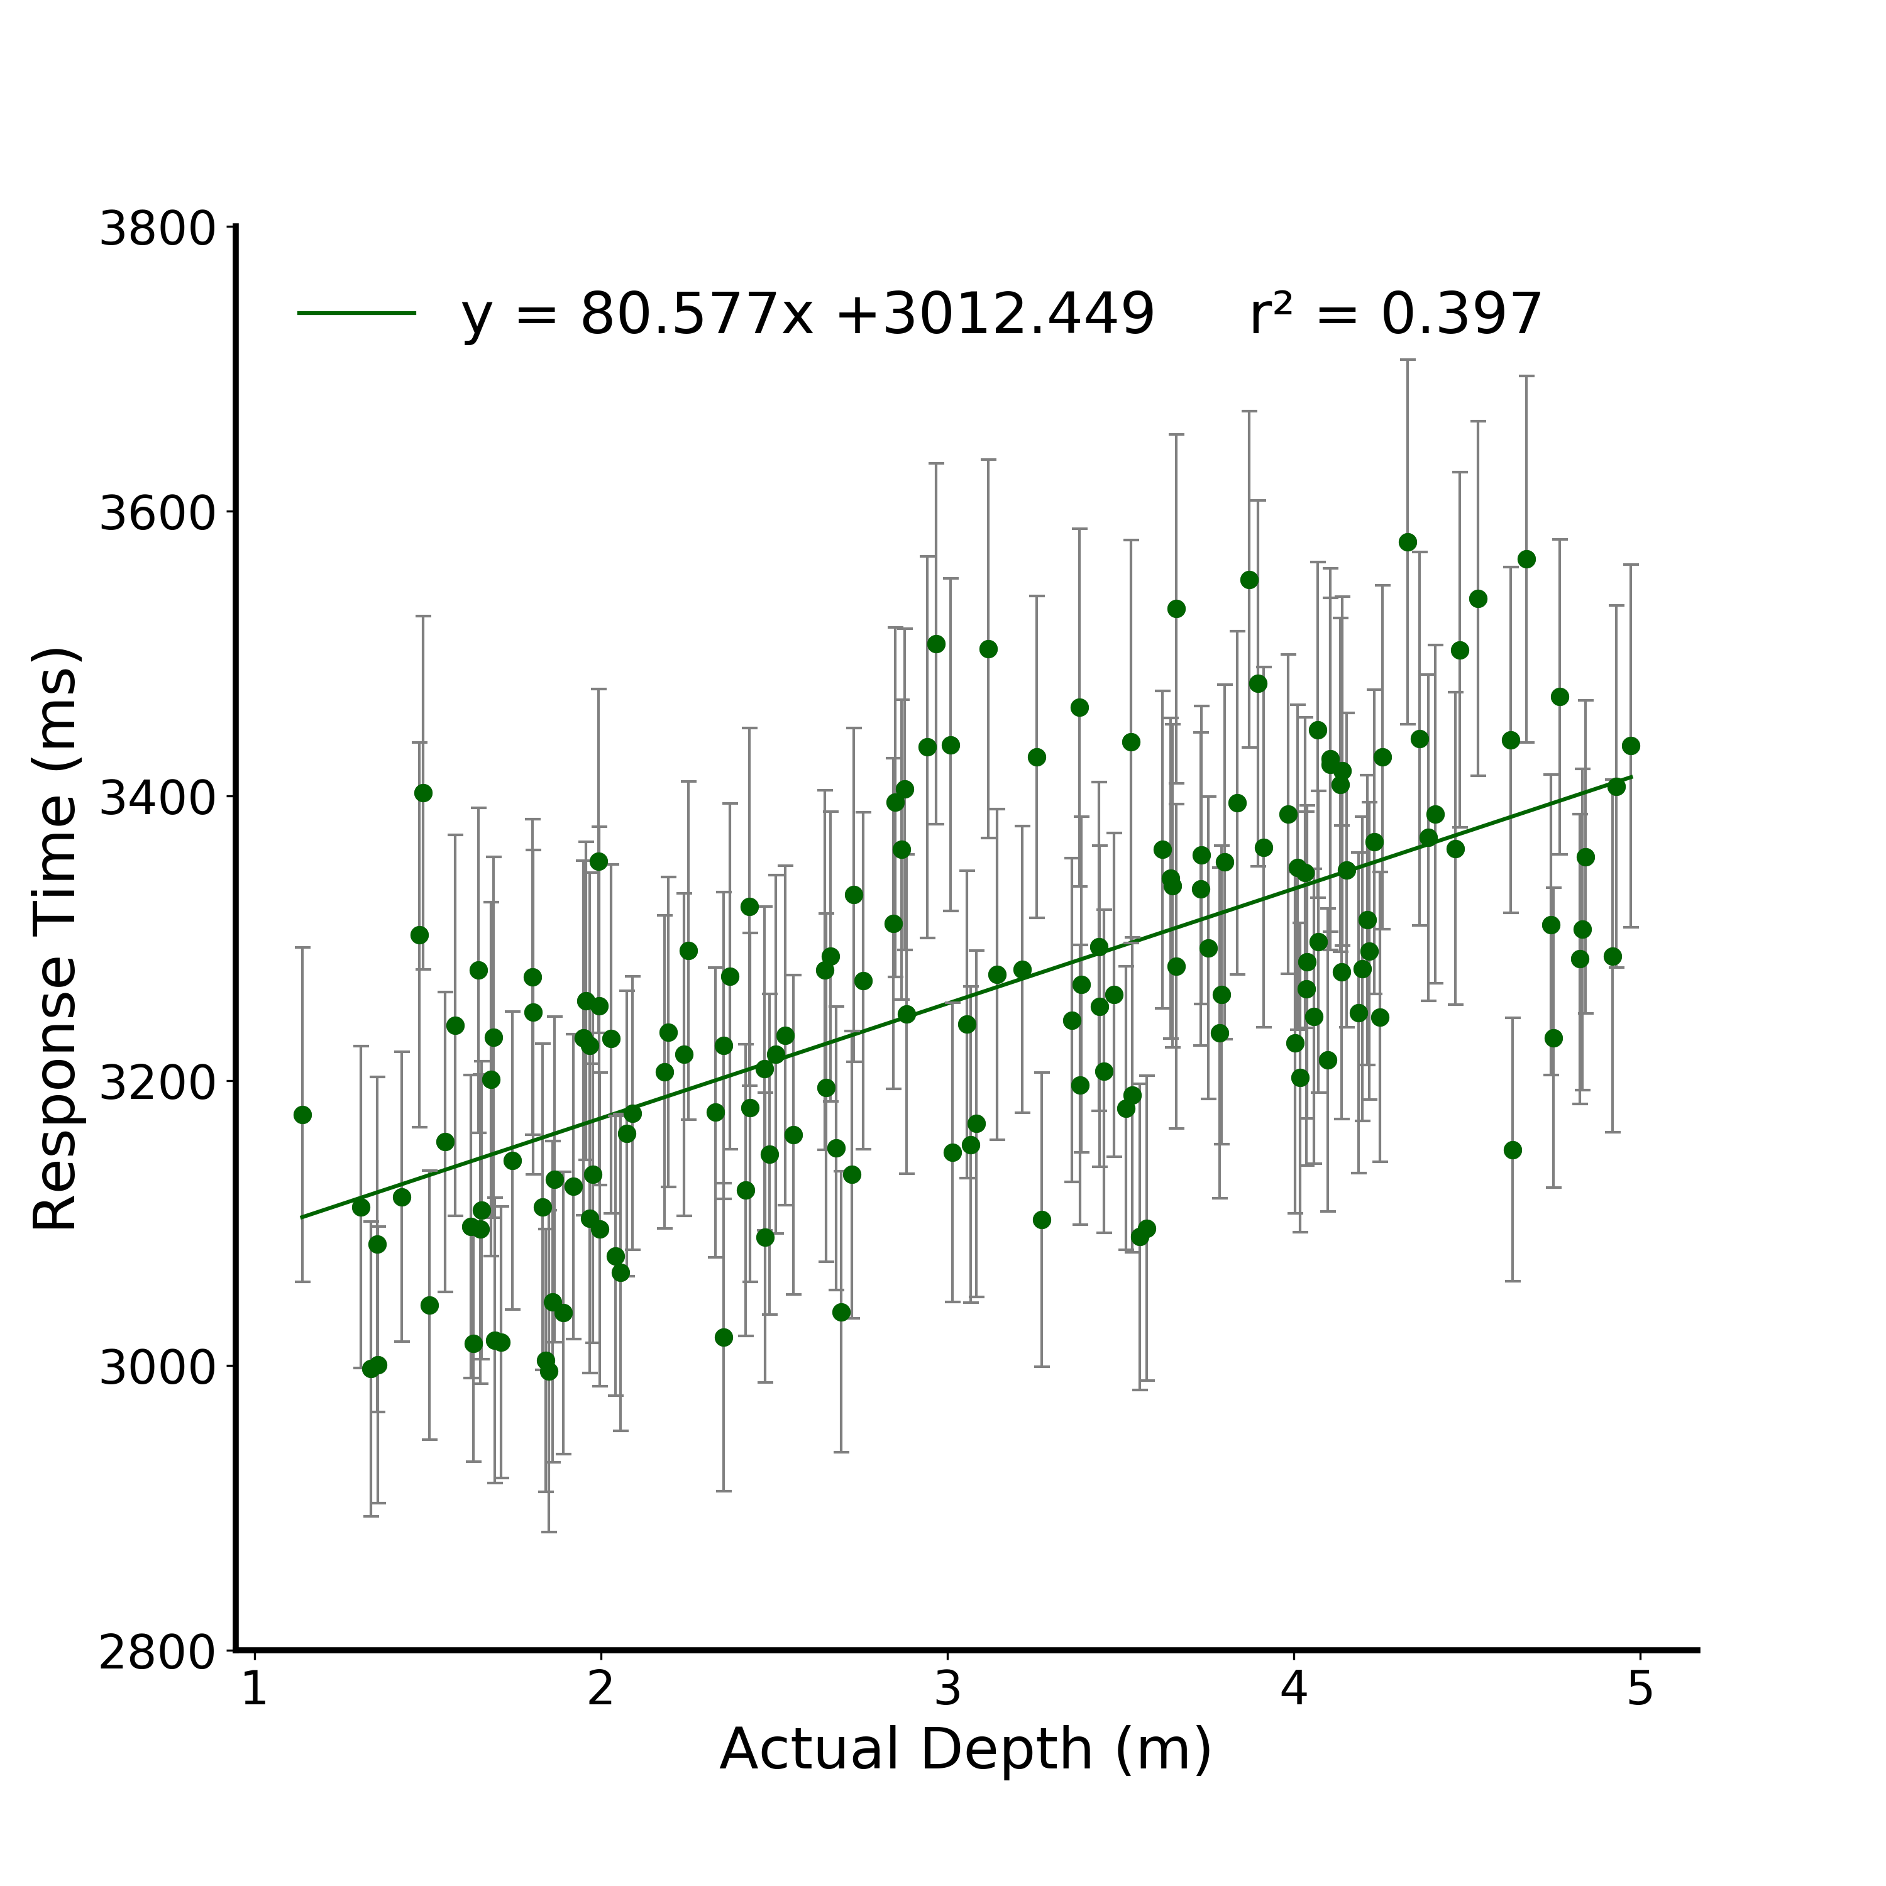


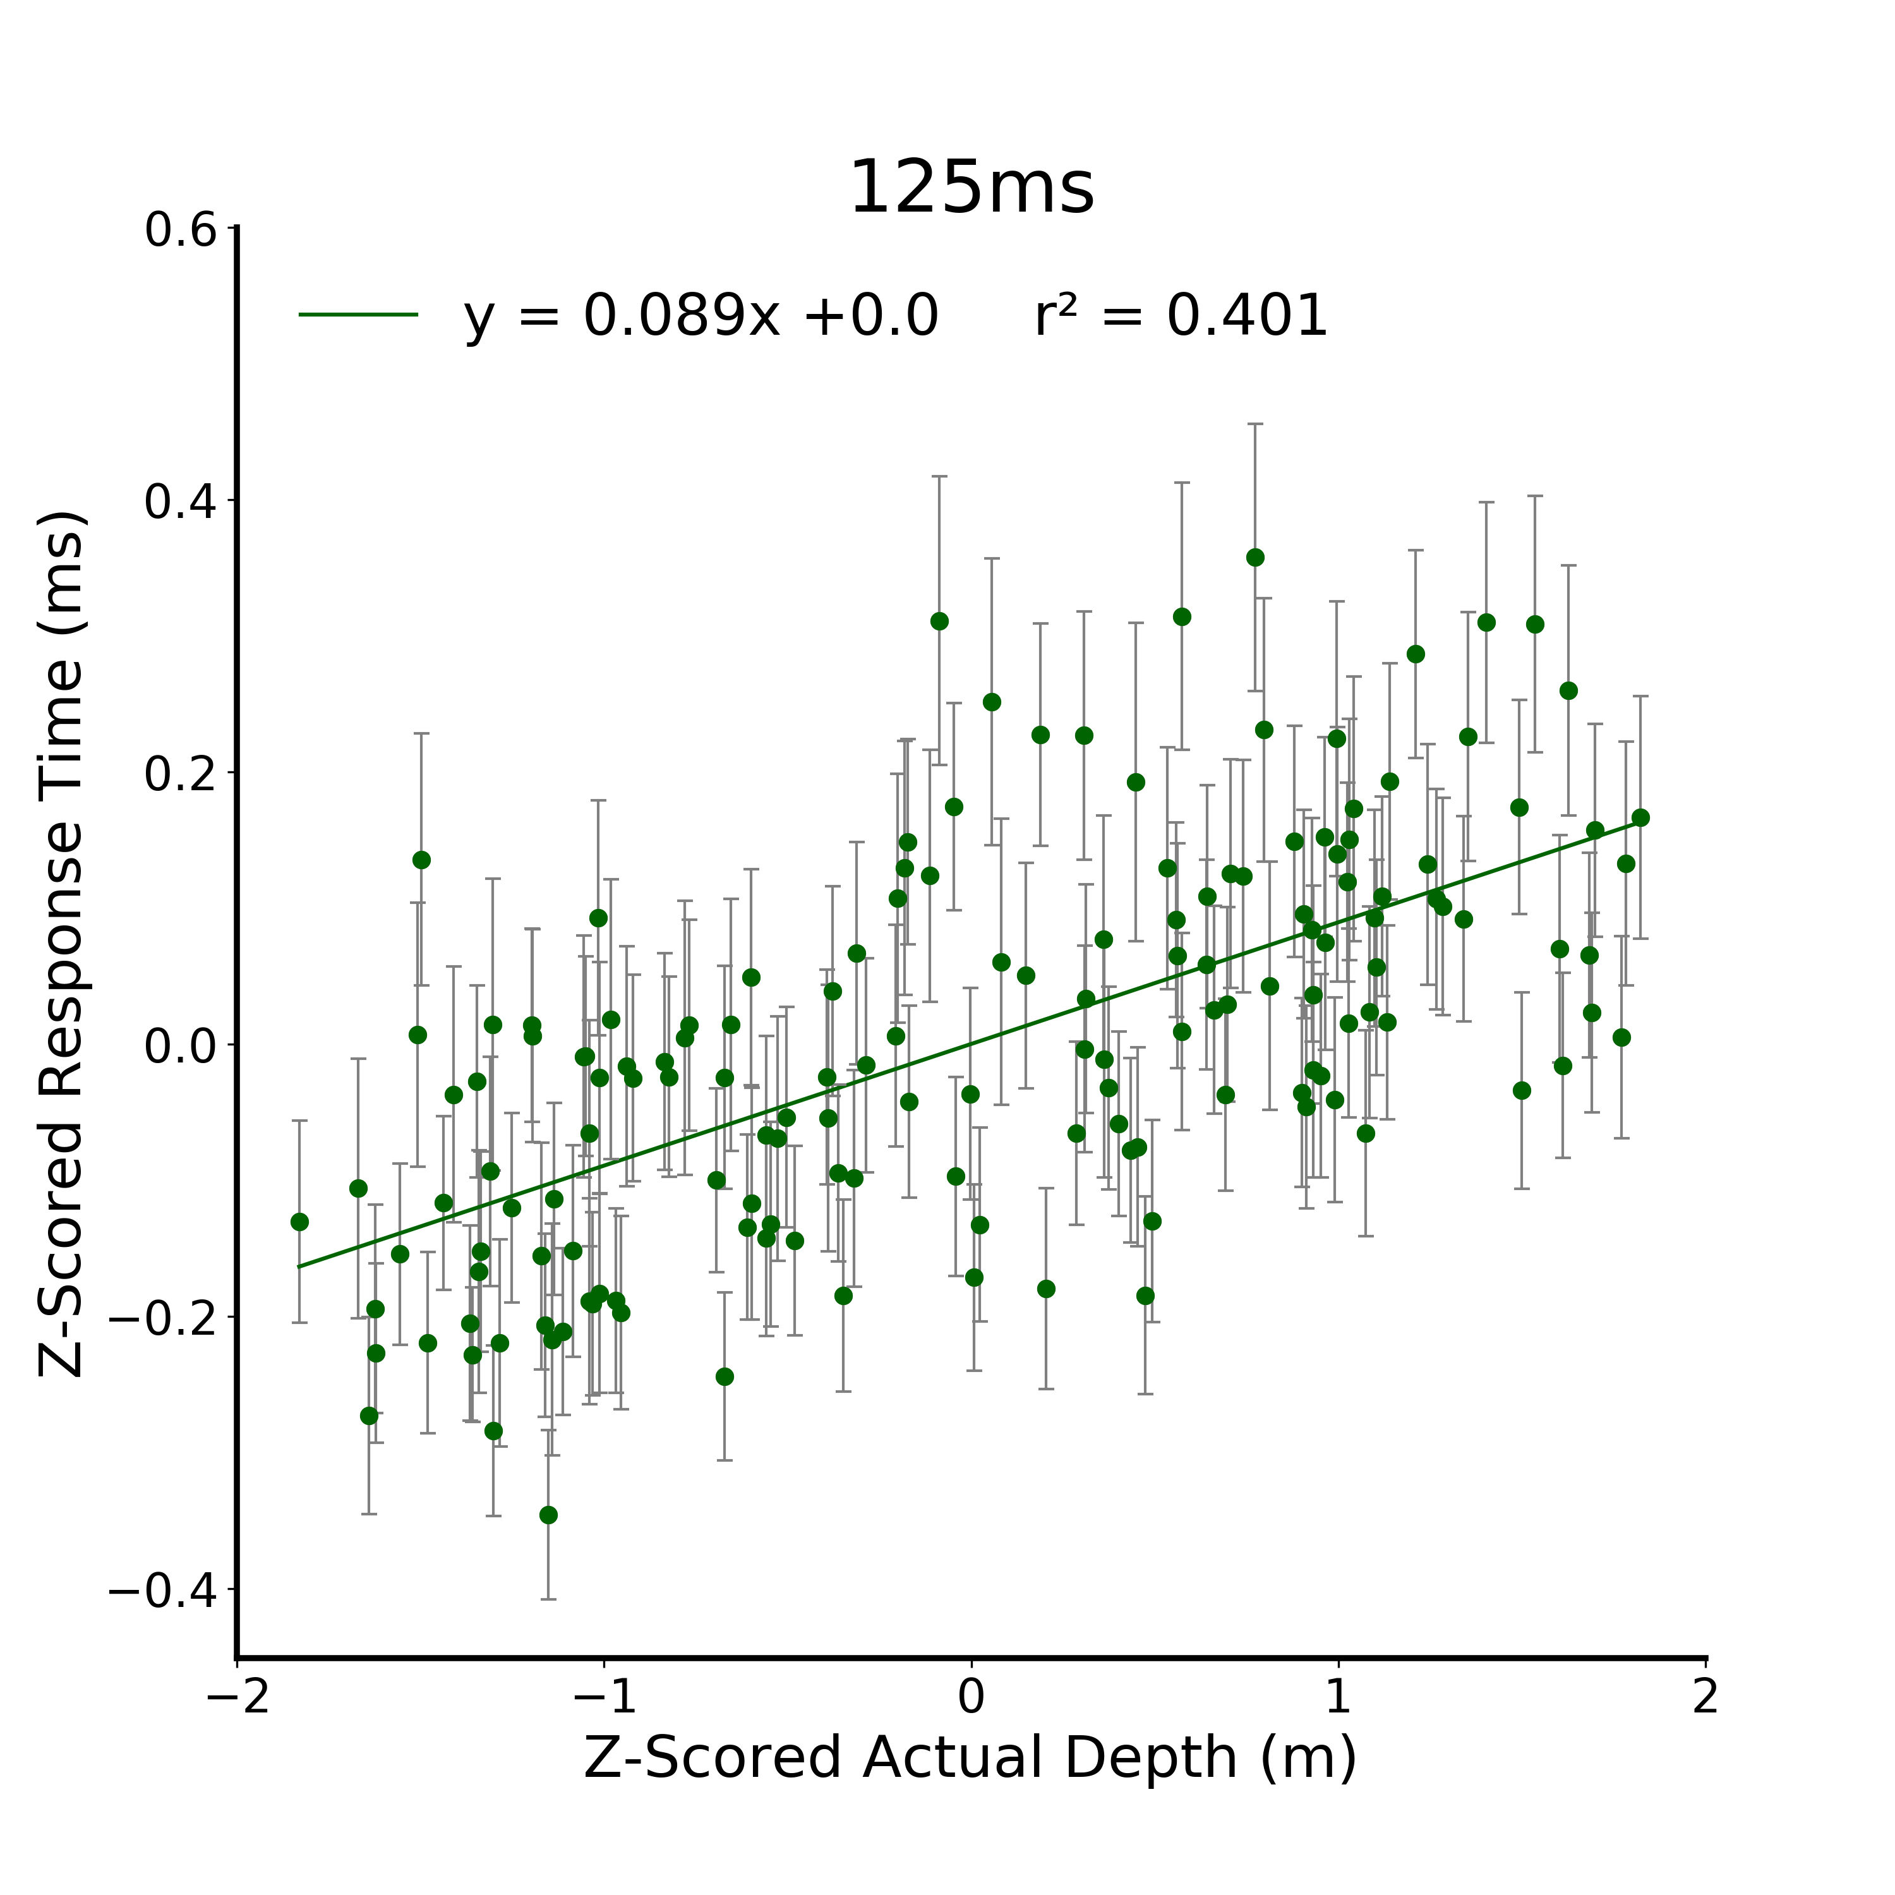
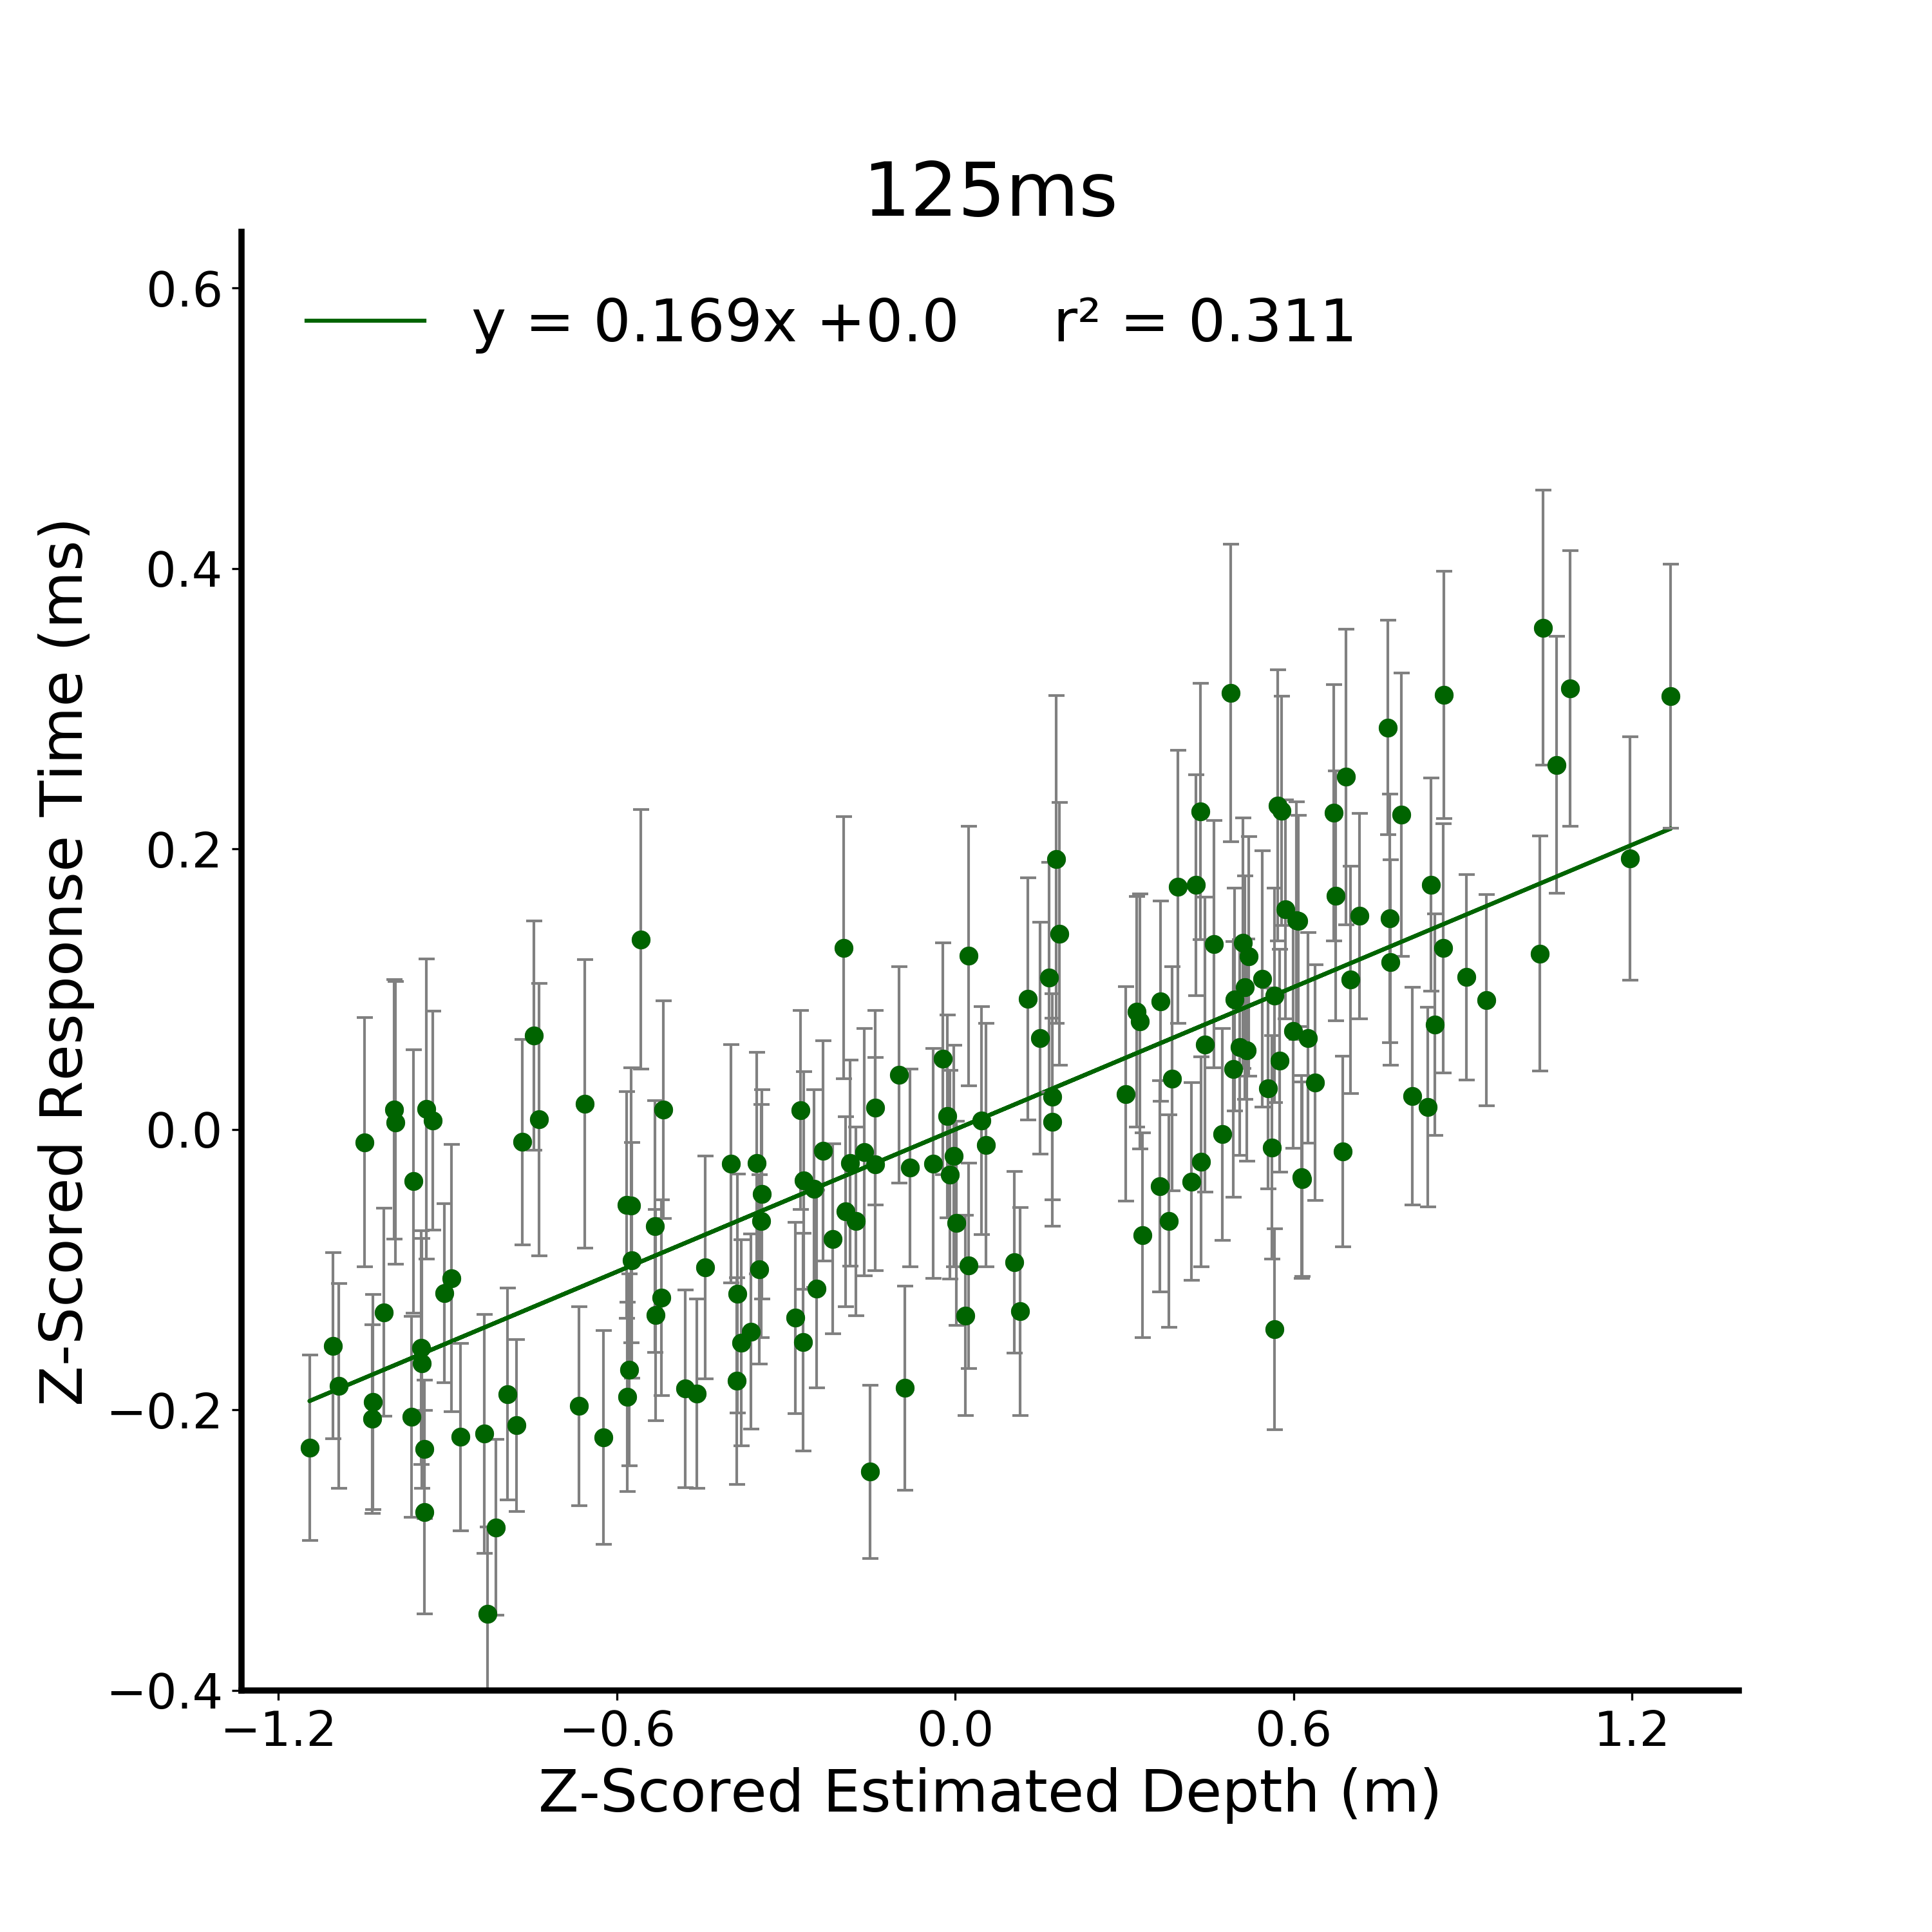

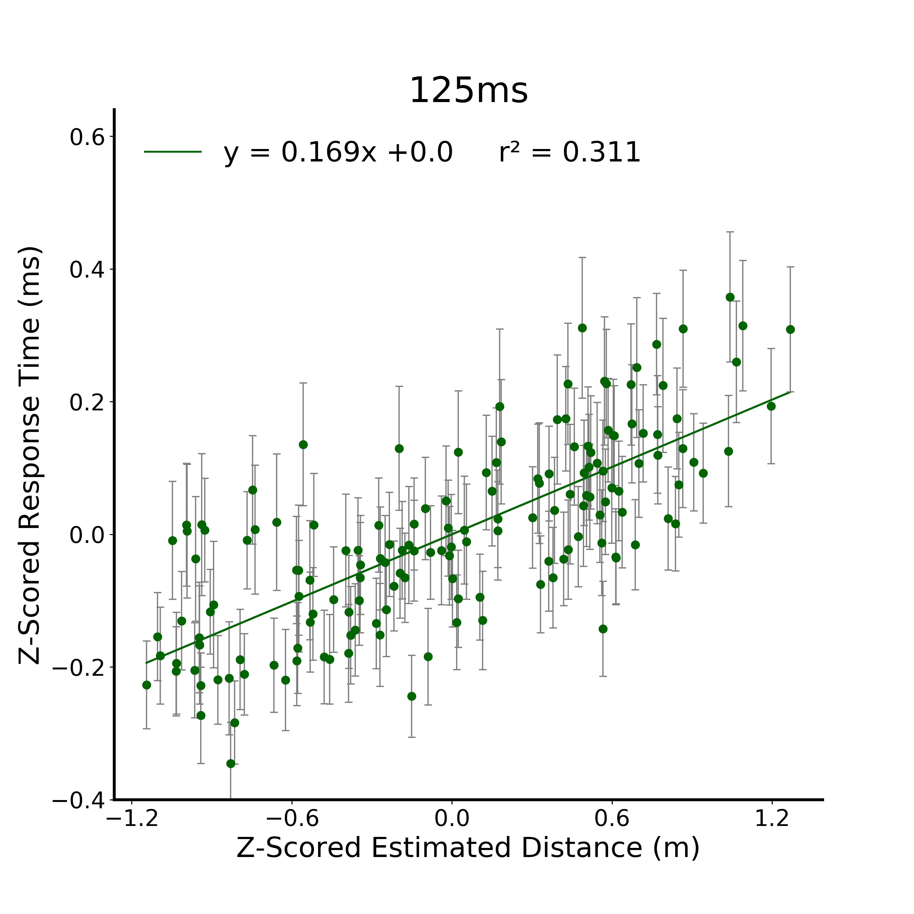
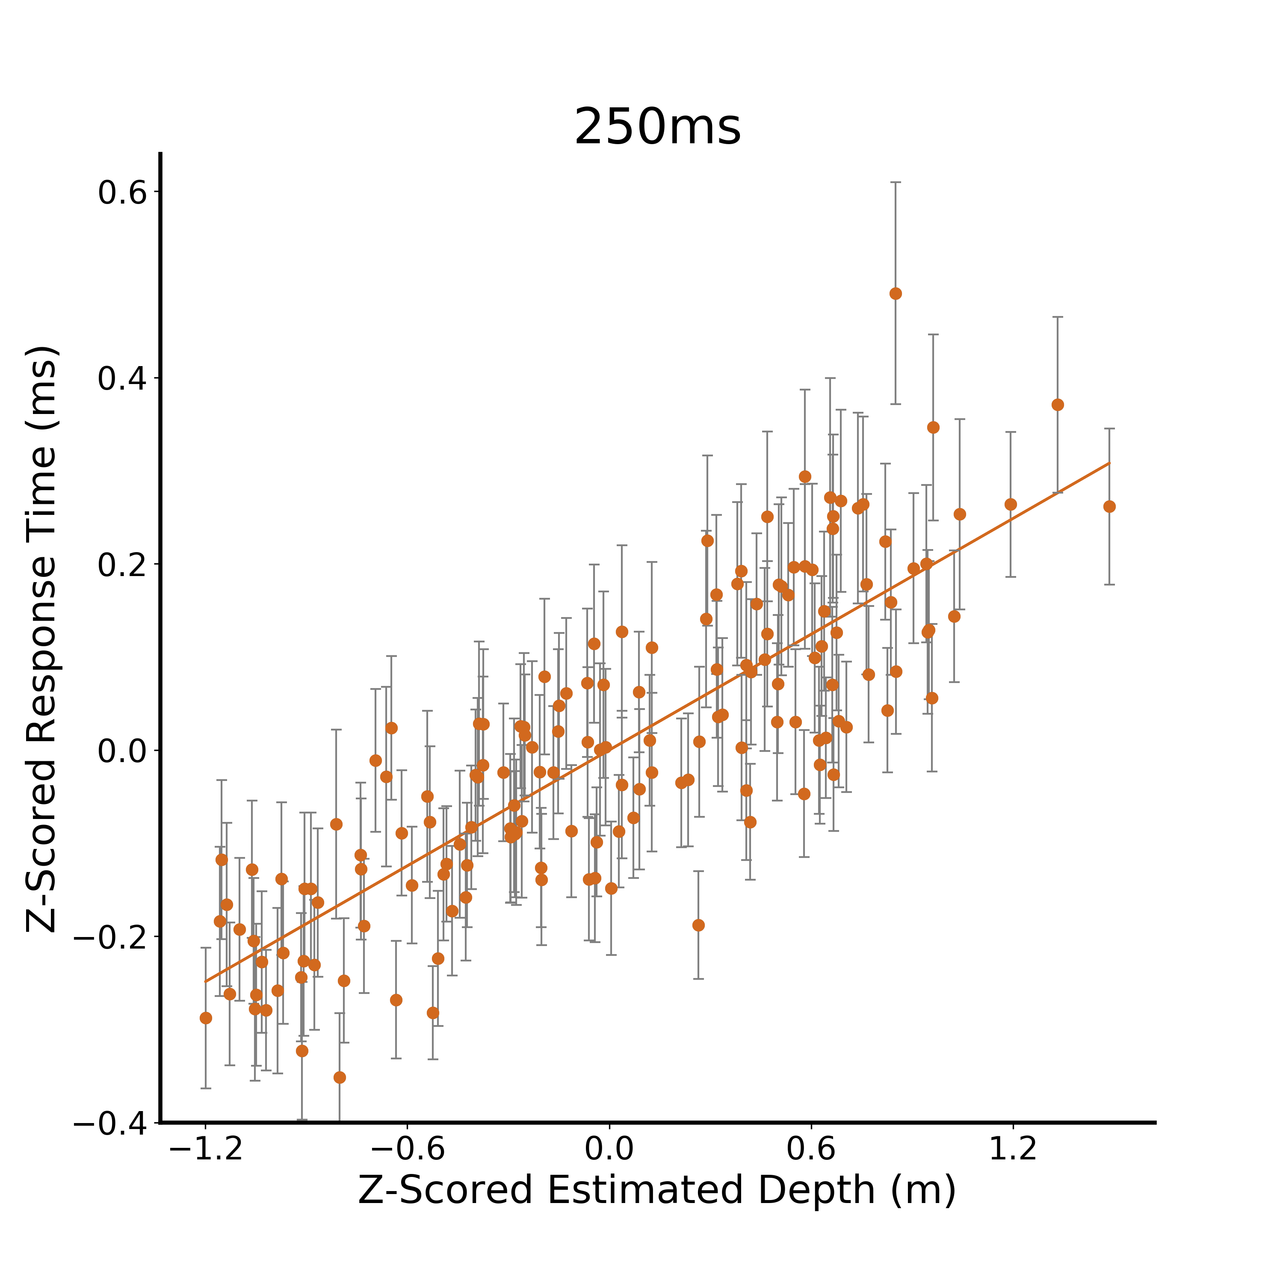
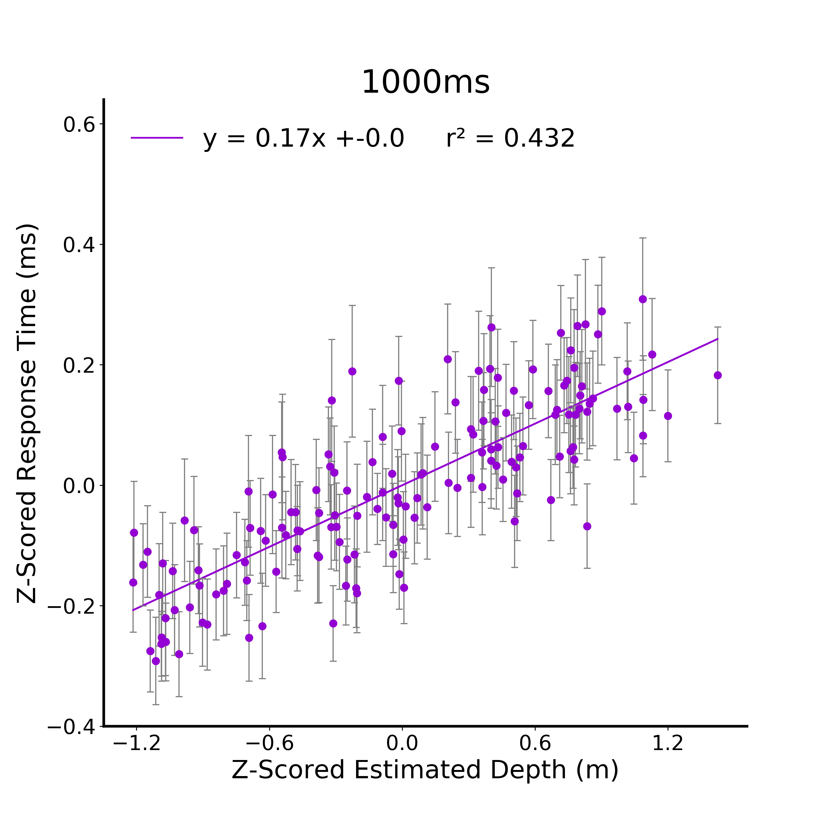
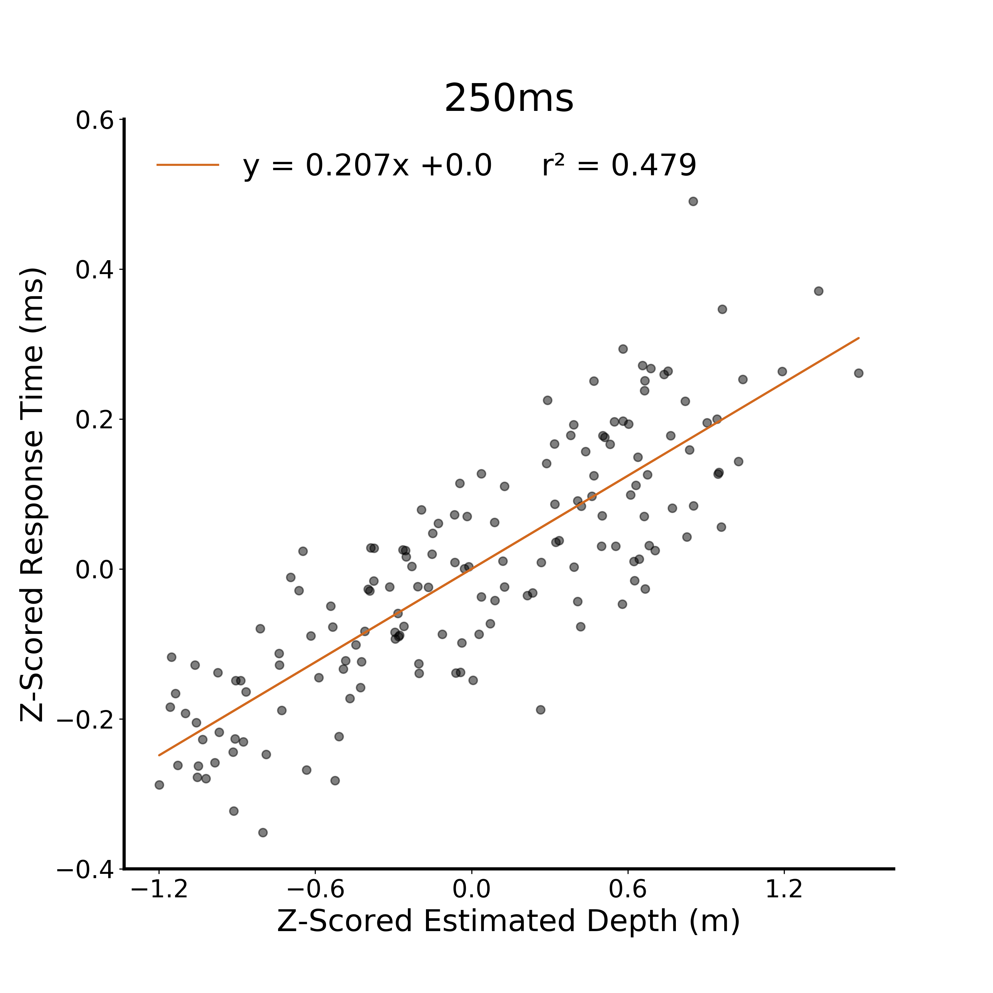
A.
B.
C.
D.
E.
Notes:
DONE

Slide 5
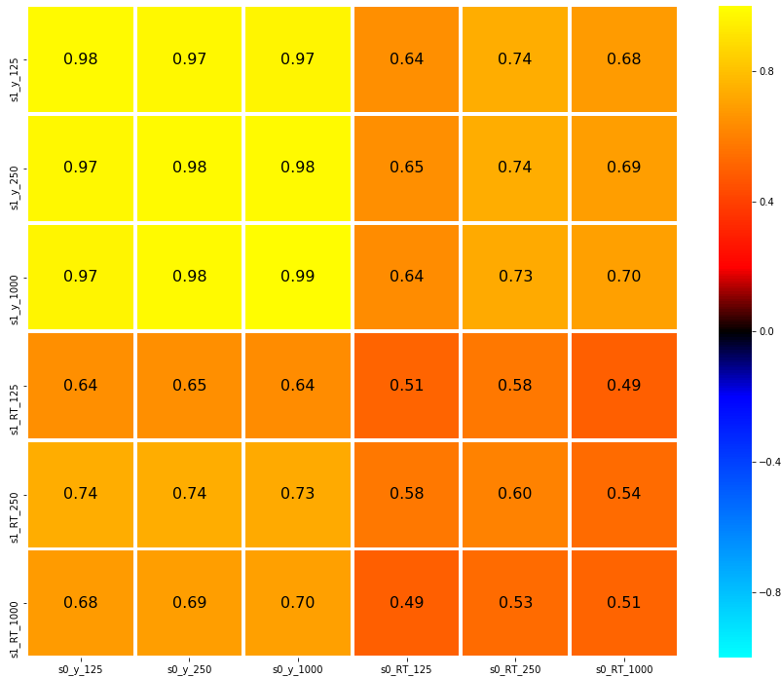
125
0.8
Distance Estimate
250
0.4
1000
0.16
*
Correlation
0
125
- 0.16
*
Response Time
- 0.4
250
1000
- 0.8
125
250
1000
125
250
1000
Distance Estimate
Response Time
Notes:
DONE

Slide 6
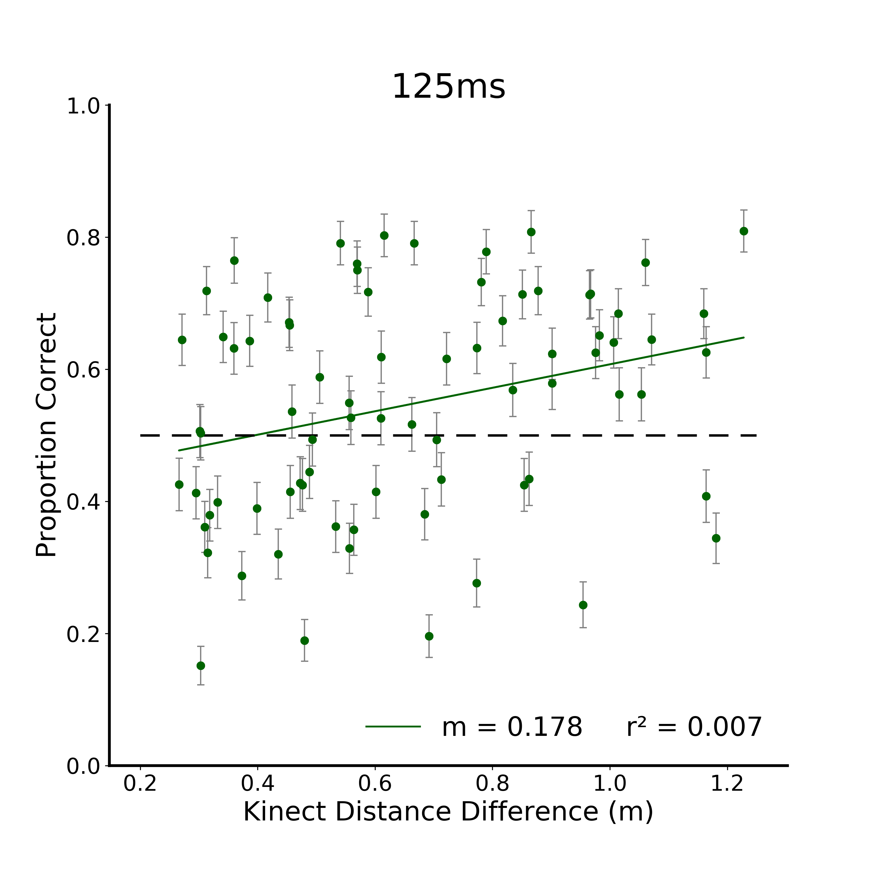
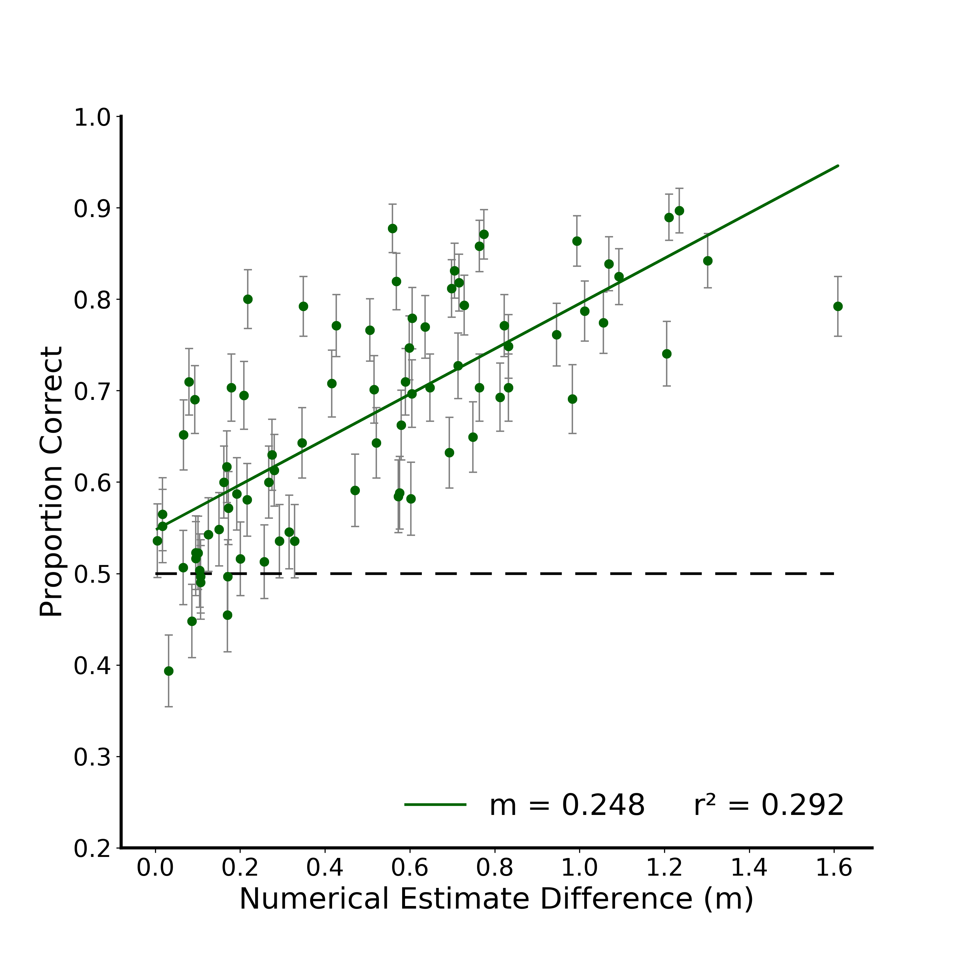

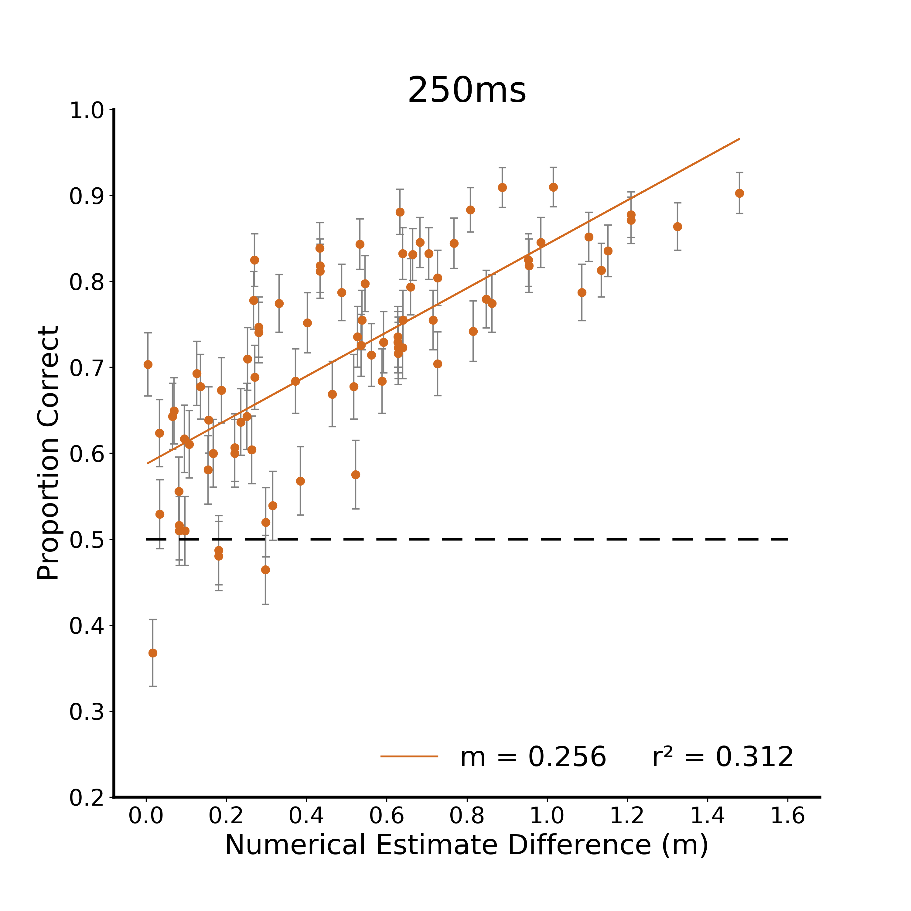
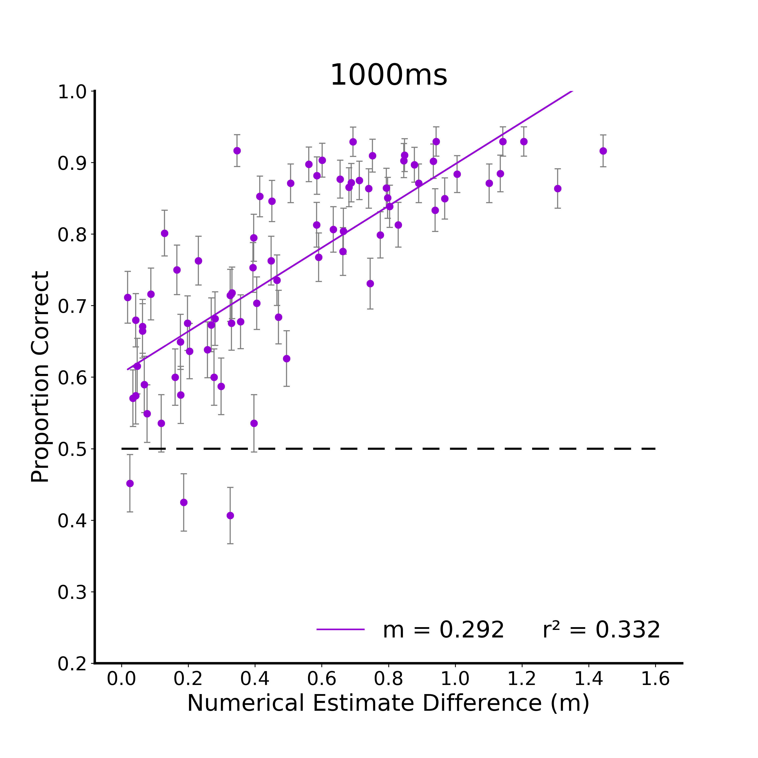
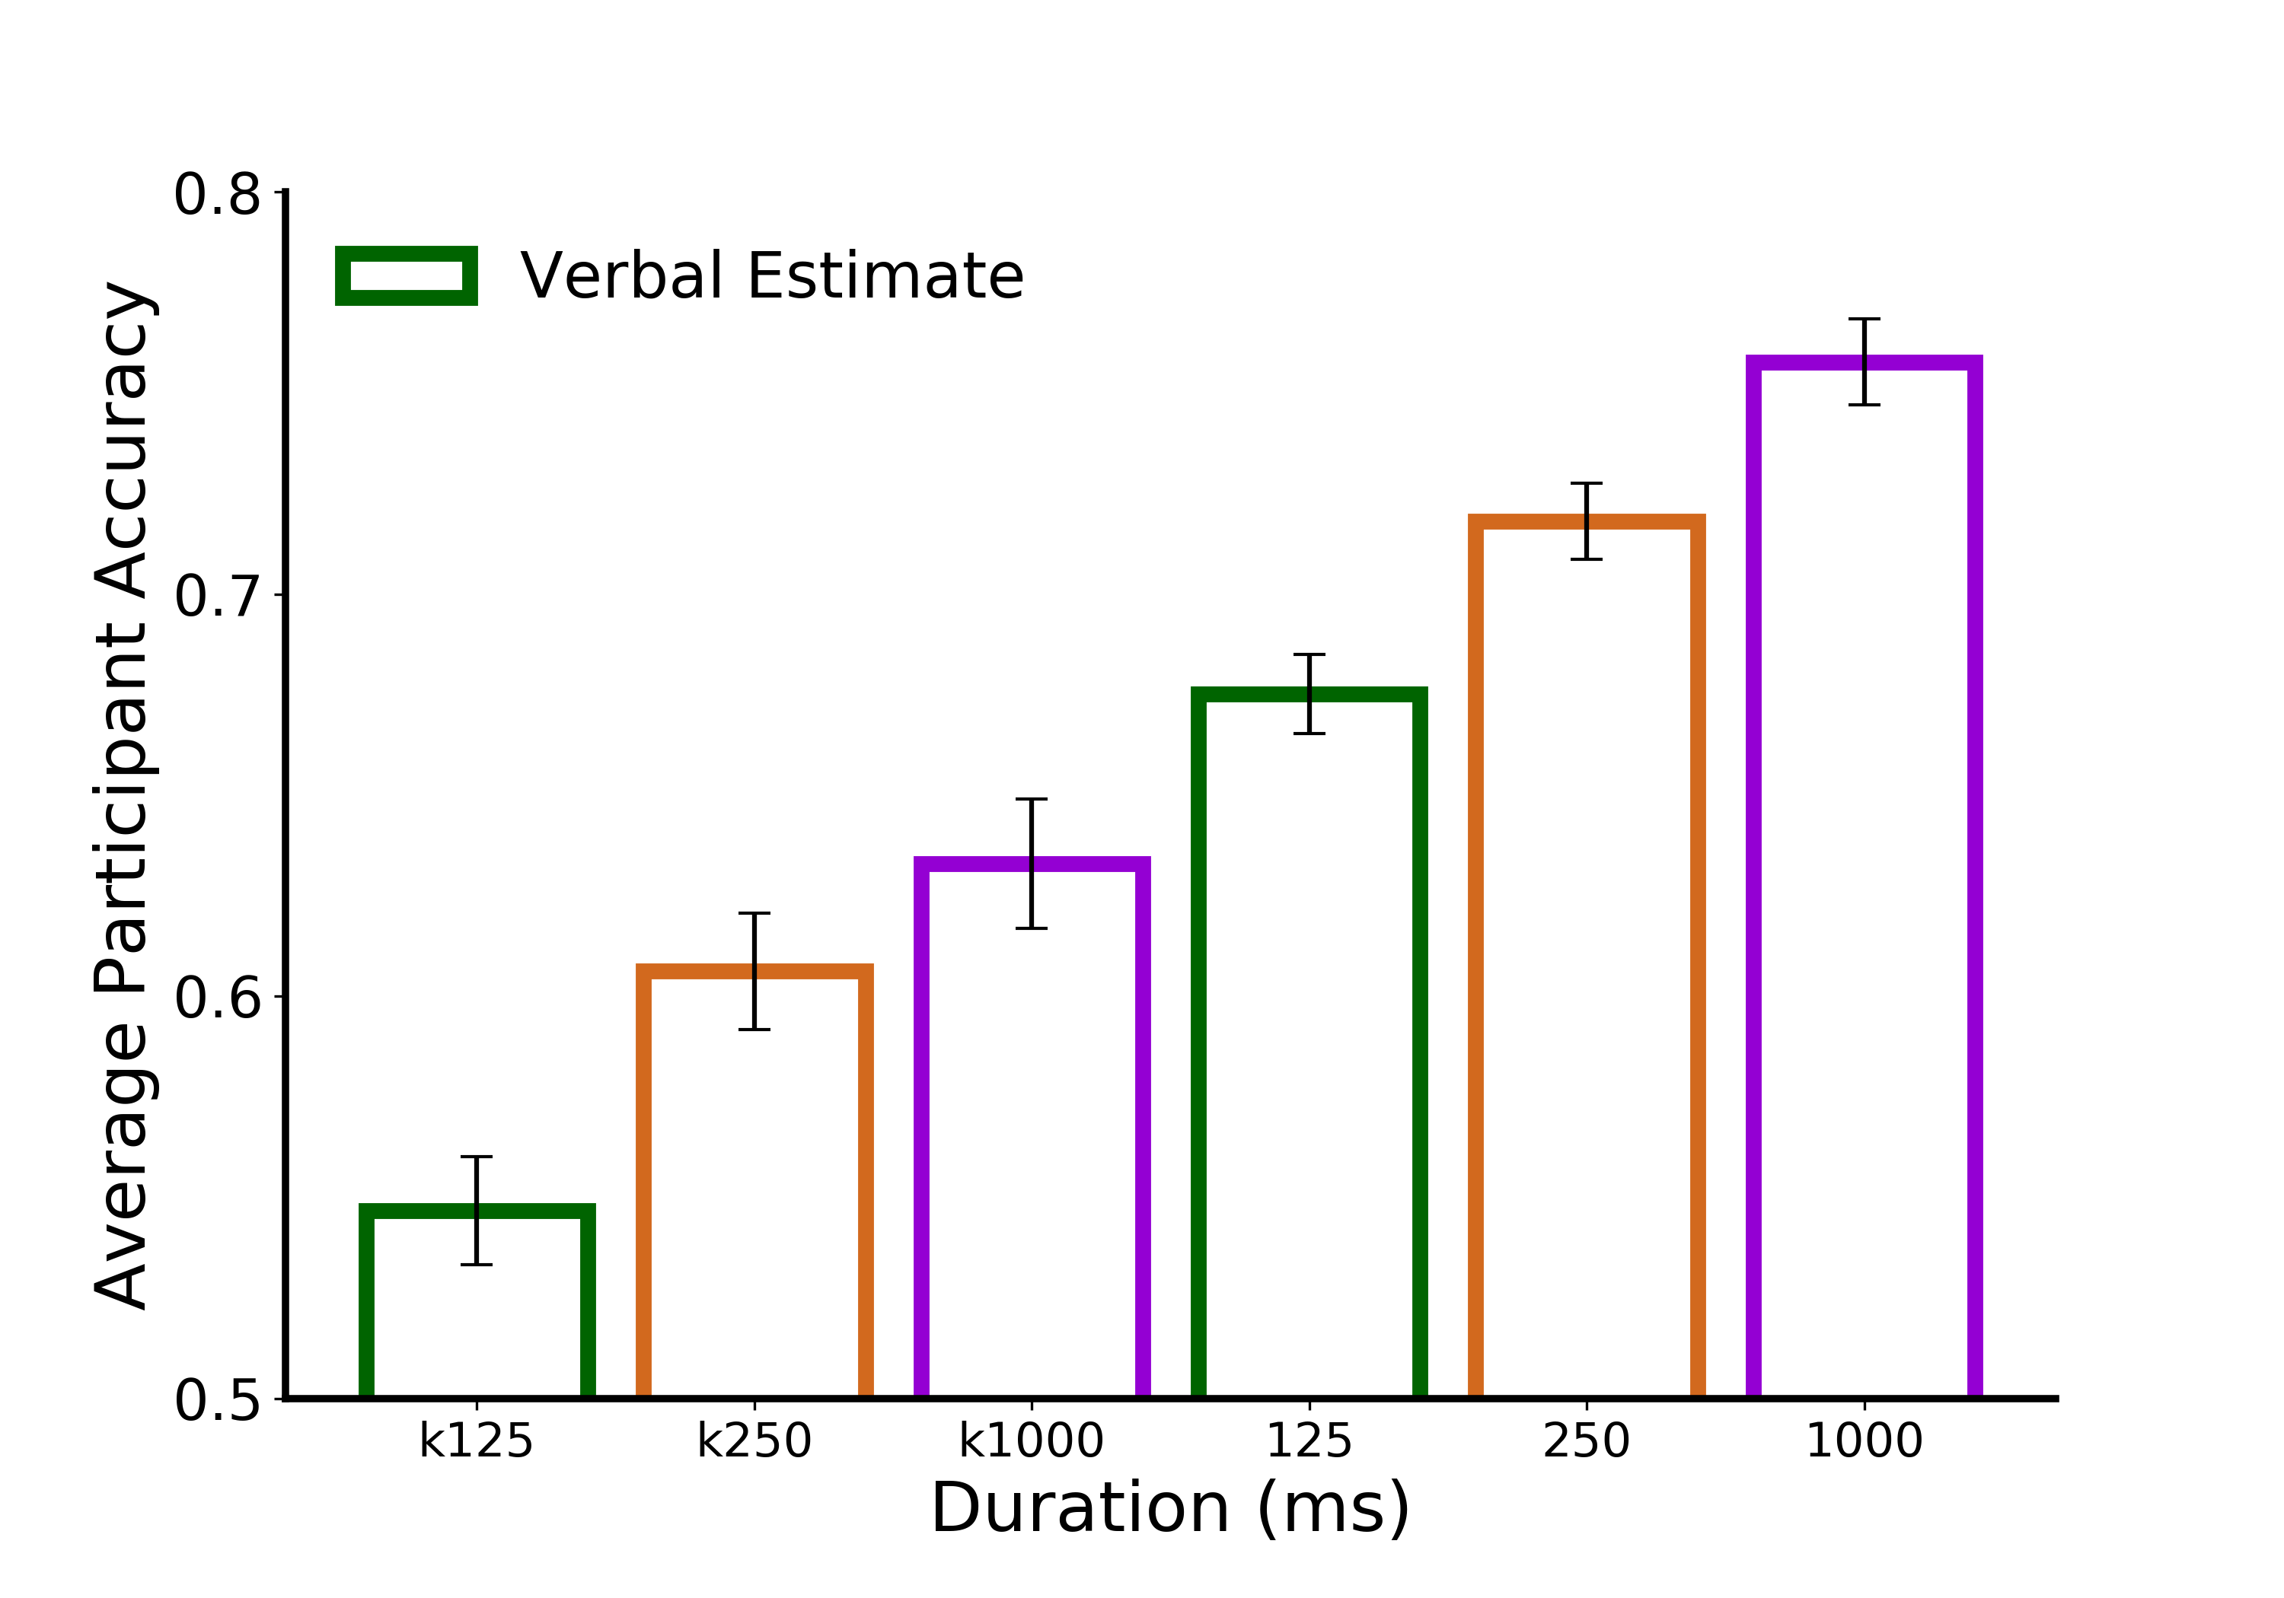
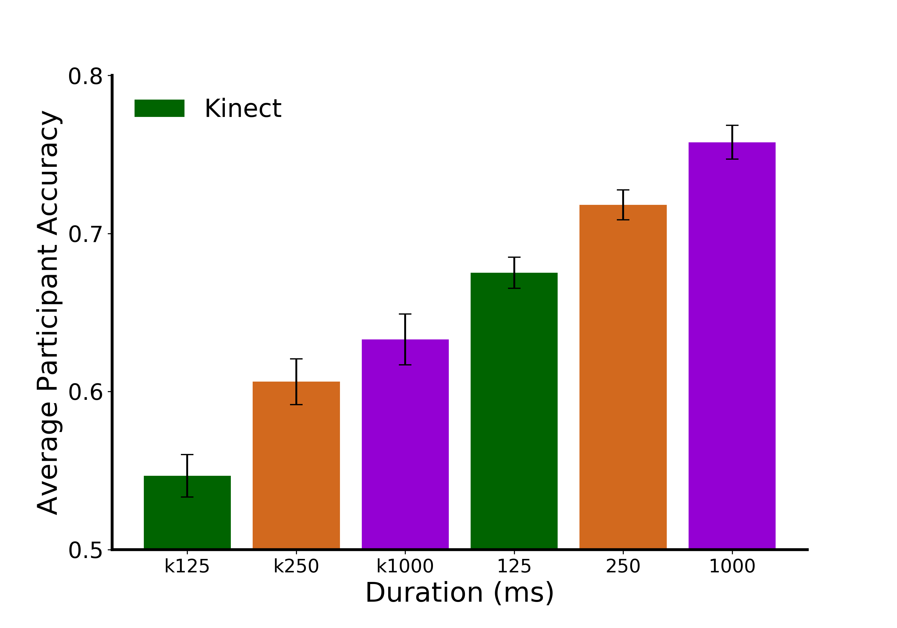
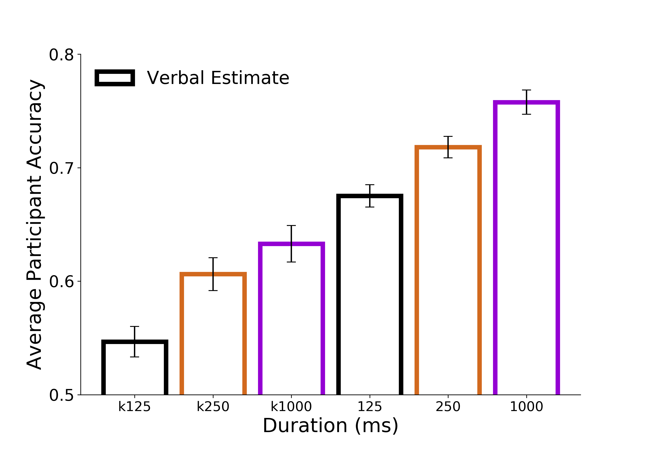
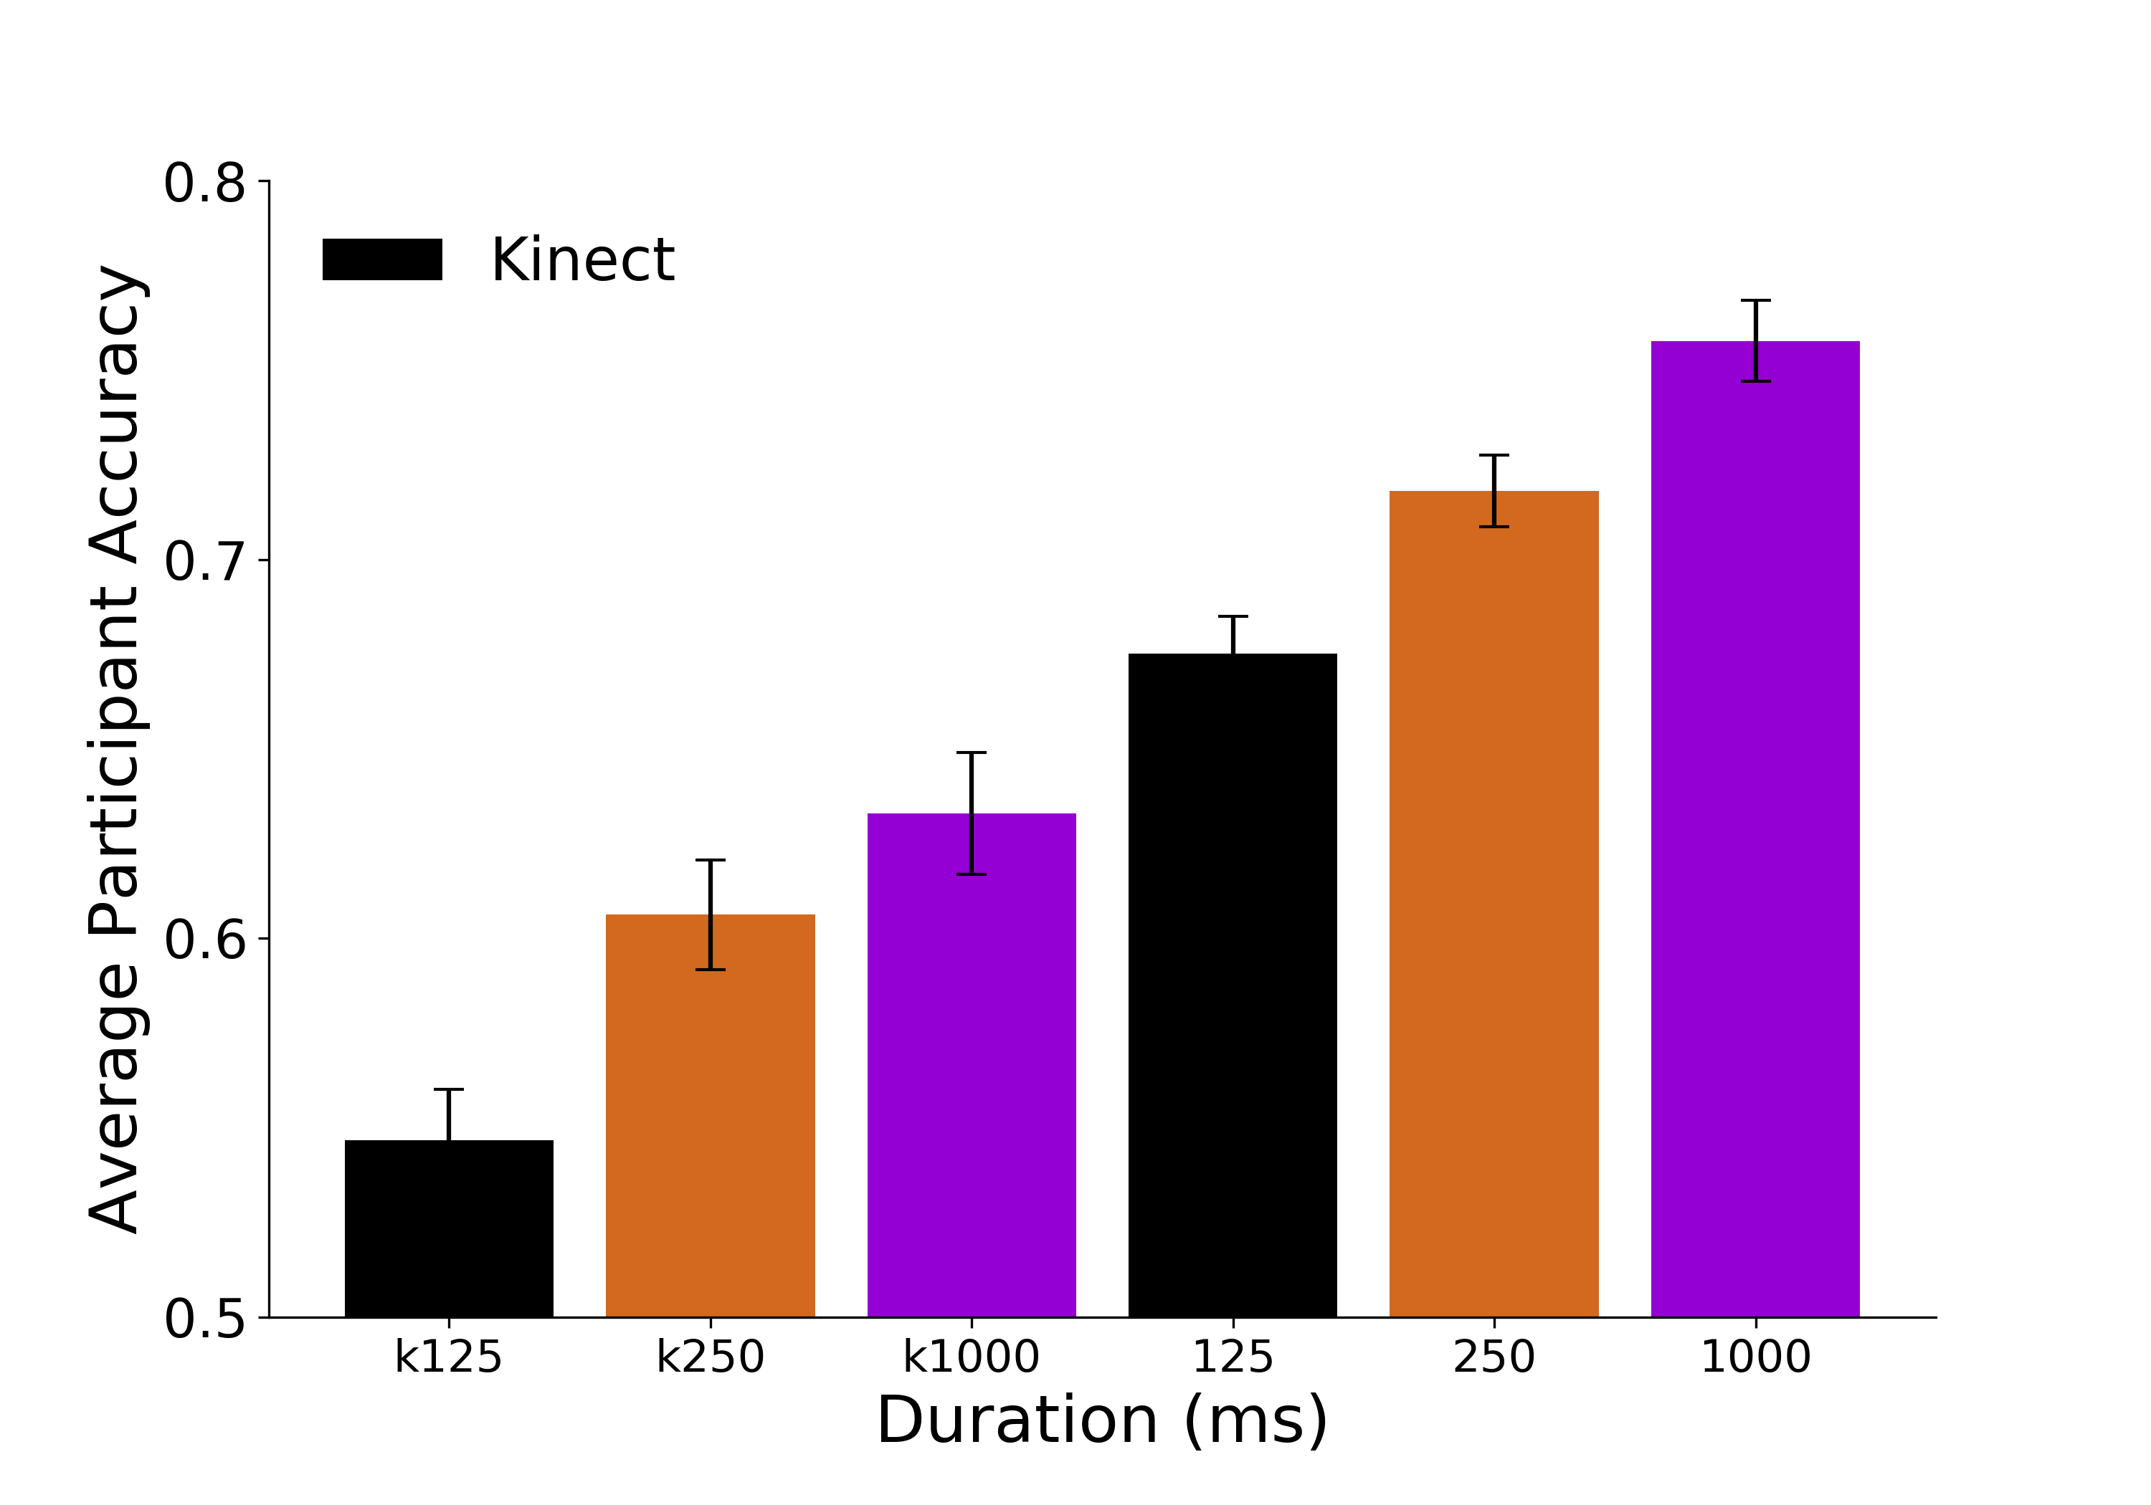
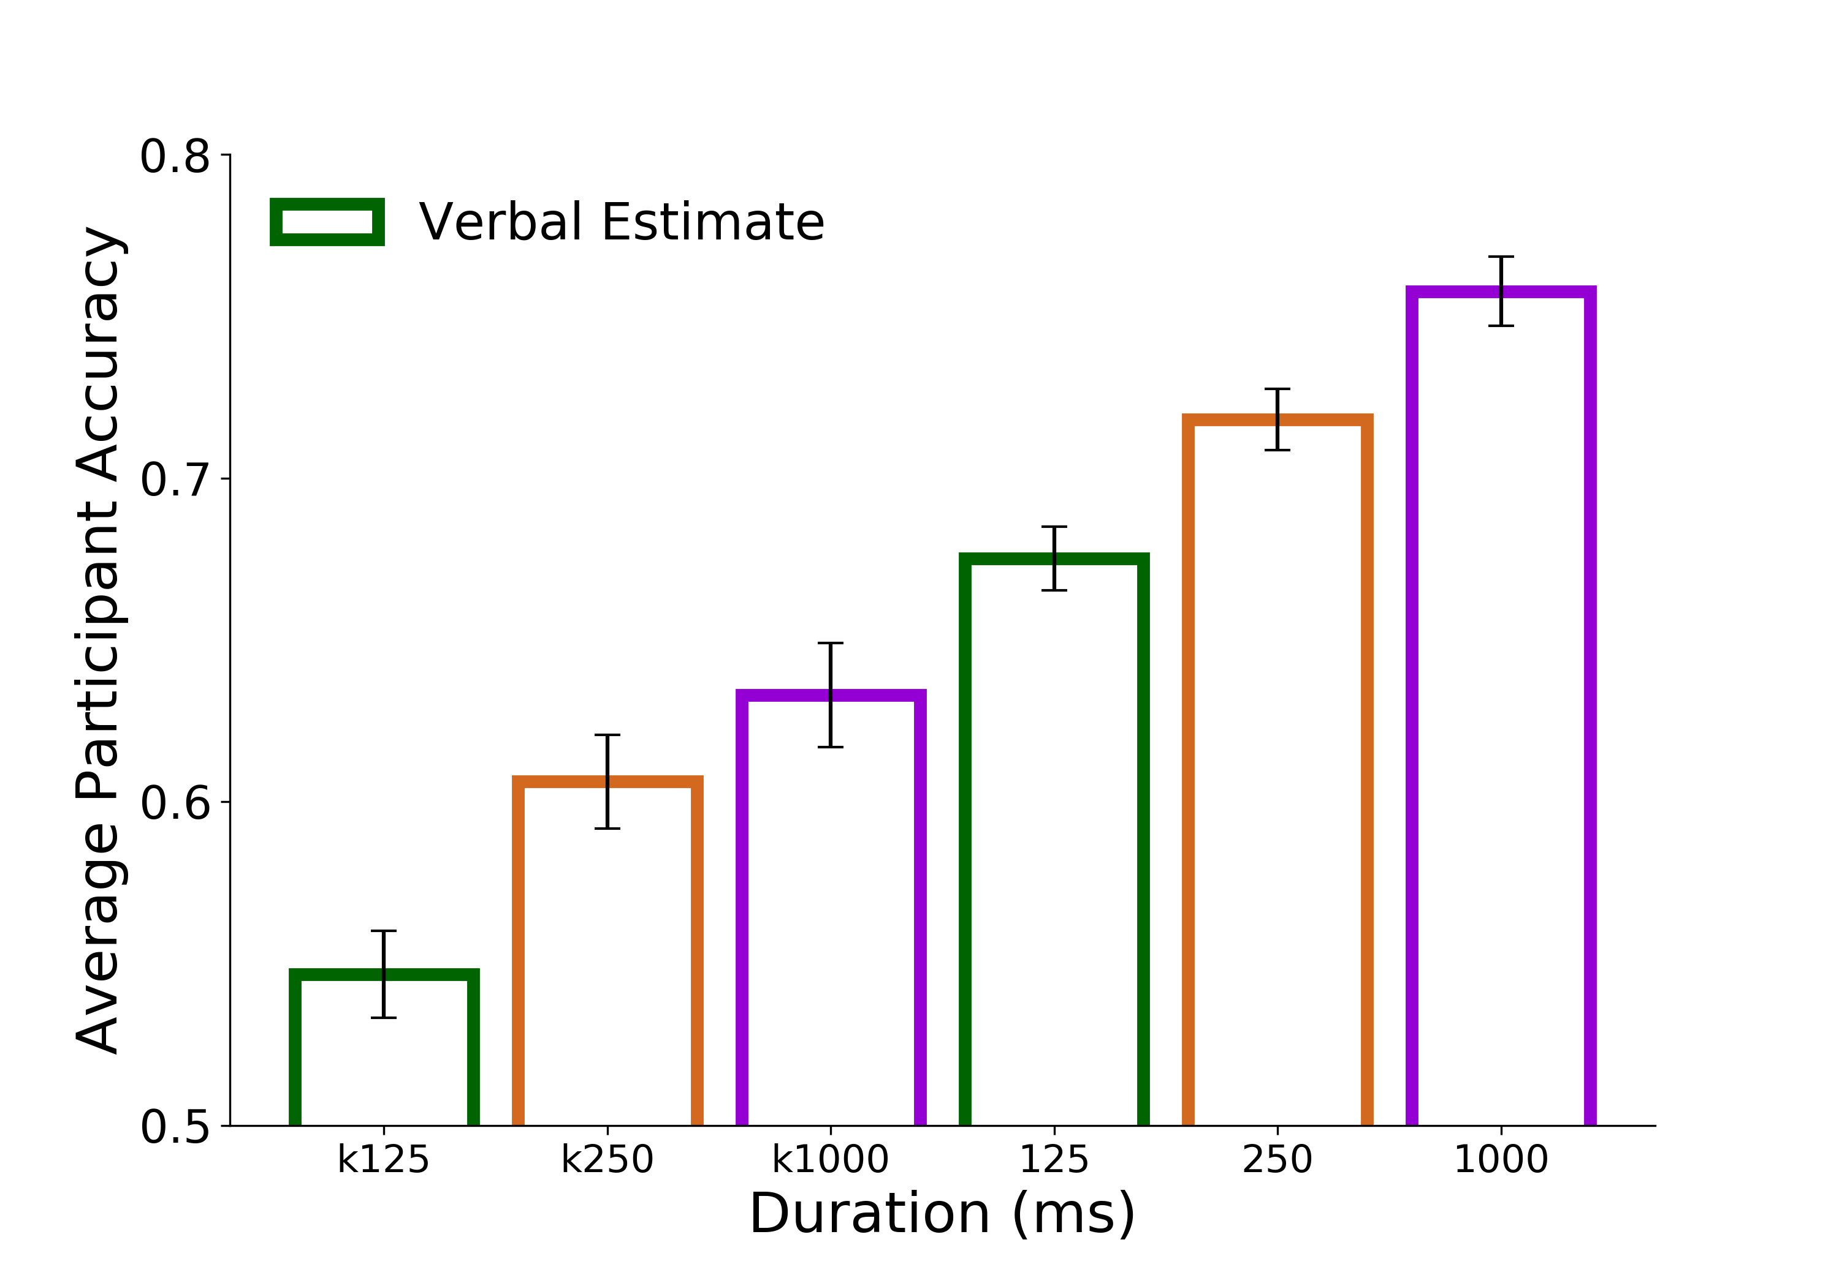
A.
B.
C.
D.
E.
Figure 6. Discrimination Accuracy Results. A) Linear model of discrimination accuracy as a function of the Kinect depth difference between targets for the 125ms viewing duration condition. B) Linear models of discrimination accuracy as a function of metric estimates from independent participants at 125ms. The metric estimate difference is calculated as the absolute difference between metric estimates for images within a discrimination trial. The metric estimate and discrimination task were comprised of independent groups of participants. C) Accuracy as a function of metric estimates at 250ms D) Accuracy as a function of metric estimates at 1000ms D) Discrimination accuracy as a function of the Kinect (bars with colored outline) and as a function of differences in metric estimates from independent participants (* indicates p<0.05; ** p<0.005; *** p<0.0005)
***
*
**
***

Slide 7
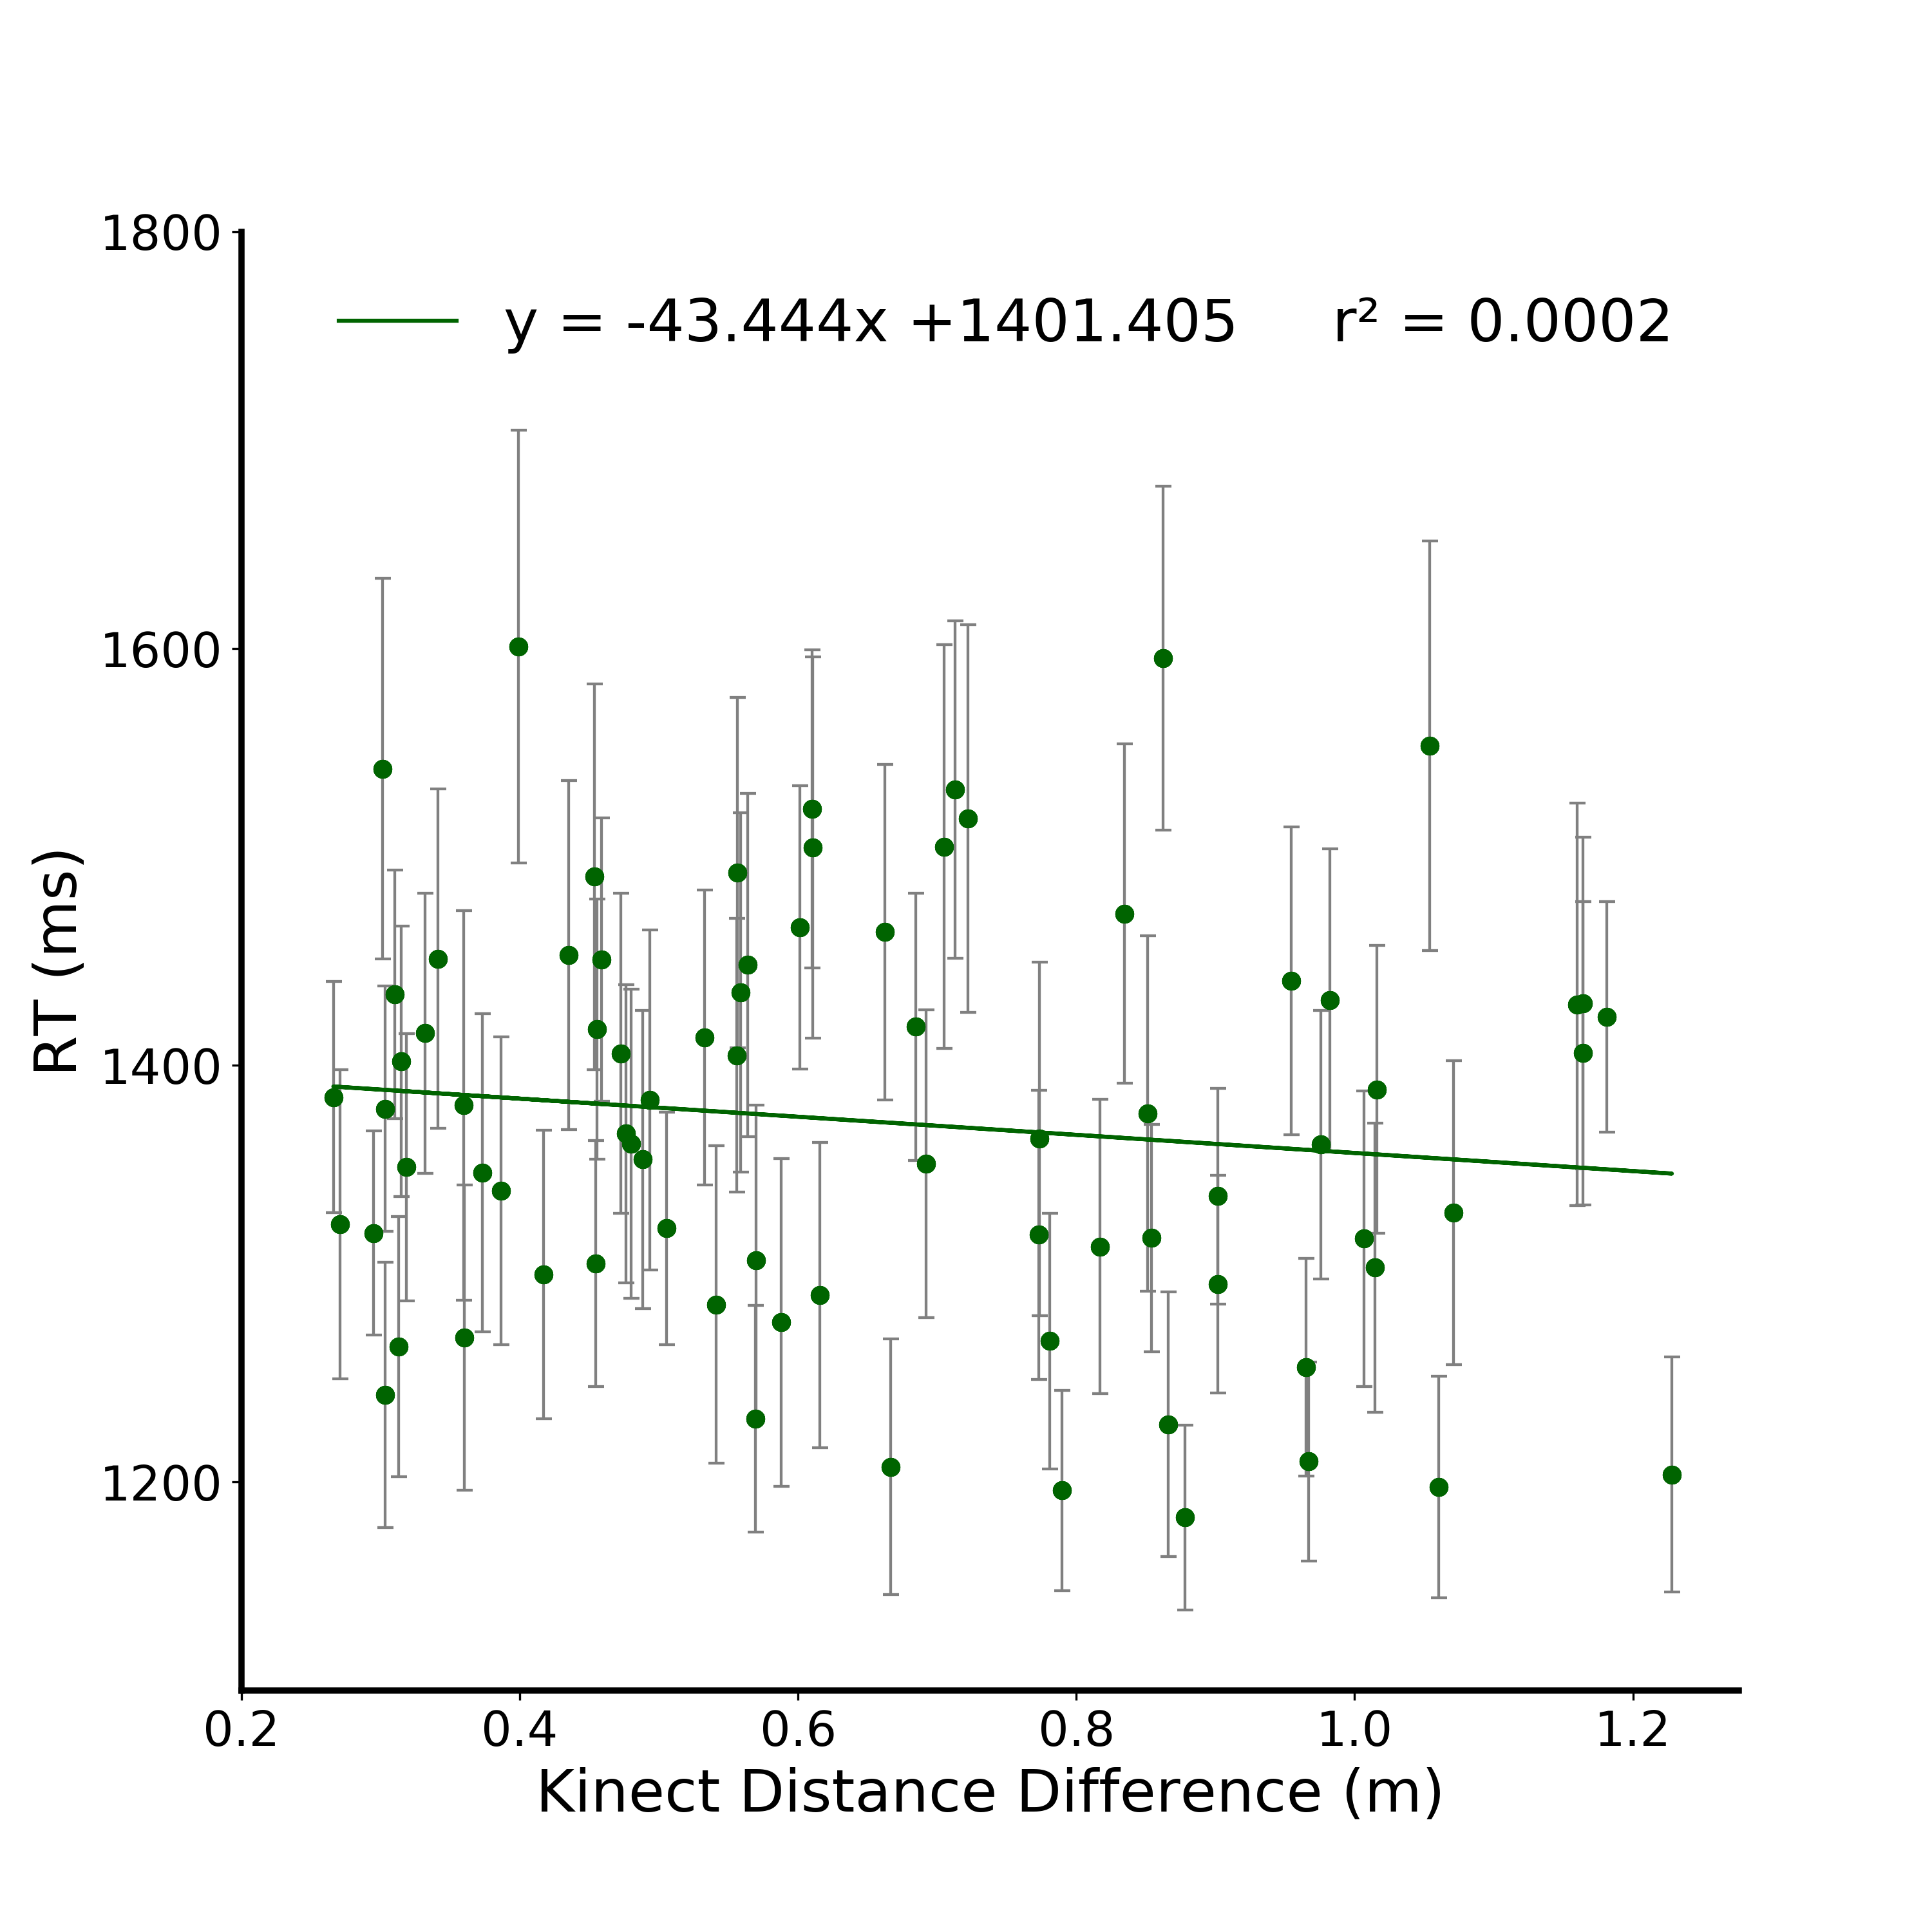
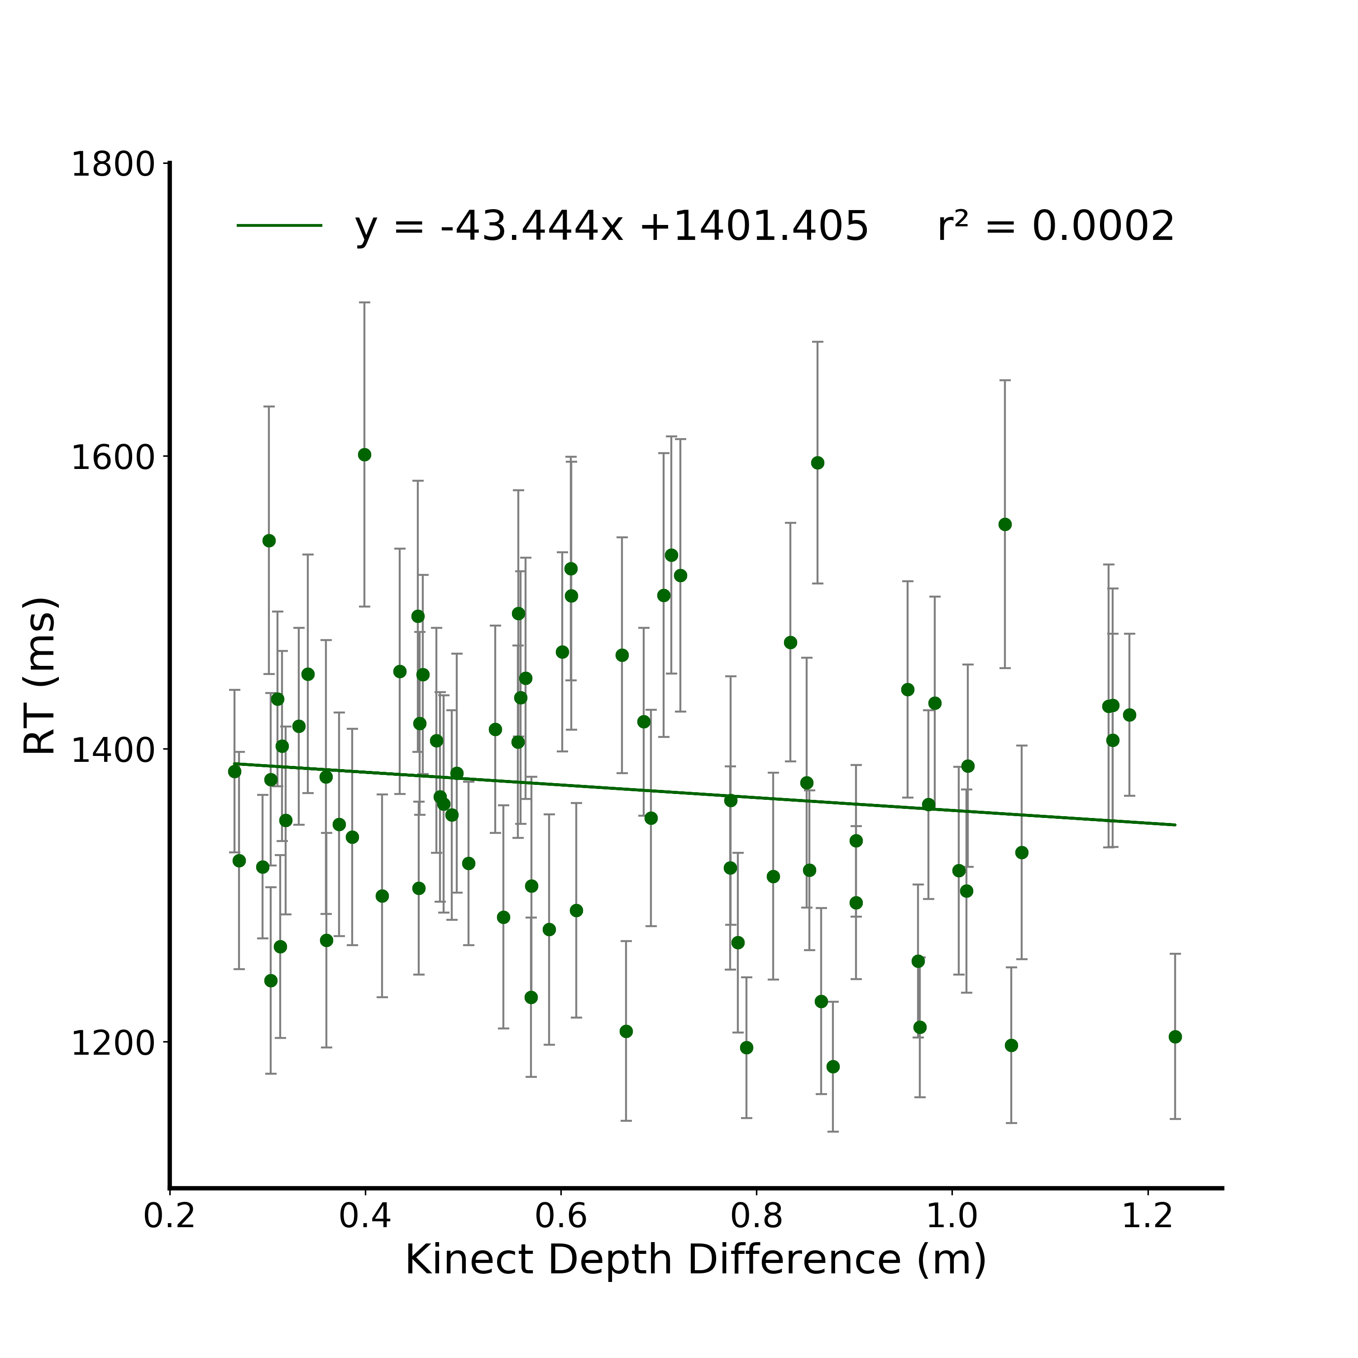
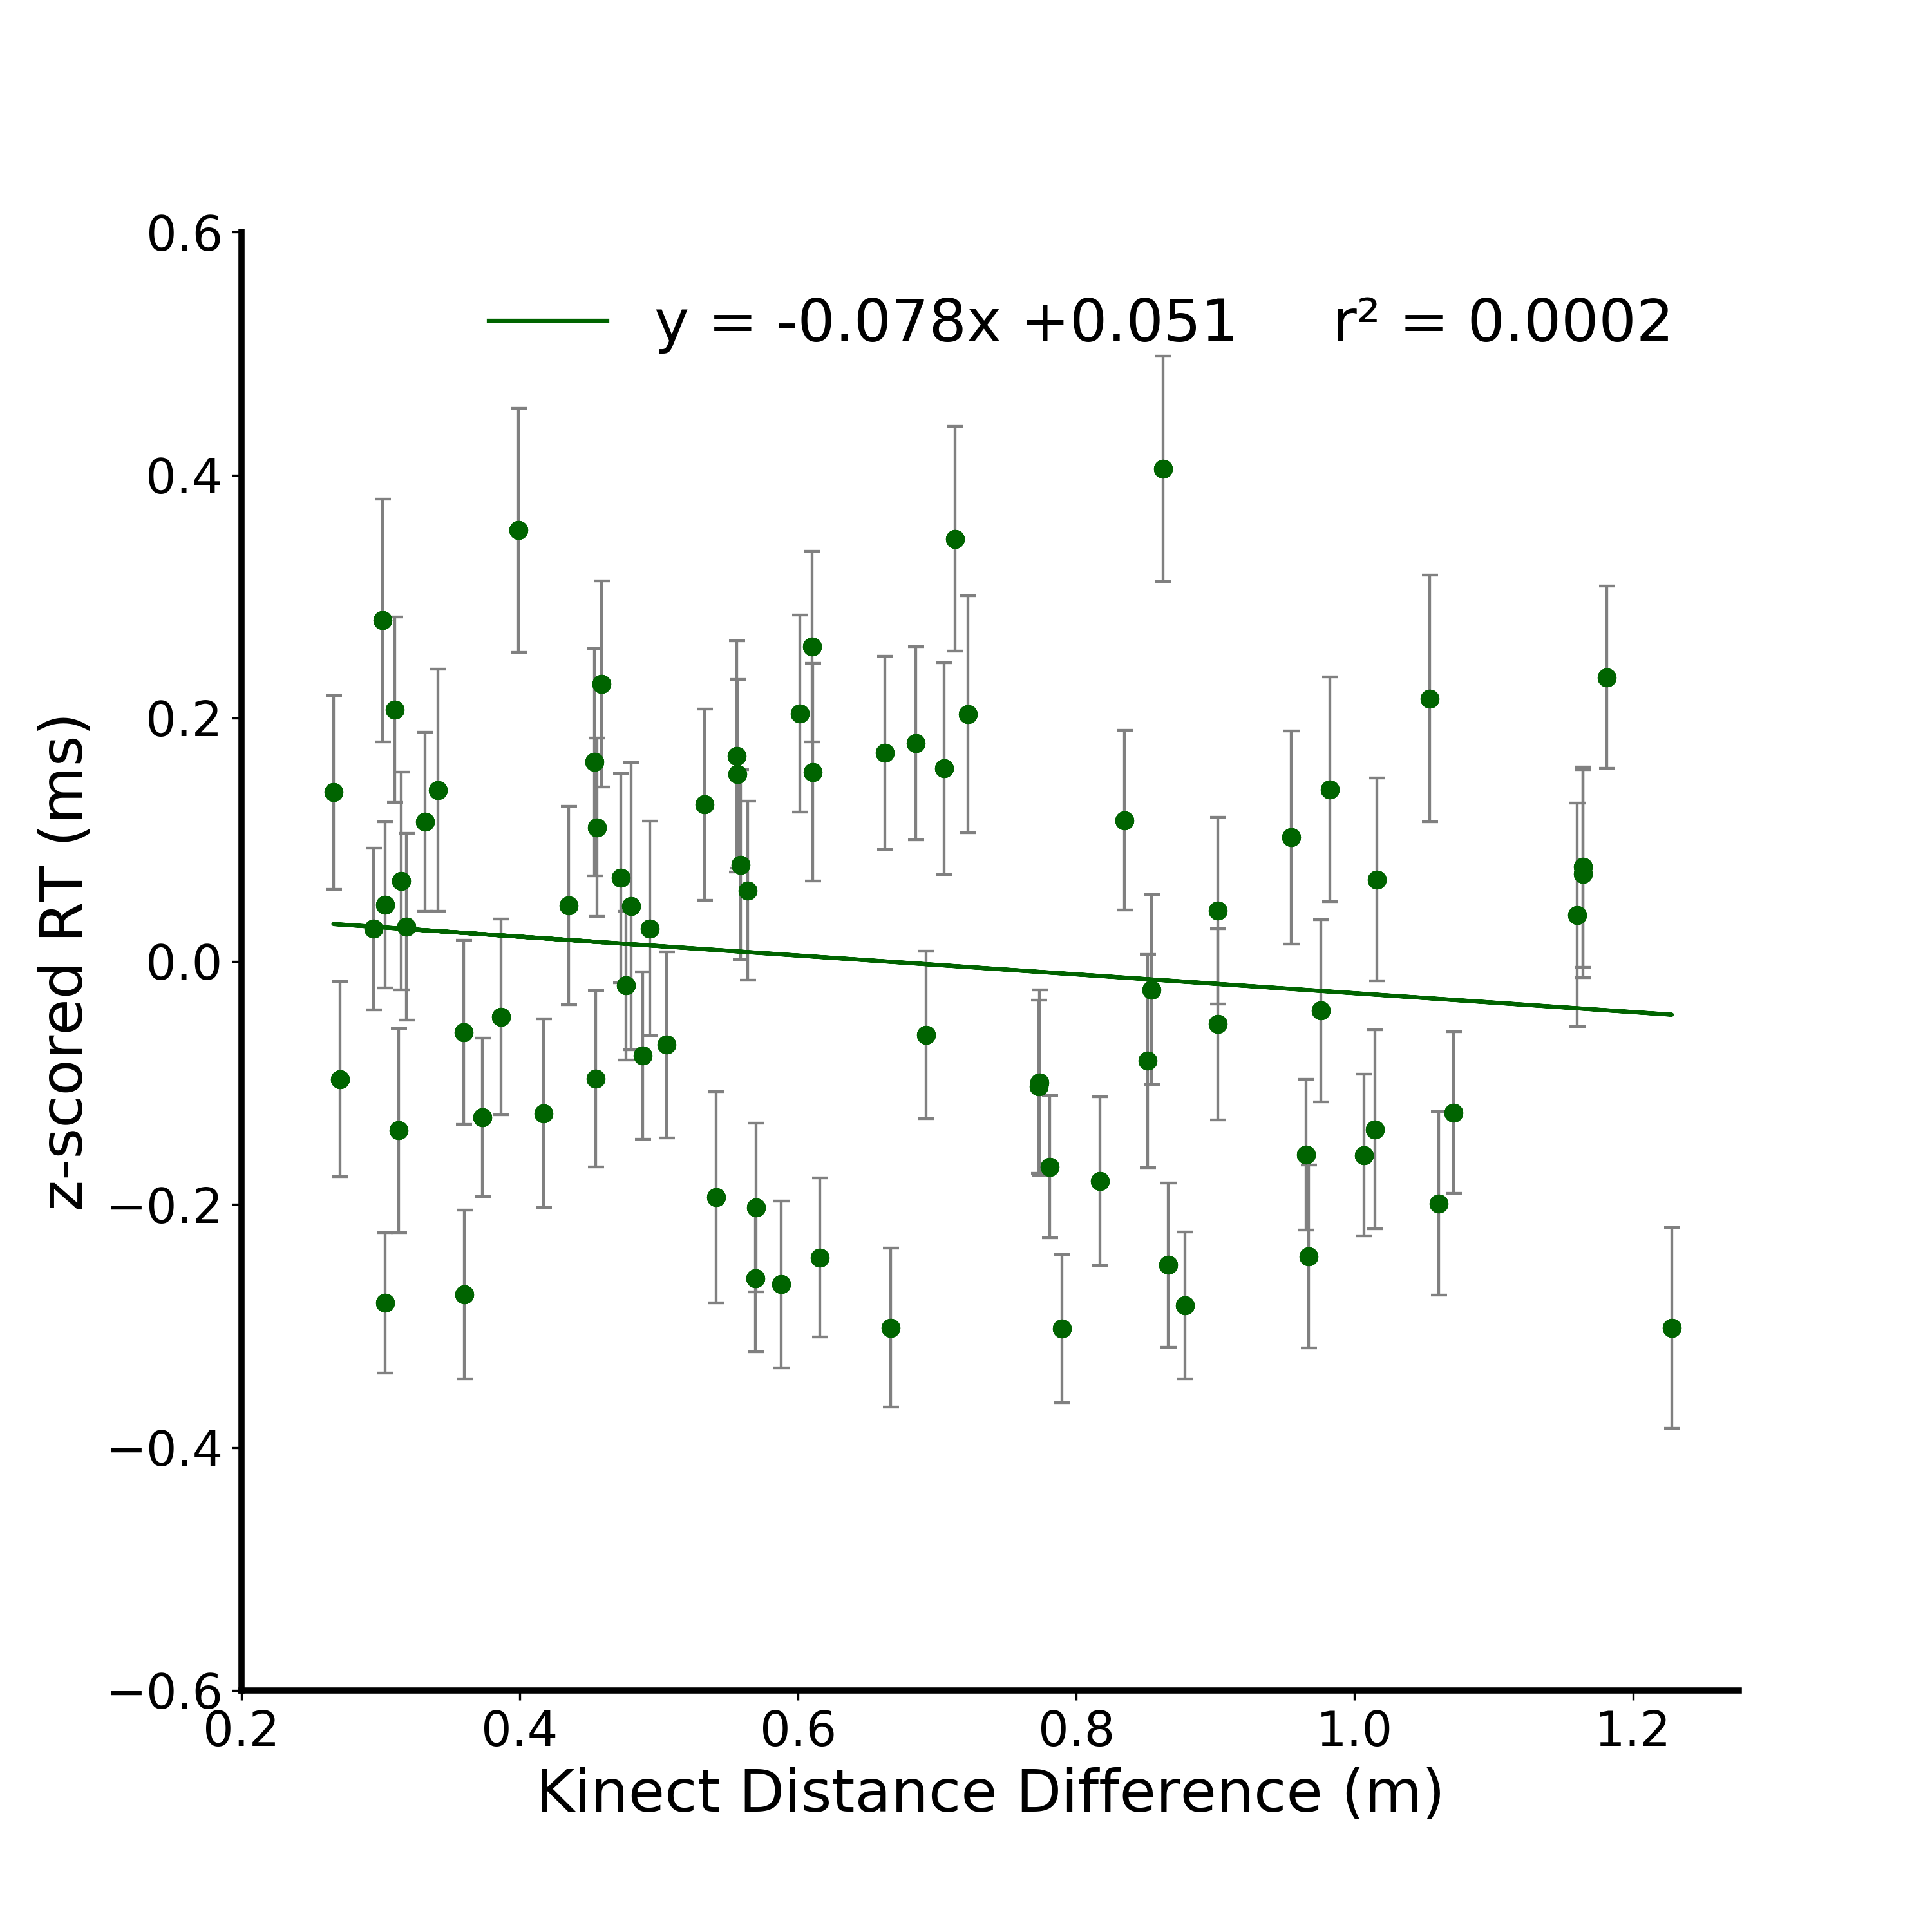
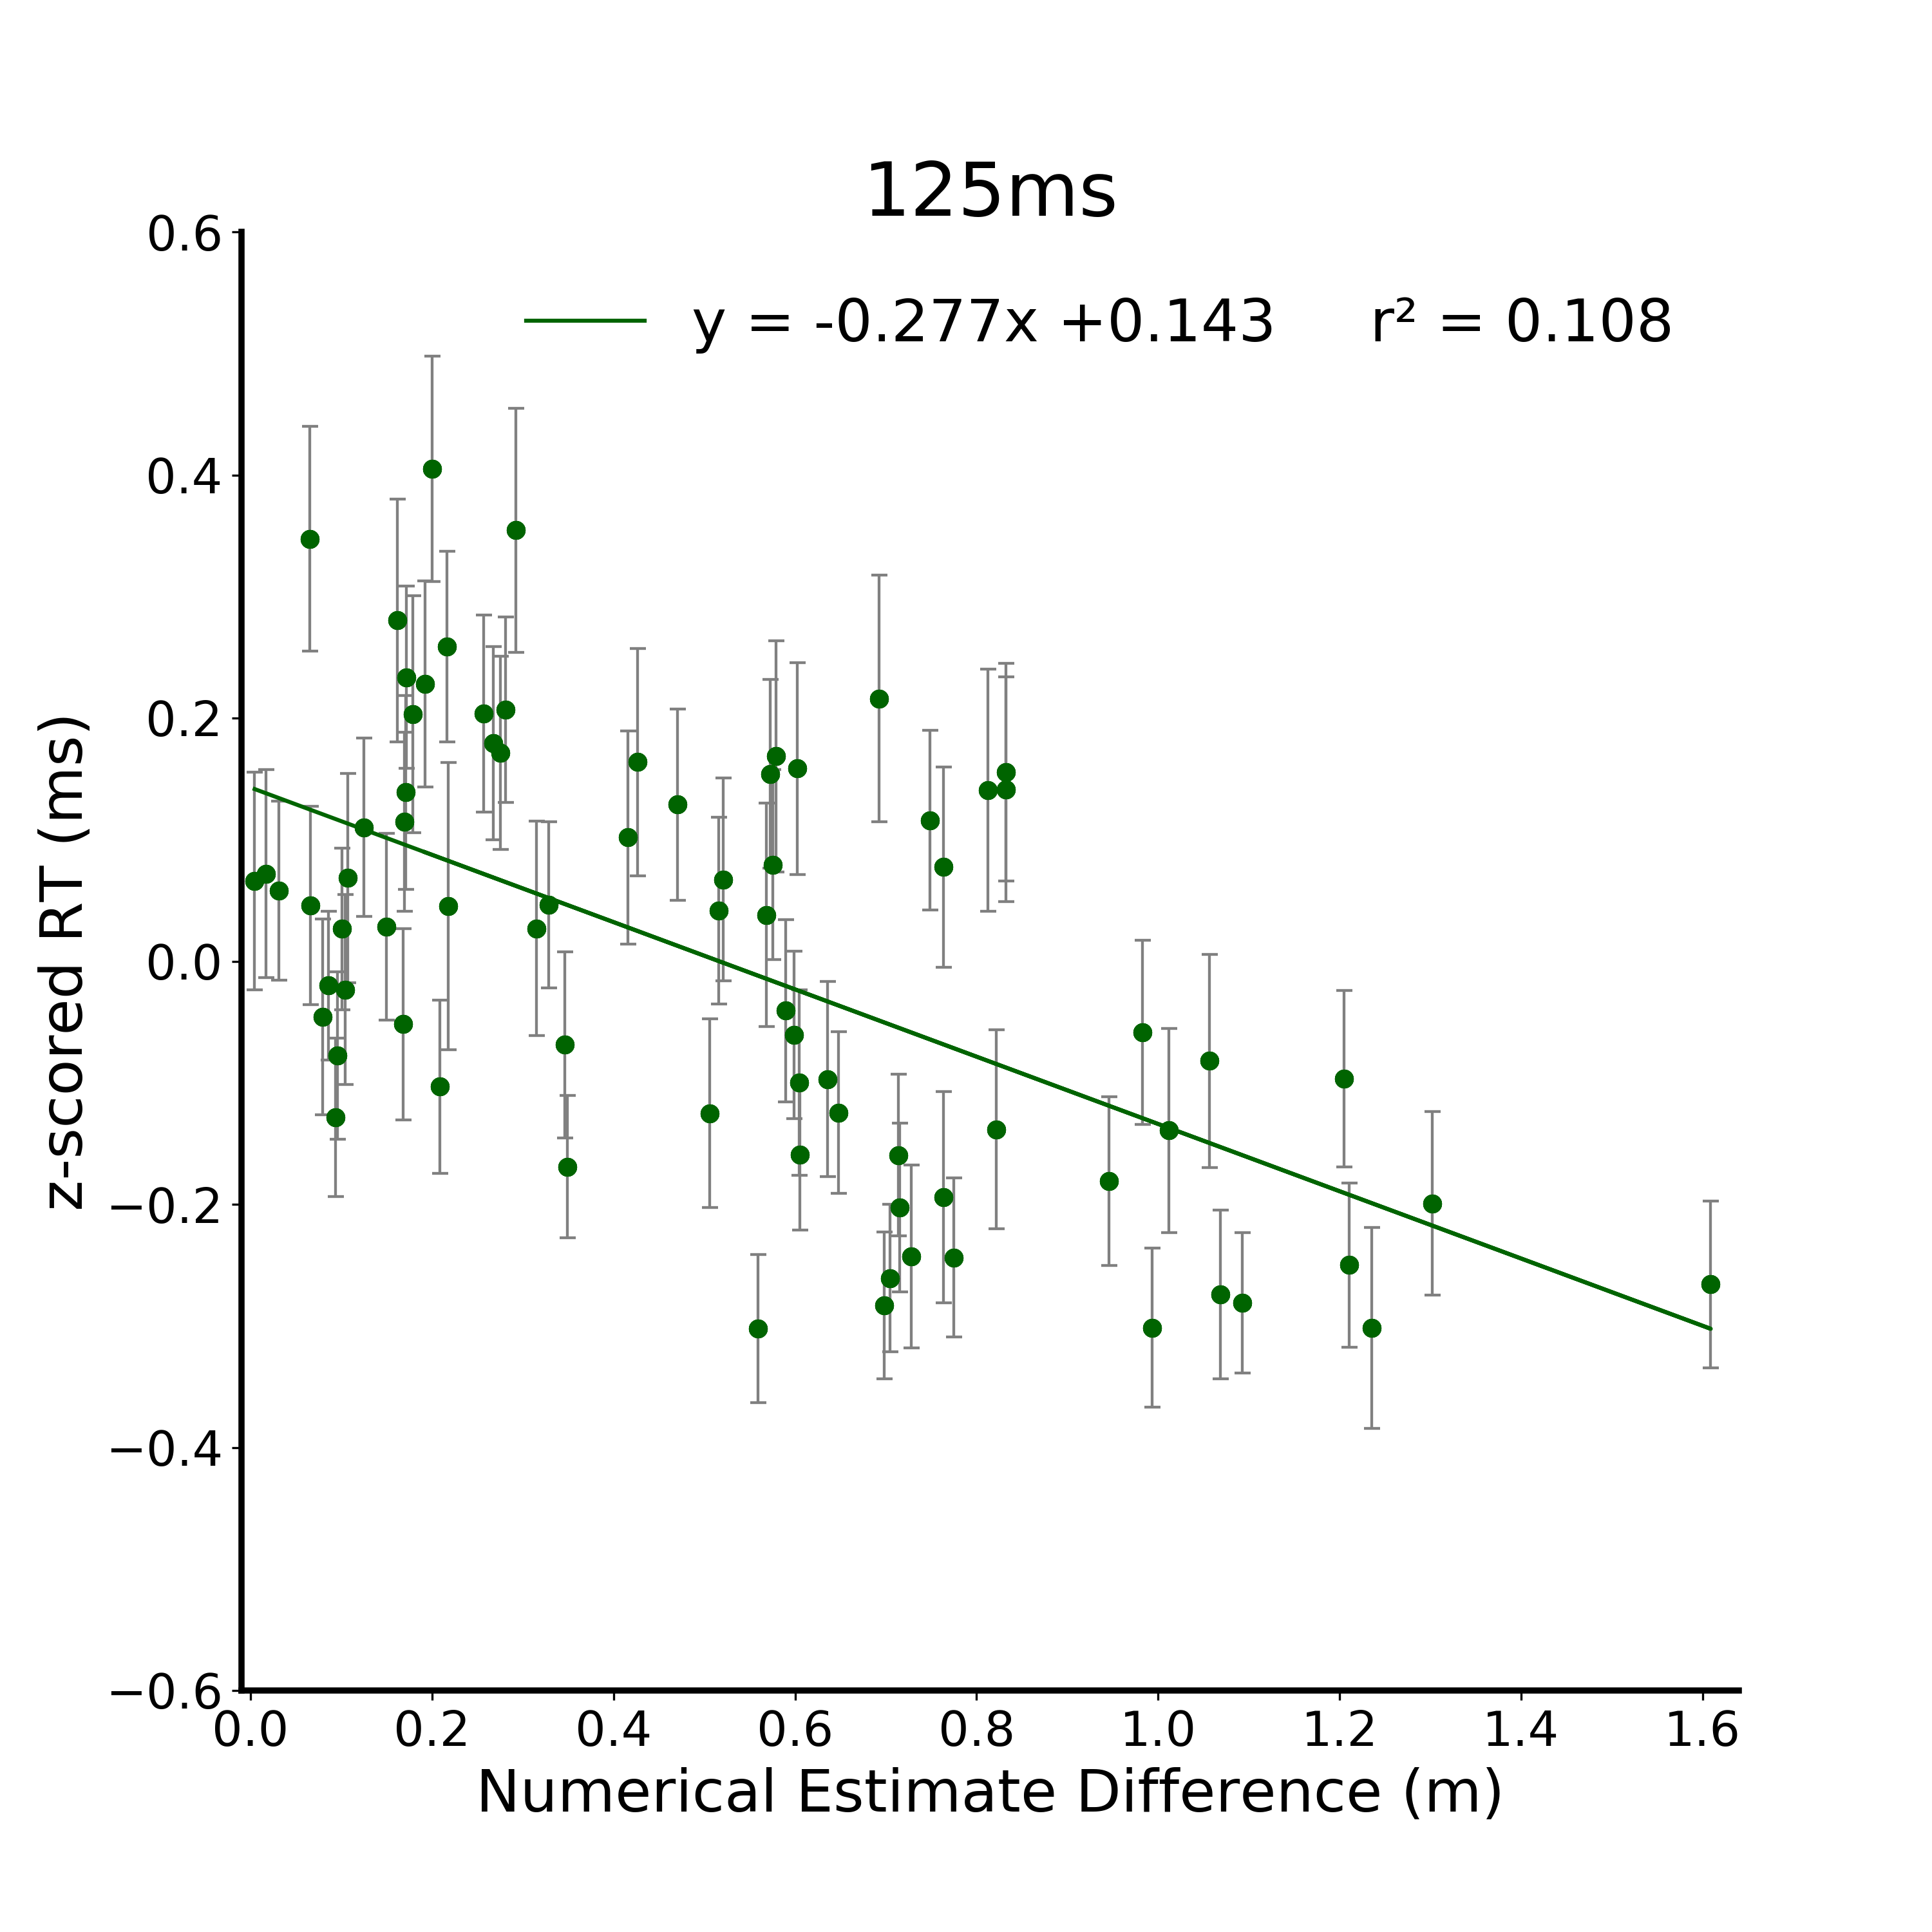

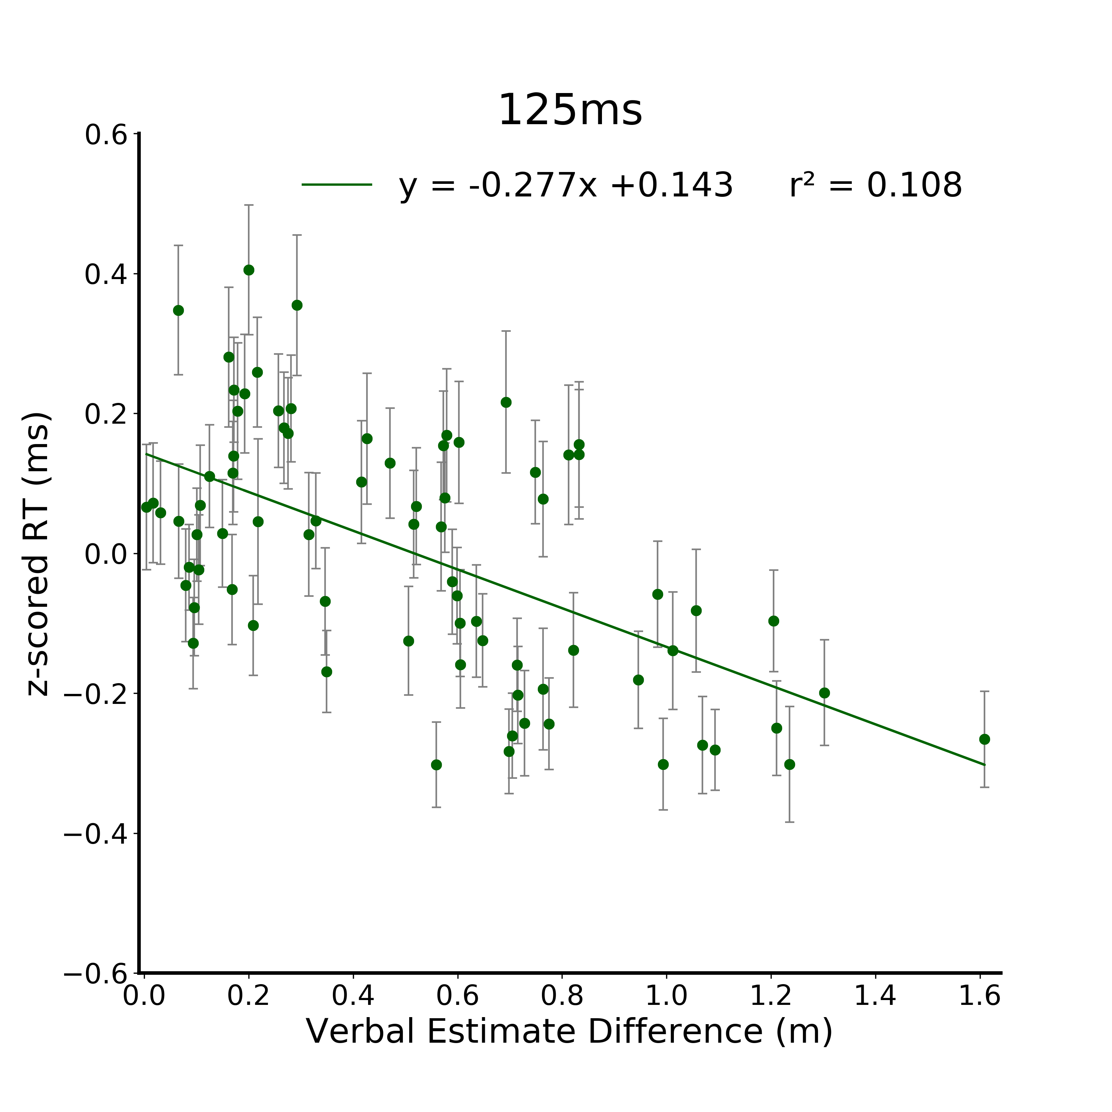
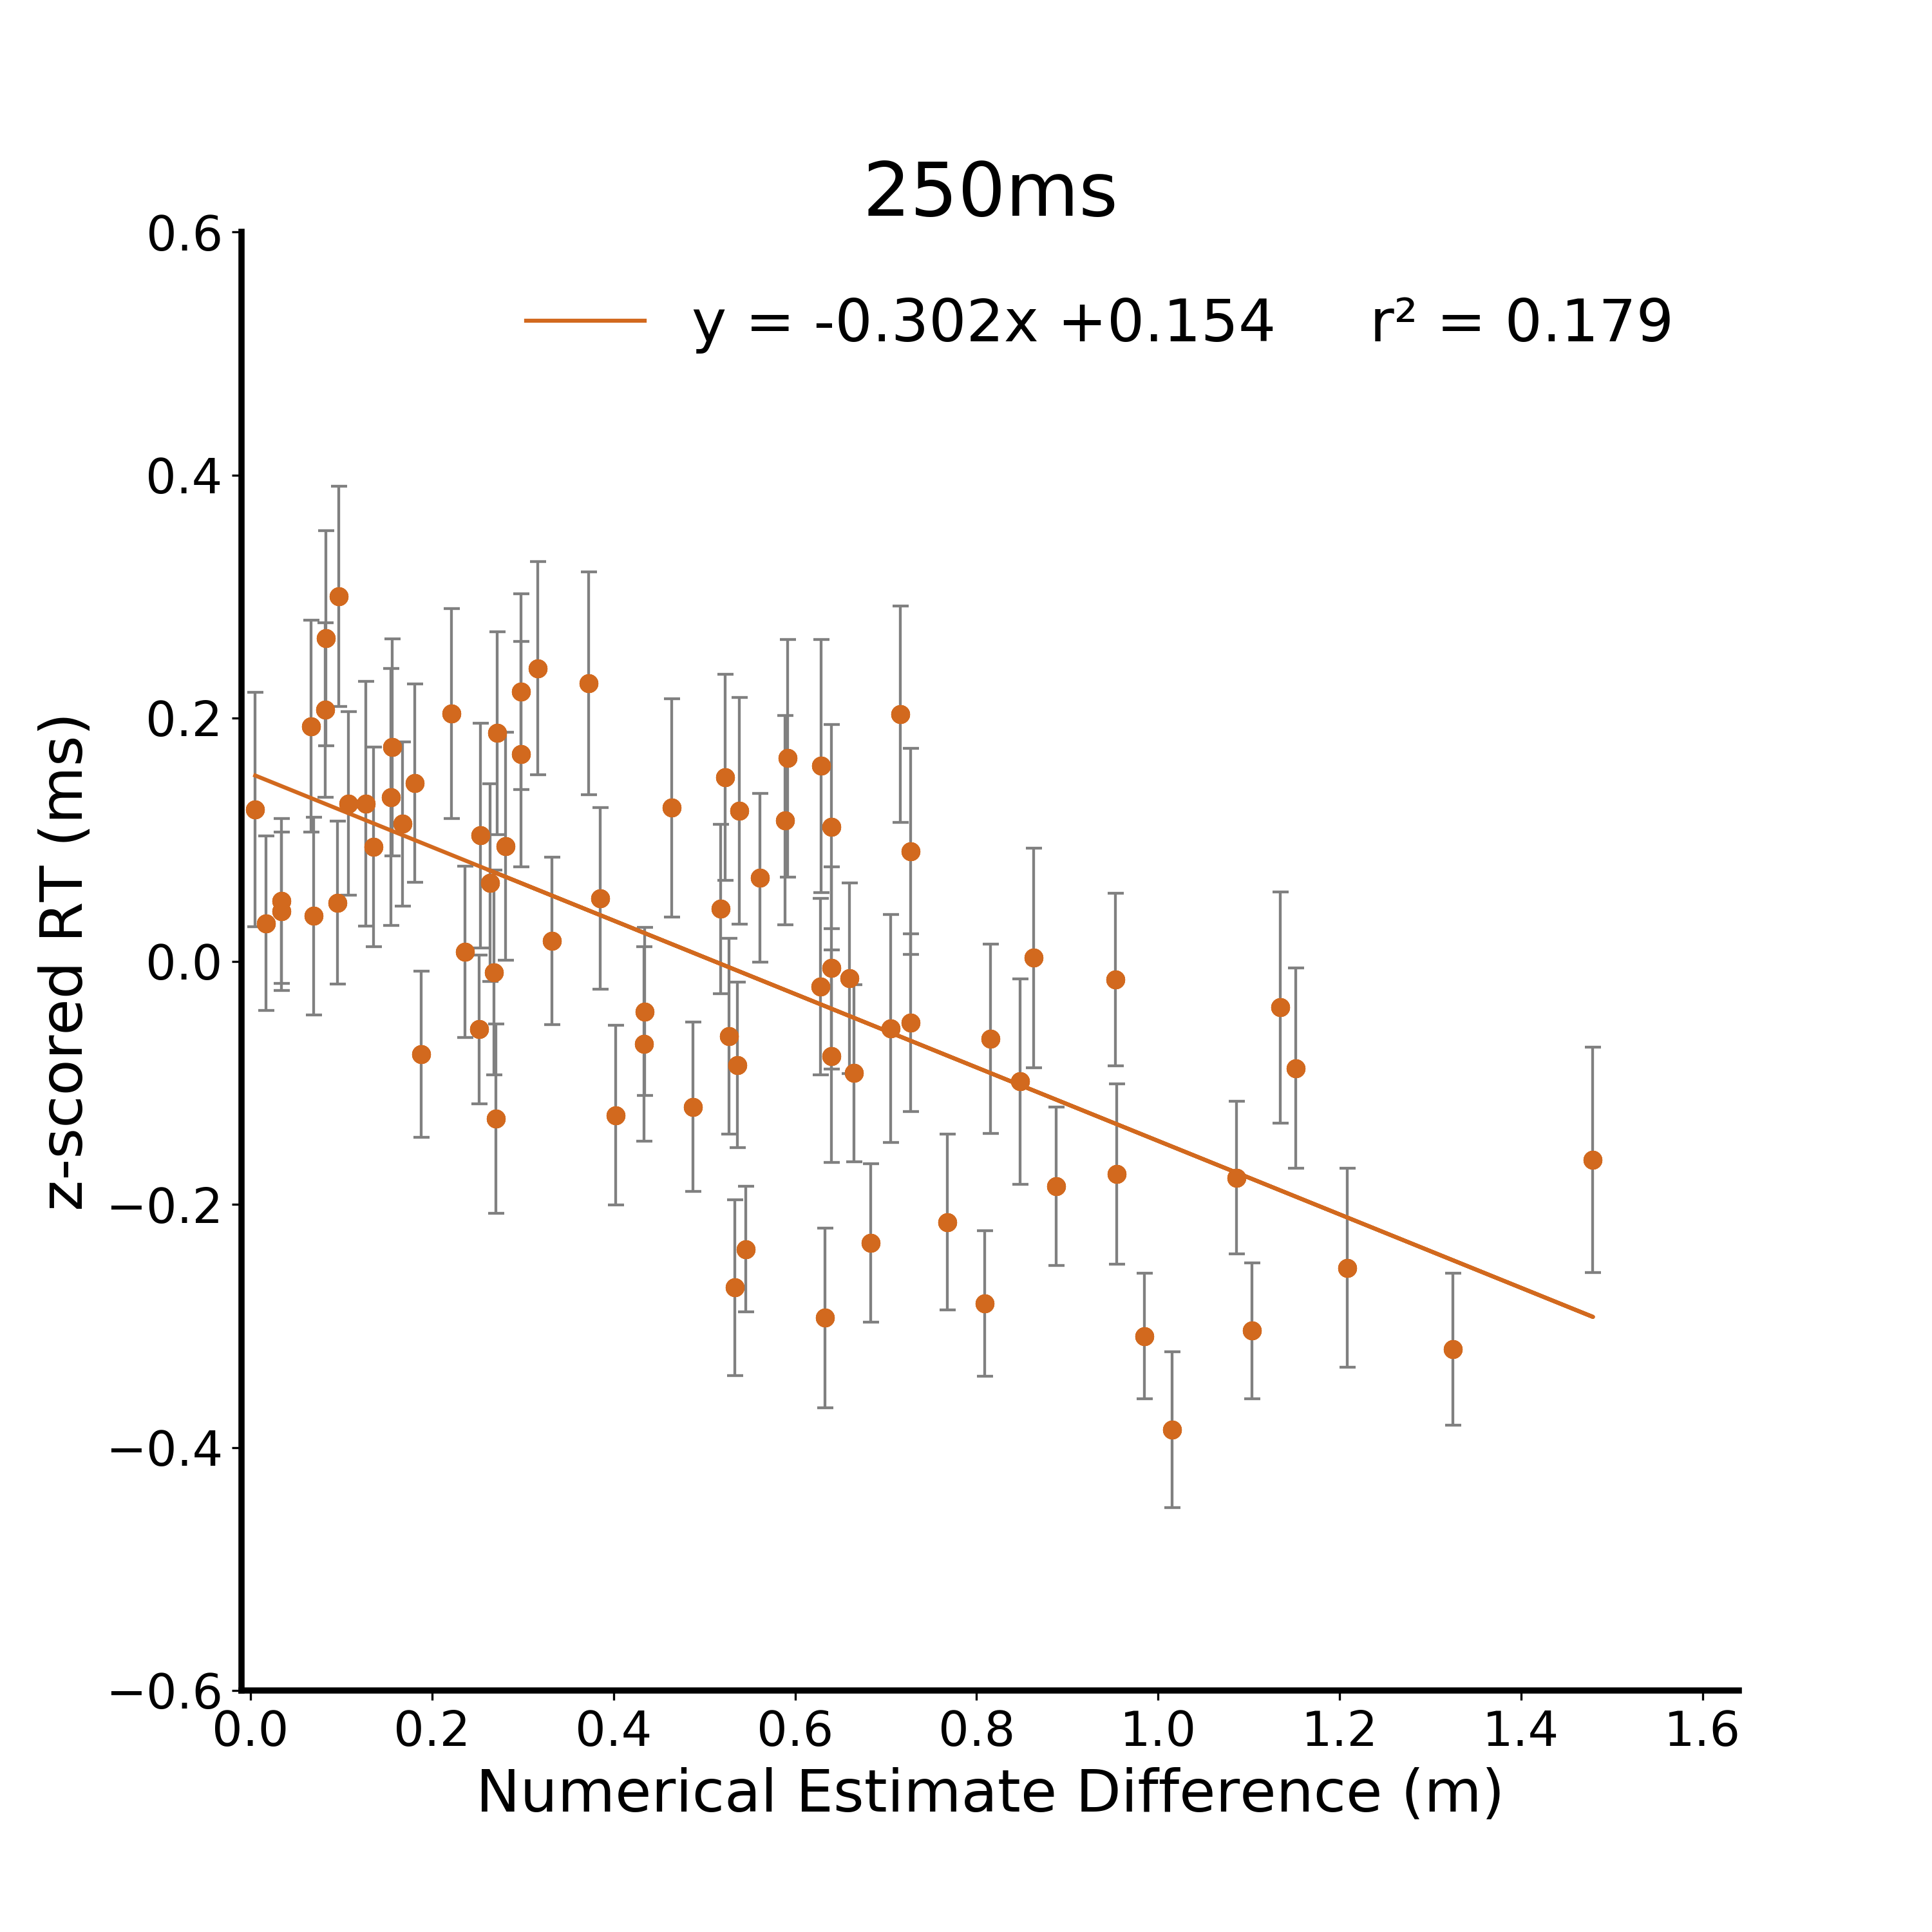
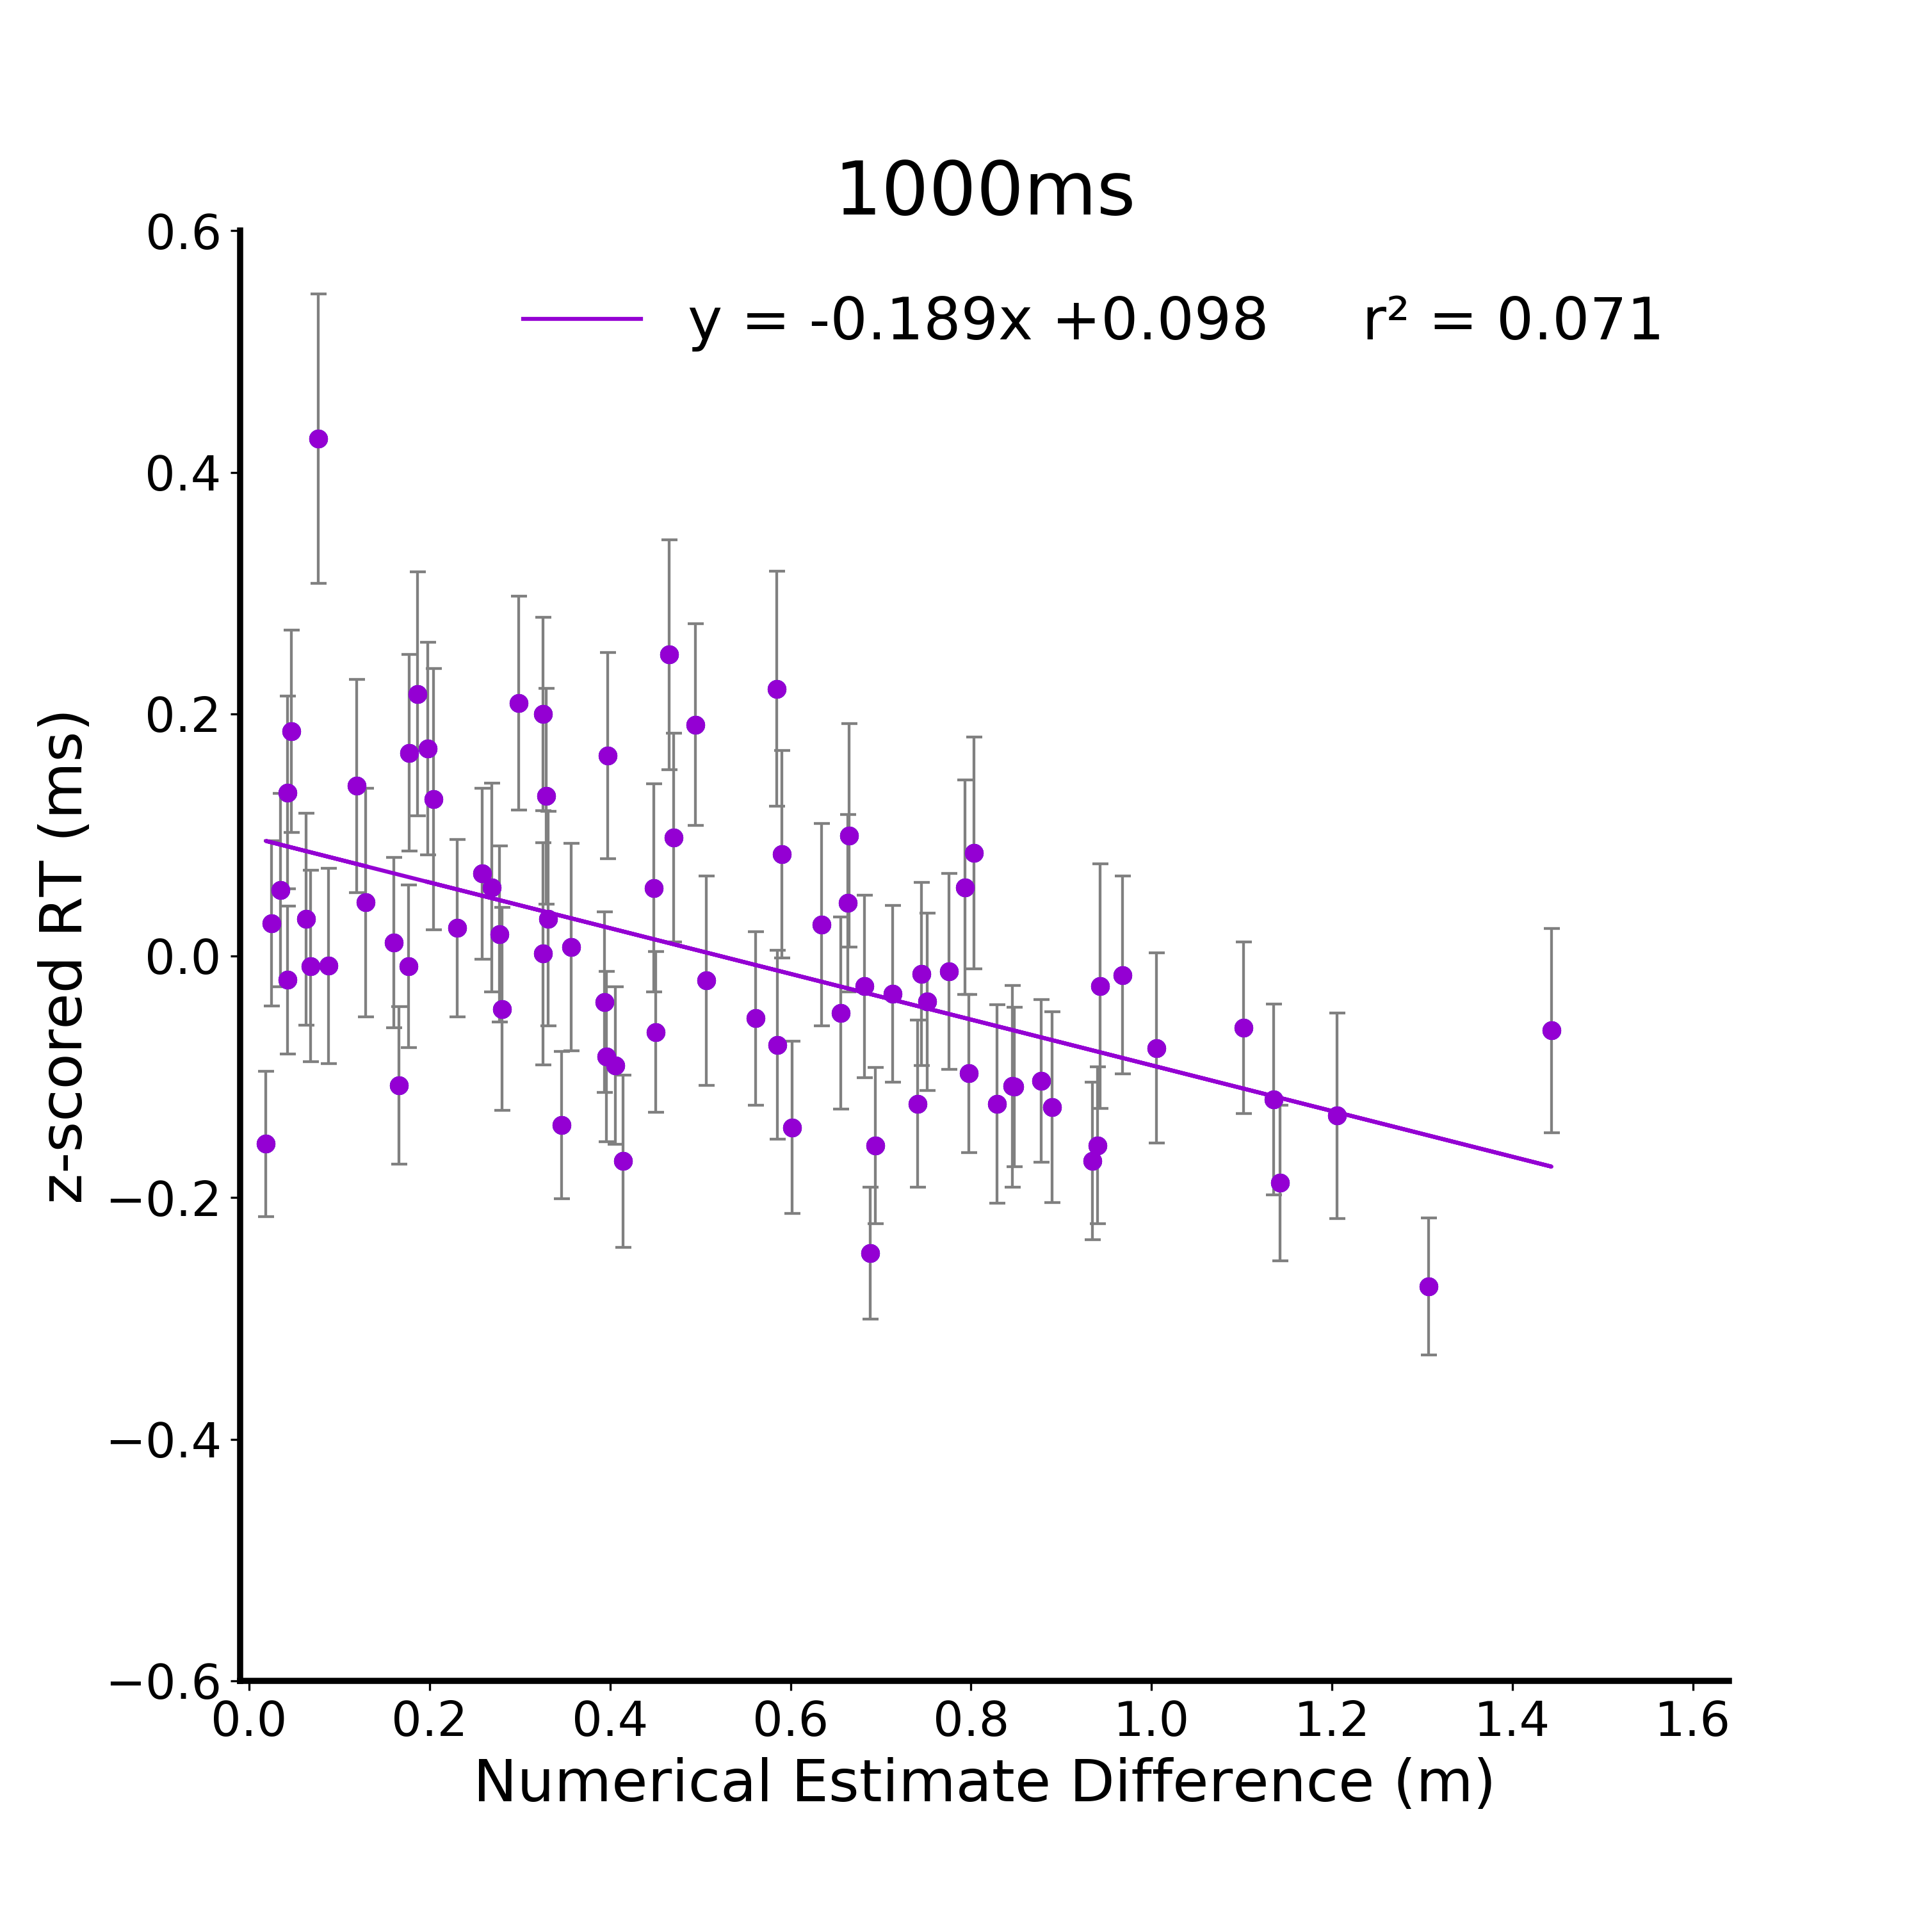


A.
Figure 7. Discrimination Response Time Results. A) Linear model of discrimination response time as a function of the Kinect depth difference between targets for the 125ms viewing duration condition. B) Linear model of z-scored response time as a function of the Kinect depth difference between targets for the 125ms viewing duration condition C) Linear model of z-scored response time as a function of metric estimates from independent participants at 125ms. The metric estimate difference is calculated as the absolute difference between metric estimates for images within a discrimination trial The metric estimate and discrimination task were comprised of independent groups of participants. D) 250ms and E) 1000ms
B.
C.
D.
E.

Slide 8

125
0.8
Percent Correct
250
0.4
1000
0.16
*
Correlation
0
125
- 0.16
*
Response Time
- 0.4
250
1000
- 0.8
125
250
1000
125
250
1000
Percent Correct
Response Time
Notes:
DONE
Within duration cmparisonas are stronger than between

Slide 9


125
0.8
250
Percent Correct
0.4
1000
0.16
*
Numerical Estimate
0
125
Correlation
- 0.16
*
250
- 0.4
Response Time
1000
- 0.8
125
250
1000
125
250
1000
Percent Correct
Response Time
Discrimination

Slide 10



A.
B.
2.64 m²
4.41 m²
(x_{res}, y_{res}, depth)
9.82 m²
1.76 m²
N1
N2
4.58 m²
POI
Visible ground plane: 7.95 m²
Complete ground plane: 13.247 m²
C.
D.
E.
Abs(Residuals) (z)
Residuals (z)
Residuals (z)
Complete Ground Plane (m²)
Complete Ground Plane (m²)
Complete Ground Plane (m²)
Notes:
Make C D E narrower so that the xaxis are not crowded
Fix AB alignment
Finish figure text

